Slide 1
Body fluids
Assist prof. dr .Dina saadoon

Slide 2
Body fluids
Body is formed by solids and fluids. Fluid part is more than two third of the whole body. Water forms most of the fluid part of the body. In human beings, the total body water varies from 45% to 75% of body weight. In a normal young adult male, body contains 60% to 65% of water and 35% to 40% of solids. In a normal young adult female, the water is 50% to 55% and solids are 45% to 50%. In females, water is less because of more amount of subcutaneous adipose tissue. In thin persons, water content is more than that in obese persons. In old age, water content is decreased due to increase in adipose tissue.
Compartments Of Body fluid
Total water in the body is about 40 L. It is distributed into
two major compartments:

Slide 3
Intracellular fluid (ICF):
Its volume is 22 L and it forms 55% of the total body water
2. Extracellular fluid (ECF): Its volume is 18 L and it forms 45% of the total body water. ECF is divided into 5 subunits:
i. Interstitial fluid and lymph (20%)
ii. Plasma (7.5%)
iii. Fluid in bones (7.5%)
iv. Fluid in dense connective tissues like cartilage (7.5%)
v. Transcellular fluid (2.5%) that includes:
a. Cerebrospinal fluid
b. Intraocular fluid
c. Digestive juices
d. Serous fluid – intrapleural fluid, pericardial fluid and peritoneal fluid
e. Synovial fluid in joints
f. Fluid in urinary tract.

Slide 4
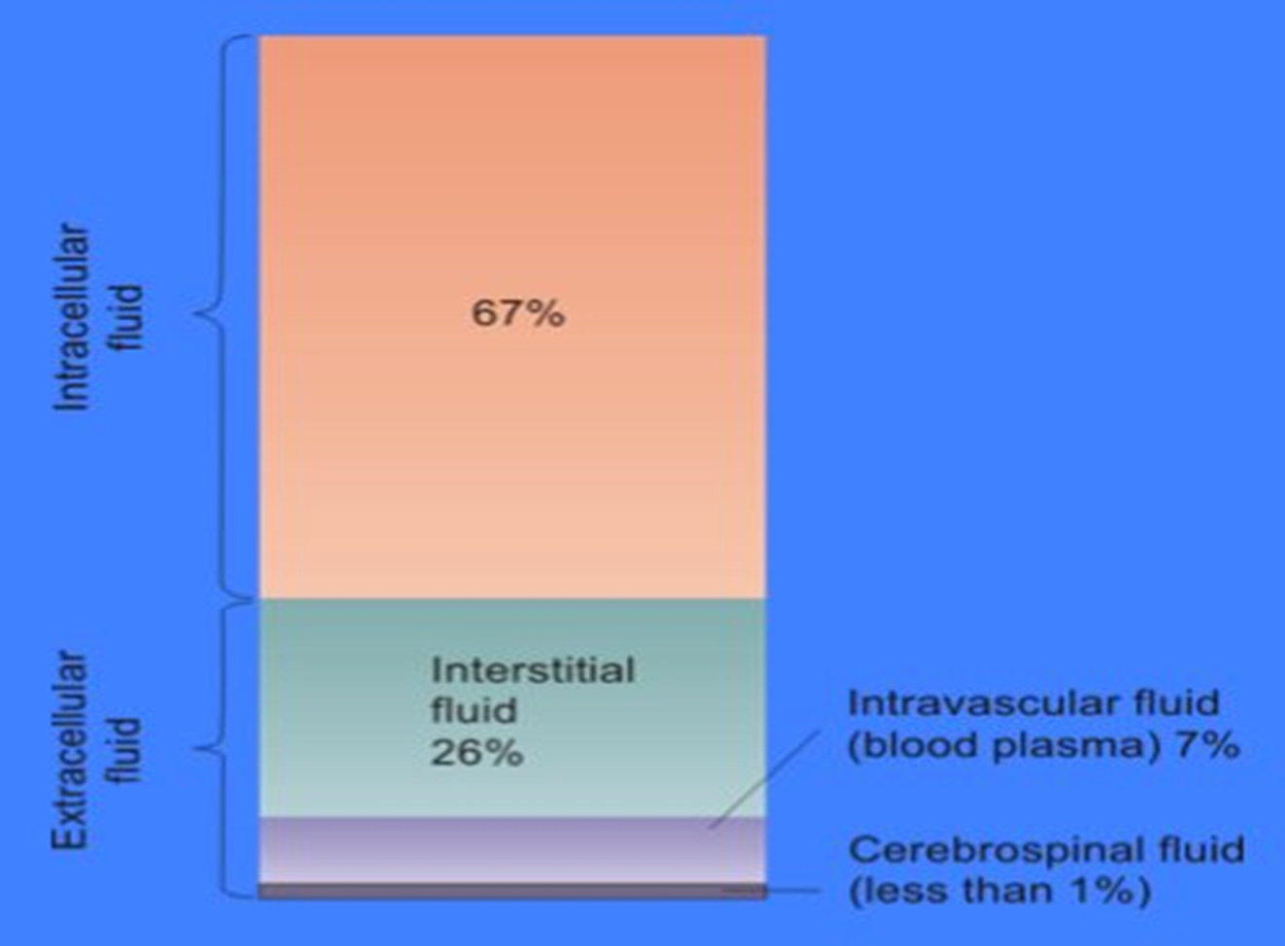

Slide 5
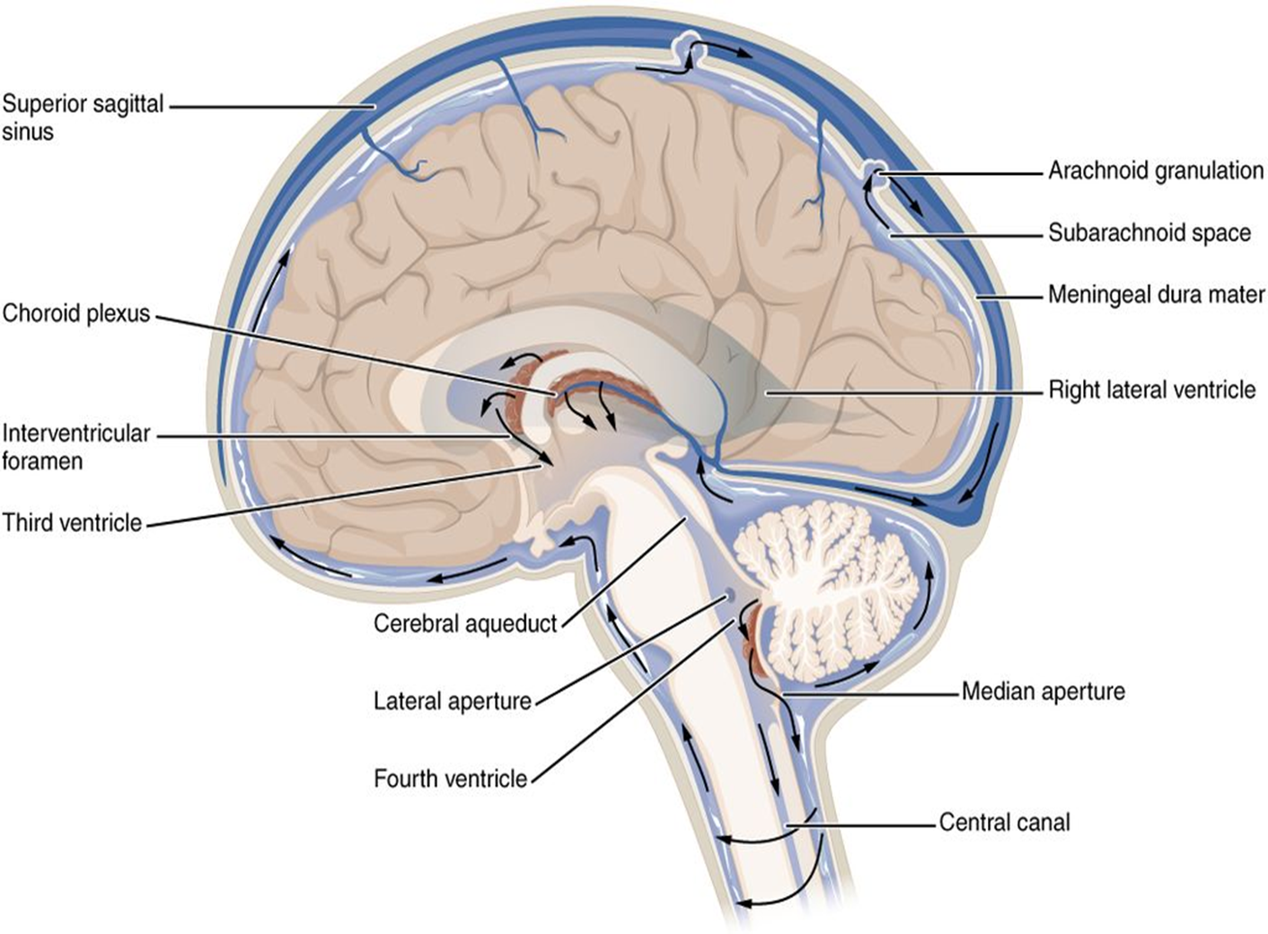

Slide 6
Organic Substances
Organic substances are glucose, amino acids and other proteins, fatty acids and other lipids, hormones and enzymes.

Inorganic Substances
Inorganic substances present in body fluids are sodium, potassium, calcium, magnesium, chloride, bicarbonate, phosphate and sulfate. ECF contains large quantity of sodium, chloride, bicarbonate, glucose, fatty acids and oxygen. ICF contains large quantities of potassium, magnesium, phosphates, sulfates and proteins. The pH of ECF is 7.4. The pH of ICF is 7.0.

Slide 7
Concentration Of Body Fluids
Concentration of body fluids is expressed in three
ways:
1. Osmolality
2. Osmolarity
3. Tonicity.
 Osmolality
Measure of a fluid’s capability to create osmotic pressure is called osmolality or osmotic (osmolar) concentration of a solution. In simple words, it is the concentration of osmotically active substance in the solution.
Osmolarity
Osmolarity is another term to express the osmotic concentration. It is the number of particles (osmoles) per liter of solution (osmoles/L).

Slide 8
TONICITY
The movement of water between the fluid compartments is not influenced by small molecules like urea and alcohol, which cross the cell membrane very rapidly. These small molecules are called ineffective osmoles. sodium and glucose, which cross the cell membrane slowly, can influence the movement of water. Therefore, such molecules are called effective osmoles. Osmolality that causes the movement of water from one compartment to another is called effective osmolality and the effective osmoles are responsible for this.
Tonicity is the measure of effective osmolality. In
terms of tonicity, the solutions are classified into three
categories:
i. Isotonic fluid
ii. Hypertonic fluid
iii. Hypotonic fluid.

Slide 9
Hypertonic solution A hypertonic is when the concentration inside the cell is high and the environment is dilute. Hypotonic solution A hypotonic is when the concentration inside of the cell is lower than a solution outside of a cell is called hypotonic. Isotonic solution A solution is isotonic when its effective osmole concentration is the same as that of another solution.

Slide 10
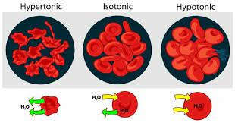

Slide 11
Dehydration
Is defined as excessive loss of water from the body. Body requires certain amount of fluid intake daily for normal functions.
Classification Basically, dehydration is of three types:
Mild dehydration: It occurs when fluid loss is about 5% of total body fluids. Dehydration is not very serious and can be treated easily by rehydration.
2. Moderate dehydration: It occurs when fluid loss is about 10%. Dehydration becomes little serious and immediate treatment should be given by rehydration.
3. Severe dehydration: It occurs when fluid loss is about 15%. Dehydration becomes severe and requires hospitalization and emergency treatment. When fluid loss is more than 15%, dehydration becomes very severe and life threatening. On the basis of ratio between water loss and sodium loss

Slide 12
Edema
Edema refers to the presence of excess fluid in the body tissues. In most instances, edema occurs mainly in the extracellular fluid compartment, but it can involve intracellular fluid.
Intracellular Edema
Three conditions are especially prone to cause intracellular swelling:
Hyponatremia
(2) depression of the metabolic systems of the tissues
(3) lack of adequate nutrition to the cells.
Extracellular Edema
Extracellular fluid edema occurs when excess fluid accumulates in the extracellular spaces. There are two general causes of extracellular edema:
(1) abnormal leakage of fluid from the plasma to the interstitial spaces across the capillaries.
(2) failure of the lymphatics to return fluid from the interstitium back into the blood, often called lymphedema.

Slide 13
BLOOD AS A CIRCULATORY FLUID Blood is a connective tissue in fluid form. It is considered as the ‘fluid of life’ because it carries oxygen from lungs to all parts of the body and carbon dioxide from all parts of the body to the lungs. It is known as ‘fluid of growth’ because it carries nutritive substances from the digestive system and hormones from endocrine gland to all the tissues. The blood is also called the ‘fluid of health’ because it protects the body against the diseases and gets rid of the waste products and unwanted substances by transporting them to the excretory organs like kidneys The normal total circulating blood volume is about 8% of the body weight (5600 mL in a 70-kg man). About 55% of this volume is plasma.

Slide 14
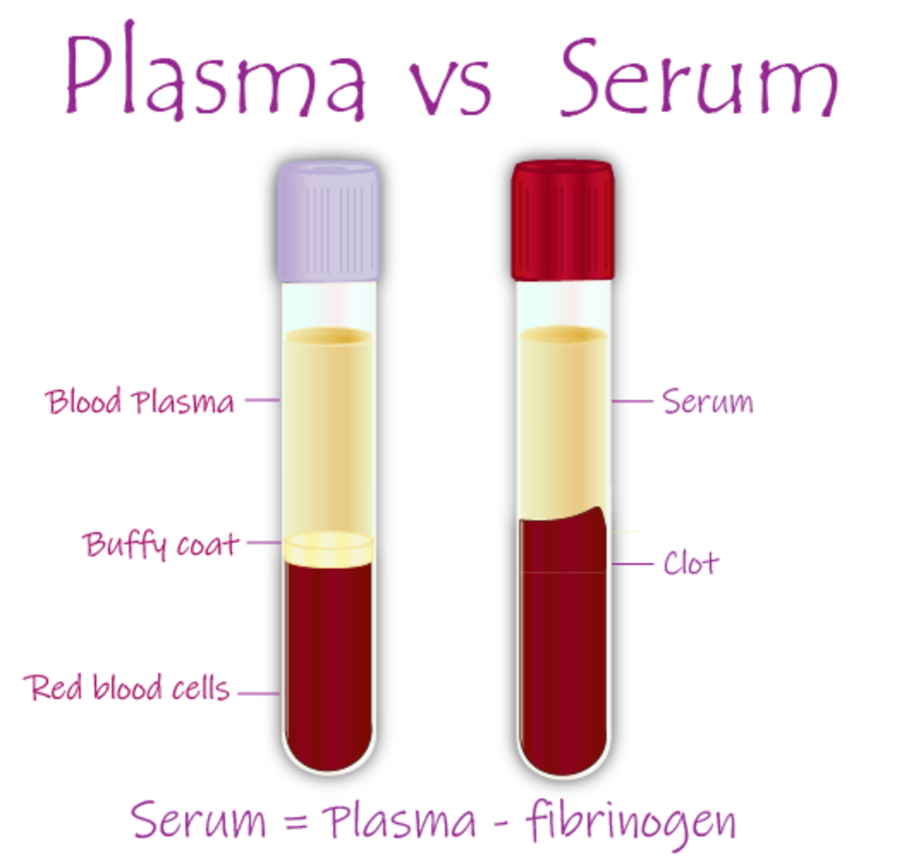
Blood is consist from : 1-cellular parts A-WBCs(granulocyte and agranulocyte) B-RBCs C-thrombocyte 2-fluid parts A-plasma B-serum

Slide 15
BONE MARROW
In the adult, red blood cells, many white blood cells, and platelets are formed in the bone marrow. In the fetus, blood cells are also formed in the liver and spleen, and in adults such extra medullary hematopoiesis may occur in diseases in which the bone marrow becomes destroyed or fibrosed. In children, blood cells are actively produced in the marrow cavities of all the bones. By age 20, the marrow in the cavities of the long bones, except for the upper humerus and femur, has become inactive .Active cellular marrow is called red marrow; inactive marrow that is infiltrated with fat is called yellow marrow. The bone marrow is actually one of the largest organs in the body, approaching the size and weight of the liver. It is also one of the most active.

Slide 16
PROPERTIES OF BLOOD
1. Color: Blood is red in color. Arterial blood is scarlet
red because it contains more oxygen and venous
blood is purple red because of more carbon
dioxide.
Blood
2. Volume: Average volume of blood in a normal adult
is 5 L. In a newborn baby, the volume is 450 ml. It
increases during growth and reaches 5 L at the time
of puberty. In females, it is slightly less and is about
4.5 L. It is about 8% of the body weight in a normal
young healthy adult, weighing about 70 kg.

Slide 17
3. Reaction and pH: Blood is slightly alkaline and its
pH in normal conditions is 7.4.
4. Specific gravity:
Specific gravity of total blood : 1.052 to 1.061
Specific gravity blood cells : 1.092 to 1.101
Specific gravity of plasma : 1.022 to 1.026
5. Viscosity: Blood is five times more viscous than water. It is mainly due to red blood cells and plasma proteins.

Slide 18
FUNCTIONS OF BLOOD
 1. NUTRITIVE FUNCTION
Nutritive substances like glucose, amino acids, lipids and
vitamins derived from digested food are absorbed from
gastrointestinal tract and carried by blood to different
parts of the body for growth and production of energy.
 2. RESPIRATORY FUNCTION
Transport of respiratory gases is done by the blood. It
carries oxygen from alveoli of lungs to different tissues
and carbon dioxide from tissues to alveoli.


Slide 19
3. EXCRETORY FUNCTION
Waste products formed in the tissues during various
metabolic activities are removed by blood and carried
to the excretory organs like kidney, skin, liver, etc. for
excretion.
 4. TRANSPORT OF HORMONES AND ENZYMES
Hormones which are secreted by ductless (endocrine)
glands are released directly into the blood. The blood
transports these hormones to their target organs/tissues.
Blood also transports enzymes.

Slide 20
5. REGULATION OF WATER BALANCE
Water content of the blood is freely interchangeable
with interstitial fluid. This helps in the regulation of water
content of the body.
 6. REGULATION OF ACID-BASE BALANCE
Plasma proteins and hemoglobin act as buffers and help
in the regulation of acid-base balance .
 7. REGULATION OF BODY TEMPERATURE
Because of the high specific heat of blood, it is responsible
for maintaining the thermoregulatory mechanism in the
body, i.e. the balance between heat loss and heat gain
in the body.


Slide 21
8. STORAGE FUNCTION
Water and some important substances like proteins,
glucose, sodium and potassium are constantly required
by the tissues. Blood serves as a readymade source
for these substances.
9. DEFENSIVE FUNCTION
Blood plays an important role in the defense of the body. The white blood cells are responsible for this function. Neutrophils and monocytes engulf the
bacteria by phagocytosis. Lymphocytes are involved in development of immunity. Eosinophils are responsible for detoxification,

Slide 22
PLASMA
Plasma is a straw-colored clear liquid part of blood. It
contains 91% to 92% of water and 8% to 9% of solids.
The solids are the organic and the inorganic substances
SERUM
Serum is the clear straw-colored fluid that oozes from
blood clot. When the blood is shed or collected in a
container, it clots. In this process, the fibrinogen is
converted into fibrin and the blood cells are trapped in
this fibrin forming the blood clot. After about 45 minutes,
serum oozes out of the blood clot. Volume of the serum is almost the same as that of plasma (55%).
Serum = Plasma – Fibrinogen

Slide 23
 Plasma proteins are:
1. Serum albumin
2. Serum globulin
3. Fibrinogen.
Functions Of Plasma Proteins
Role in coagulation of blood
2. Role in defense mechanism of body
3. Role in transport mechanism
4. Role in maintenance of osmotic
pressure in blood
5. Role in regulation of
acid-base balance
6. Role in viscosity of blood

Slide 24
7. Role in erythrocyte
sedimentation rate
8. Role in suspension stability of
red blood cells
9. Role as reserve proteins

Slide 25
RED BLOOD CELLS The red blood cells (erythrocytes) carry hemoglobin in the circulation. They are biconcave disks .that are manufactured in the bone marrow. In mammals, they lose their nuclei before entering the circulation. In humans, they survive in the circulation for an average of 120 day. The average normal red blood cell count is 5.4 million/μL in men and 4.8 million/μL in women. Each human red blood cell is about 7.5 μm in diameter and 2 μm thick, and each contains approximately 29 pg of hemoglobin .There are thus about 3 × 1013 red blood cells and about 900 g of hemoglobin in the circulating blood of an adult man.

Slide 26
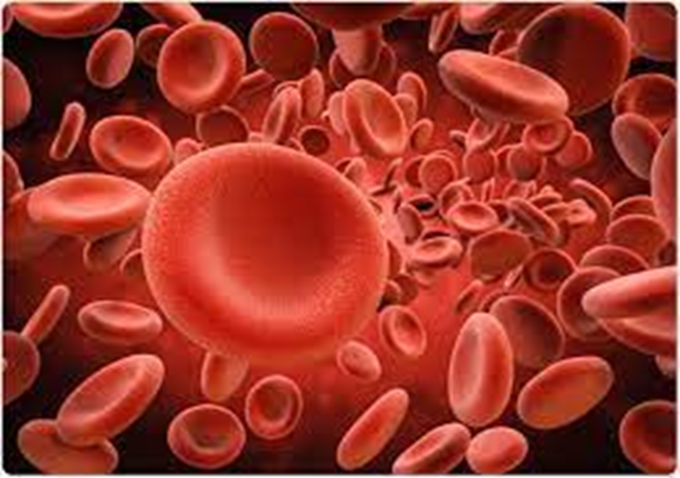

Slide 27
The red cell develops in bone marrow in several stages: from a hemocytoblast, a multipotential cell in the mesenchyme, it becomes an erythroblast (normoblast); during two to five days of development, the erythroblast gradually fills with hemoglobin, and its nucleus and mitochondria (particles in the cytoplasm that provide energy for the cell) disappear. In a late stage the cell is called a reticulocyte, which ultimately becomes a fully mature red cell. The average red cell in humans lives 100–120 days; there are some 5.2 million red cells per cubic millimetre of blood in the adult human. Some diseases also display red cells of abnormal shape—e.g., oval in pernicious anemia, crescent-shaped in sickle cell anemia, and with projections giving a thorny appearance in the hereditary disorder acanthocytosis. The number of red cells and the amount of hemoglobin vary among different individuals and under different conditions; the number is higher, for example, in persons who live at high altitudes and in the disease polycythemia. At birth the red cell count is high; it falls shortly after birth and gradually rises to the adult level at puberty.

Slide 28
Production of red blood cells (erythropoiesis) Red cells are produced continuously in the marrow of certain bones. As stated above, in adults the principal sites of red cell production, called erythropoiesis, are the marrow spaces of the vertebrae, ribs, breastbone, and pelvis. Within the bone marrow the red cell is derived from a primitive precursor, or erythroblast, a nucleated cell in which there is no hemoglobin. Proliferation occurs as a result of several successive cell divisions. During maturation, hemoglobin appears in the cell, and the nucleus becomes progressively smaller.
After a few days the cell loses its nucleus and is then introduced into the bloodstream in the vascular channels of the marrow. Almost 1 percent of the red cells are generated each day, and the balance between red cell production and the removal of aging red cells from the circulation is precisely maintained. When blood is lost from the circulation, the erythropoietic activity of marrow increases until the normal number of circulating cells has been restored. Erythropoietin (EPO) acts as the primary stimulus for erythropoiesis, being mostly produced by the kidneys in response to decreased tissue oxygenation

Slide 29
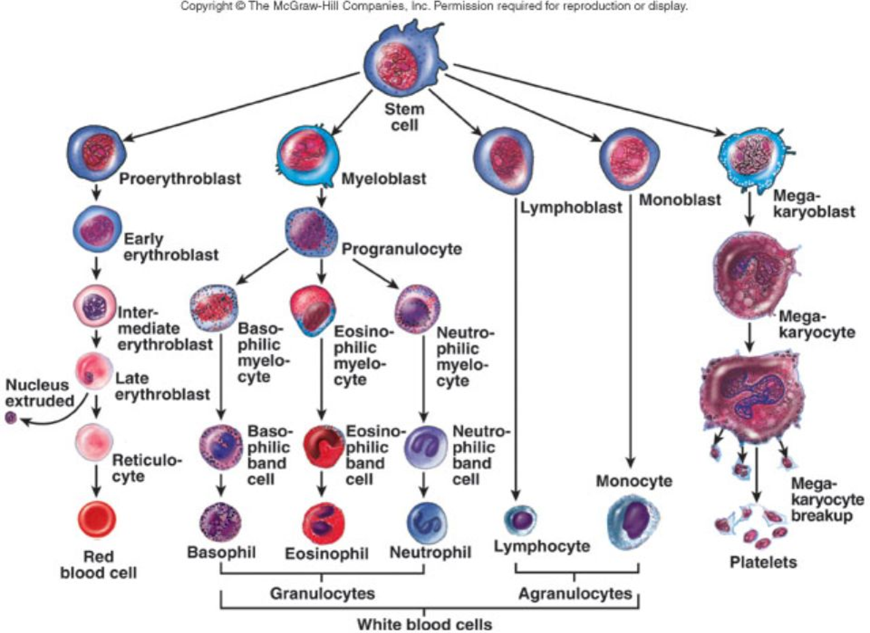

Slide 30
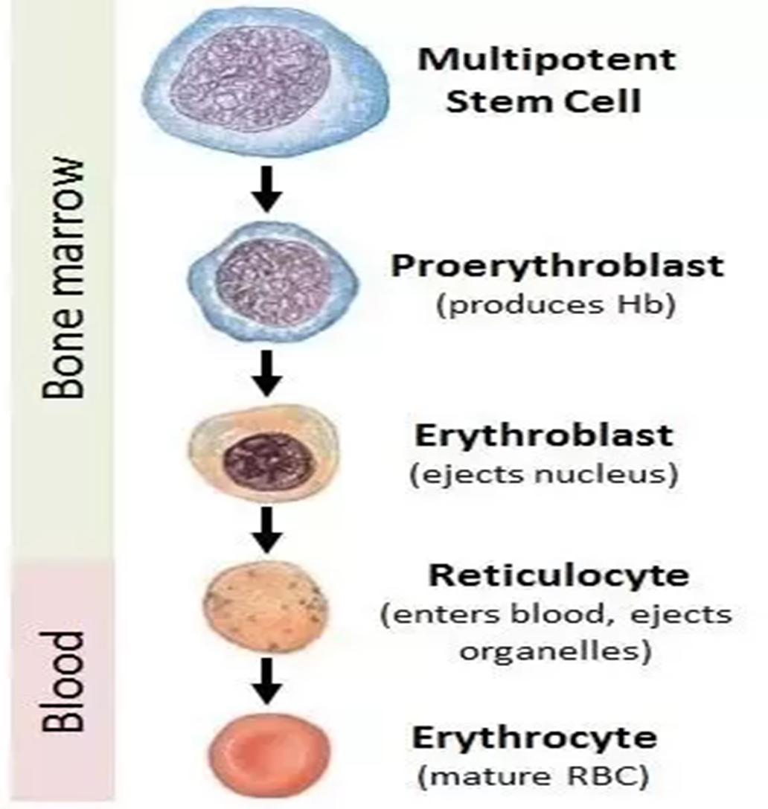

Slide 31
WHITE BLOOD CELLS Normally, human blood contains 4000 to 11,000 white blood cells per microliter .Of these, the granulocytes (polymorph nuclear leukocytes, PMNs) are the most numerous. Young granulocytes have horseshoe-shaped nuclei. that become multilobed as the cells grow older Most of them contain neutrophil granules (neutrophils), but a few contain granules that stain with acidic dyes (eosinophil), and some have basophilic granules (basophils). The other two cell types found normally in peripheral blood are lymphocytes, which have large round nuclei and scanty cytoplasm, and monocytes, which have abundant granular cytoplasm and kidney-shaped nuclei. Acting together, these cells provide the body with powerful defenses against tumors and viral, bacterial, and parasitic infections.

Slide 33
Types of WBCs 1-Graulocyte consist from : Neutrophils Are the most abundant white blood cell, constituting 60-70% of the circulating leukocytes. They defend against bacterial or fungal infection. They are usually first responders to microbial infection; their activity and death in large numbers form pus. They are commonly referred to as poly morph nuclear (PMN) leukocytes, although, in the technical sense, PMN refers to all granulocytes. They have a multi-lobed nucleus, which consists of three to five lobes connected by slender strands. This gives the neutrophils the appearance of having multiple nuclei, hence the name polymorph nuclear leukocyte.
Neutrophils are the most common cell type seen in the early stages of acute inflammation. The average lifespan of inactivated human neutrophils in the circulation has been reported by different approaches to be between 5 and 135 hours.

Slide 34
Basophils Are chiefly responsible for allergic and antigen response by releasing the chemical histamine causing the dilation of blood vessels. Basophils also have coarse granules in the cytoplasm. The granules stain purple blue with methylene blue. They excrete two chemicals that aid in the body's defenses: histamine and heparin. Histamine is responsible for widening blood vessels and increasing the flow of blood to injured tissue. It also makes blood vessels more permeable so neutrophils and clotting proteins can get into connective tissue more easily. Heparin is an anticoagulant that inhibits blood clotting and promotes the movement of white blood cells into an area.

Slide 35
Eosinophils compose about 2-4% of white blood cells in circulating blood. This count fluctuates throughout the day, seasonally, and during menstruation. It rises in response to allergies, parasitic infections, collagen diseases, and disease of the spleen and central nervous system. They are rare in the blood, but numerous in the mucous membranes of the respiratory, digestive, and lower urinary tracts. They primarily deal with parasitic infections. Eosinophils are also the predominant inflammatory cells in allergic reactions. Eosinophils have coarse (larger) granules in the cytoplasm, which stain pink or red with eosin. Nucleus is bilobed and spectacle-shaped.

Slide 36
2-Agranulocyte consist from: Lymphocyte the lymphocytes also do not have granules in the cytoplasm. Nucleus is oval, bean-shaped or kidney-shaped. Nucleus occupies the whole of the cytoplasm. Types of Lymphocytes Depending upon the size, lymphocytes are divided into two groups: 1. Large lymphocytes: Younger cells with a diameter of 10 to 12 µ. 2. Small lymphocytes: Older cells with a diameter of 7 to 10 µ. Depending upon the function, lymphocytes are divided into two types: 1. T lymphocytes: Cells concerned with cellular immunity. 2. B lymphocytes: Cells concerned with humoral immunity

Slide 37
Monocytes Monocytes are the largest leukocytes with diameter of 14 to 18 µ. The cytoplasm is clear without granules. Nucleus is round, oval and horseshoe shaped, bean shaped or kidney shaped. Nucleus is placed either in the center of the cell or pushed to one side and a large amount of cytoplasm . the largest type of white blood cell, share the "vacuum cleaner" (phagocytosis) function of neutrophils, but are much longer lived as they have an extra role. Monocytes eventually leave the bloodstream and become tissue macrophages, which remove dead cell debris as well as attack microorganisms.

