Slide 1
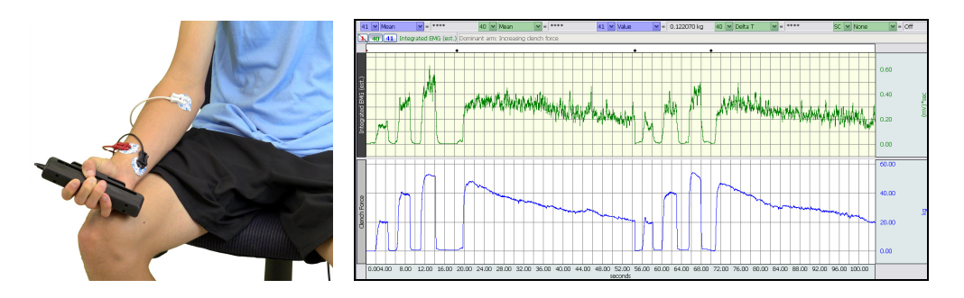
Biopac Student Lab Lesson 2
ELECTROMYOGRAPHY (EMG) II

Slide 2
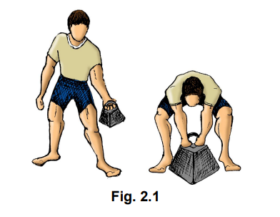
Mechanical work, in the physical sense, refers to the application of a force, resulting in the movement of an object.
Skeletal muscle performs mechanical work when the muscle contracts and an object is moved, as in lifting a weight. To lift a weight, your muscles must exert a force great enough to overcome the weight. If you exert less force, then the weight does not move. (Fig. 1)
Physiologically, skeletal muscle is stimulated to contract when the brain or spinal cord
activates motor units of the muscle.

Slide 3
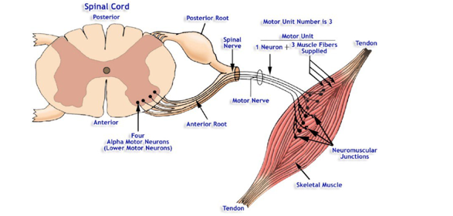
When a skeletal muscle is called on to perform mechanical work, the number of motor units in the muscle activated by the brain is proportional to the amount of work to be done by the muscle. Fig2
the greater the amount of work to be done, the greater the number of motor units activated.
Thus, more motor units are simultaneously active when a skeletal muscle lifts 20 kilograms than when the same muscle lifts 5 kilograms.
The brain determines the number of active
motor units required for a muscle to perform
a given task by utilizing sensory information
from stretch receptors in the muscle and
associated tendons and joint capsules. The
sequential activation of motor units to perform
a designated task is called motor unit recruitment.
Fig2

Slide 4
Fatigue is defined as a decrease in the muscle’s ability to generate force.
If the muscle uses its energy sources faster than they can be generated by cellular metabolism, fatigue occurs. During contraction, skeletal muscle cells convert chemical energy into thermal and mechanical energy, and, in the process, produce chemical waste products.
Normally the waste products are removed from the muscle by the circulatory system as the blood brings nutrients to the muscle for energy transformation. If certain waste products (metabolites) are not removed at an adequate rate, they will accumulate and chemically interfere with the contractile process. Accumulated waste products also stimulate pain receptors in surrounding connective tissue and induce cramping of skeletal muscle.
In this lesson, you will examine motor unit recruitment and skeletal muscle fatigue by combining electromyography with dynamometry.

Slide 5
Power is defined as the amount of work done per unit of time.
Dynamometry means the measurement of power (dyno =power, meter = measure,)
Dynagram is the graphic record derived from the use of a dynamometer
In this lesson, the power of contraction of clenched muscles will be determined by a hand dynamometer equipped with an electronic transducer.
The BIOPAC system will simultaneously record three bands of information:
1) The force you exert on the transducer,
2) The electrical signal produced by the muscle during contraction, and
3) The integrated waveform, which is an indication of the activity levels of the muscle.

