Slide 1
Isomerism in Coordination Chemistry

Slide 2
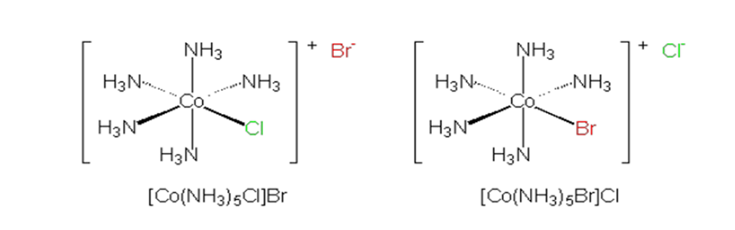
Structural Isomers
Ionization Isomerism

Slide 3
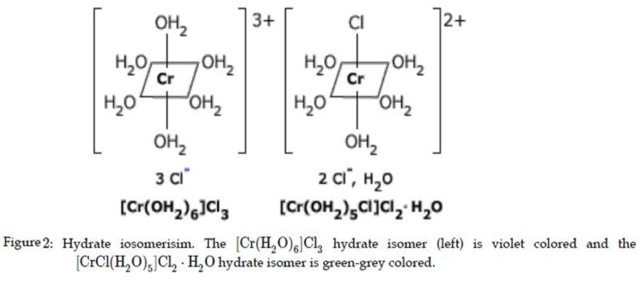
Solvent & Hydrate Isomerism

Slide 4
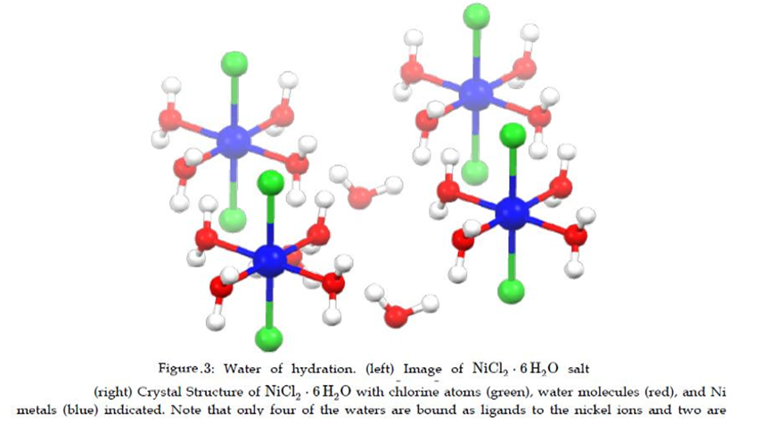
Waters of Crystallization

Slide 5
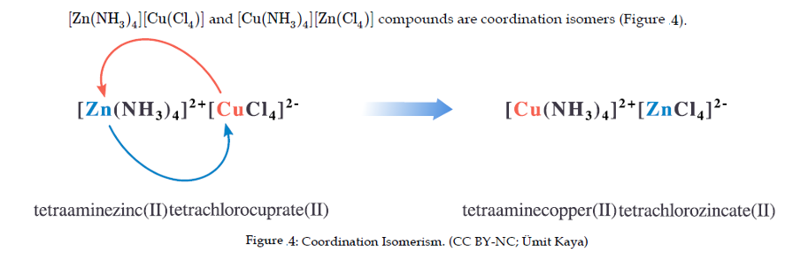
Coordination Isomerism

Slide 6
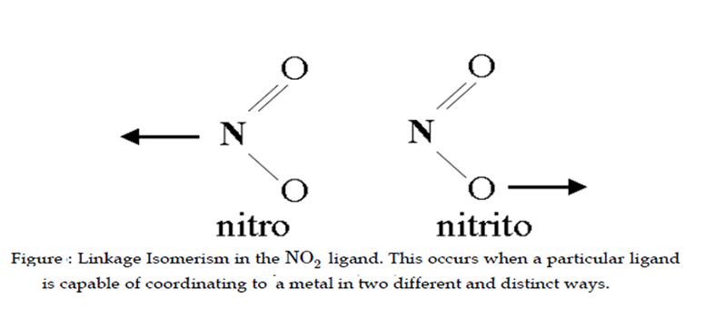
Linkage Isomerism

Slide 7
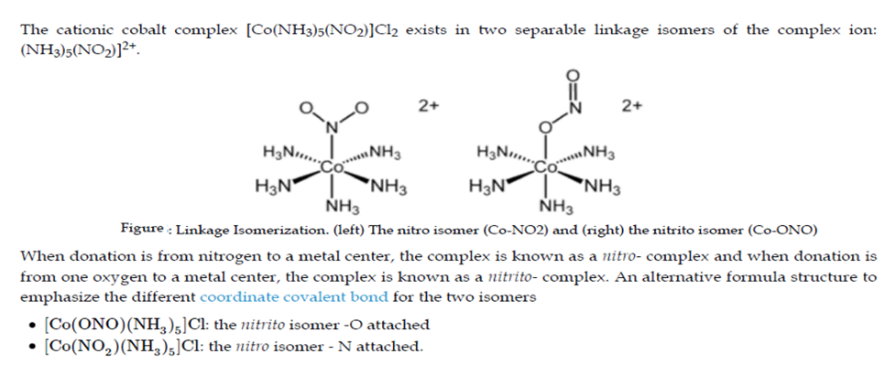
Example: Linkage Isomerization

Slide 8
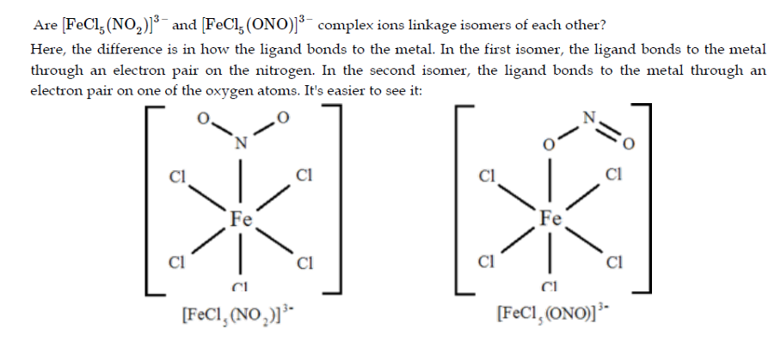

Slide 9
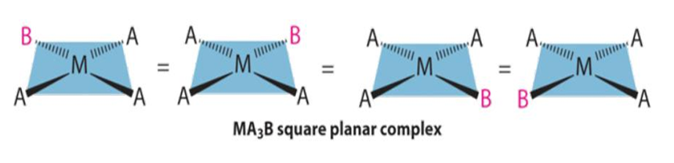
Geometric Isomers
Planar Isomers

Slide 10
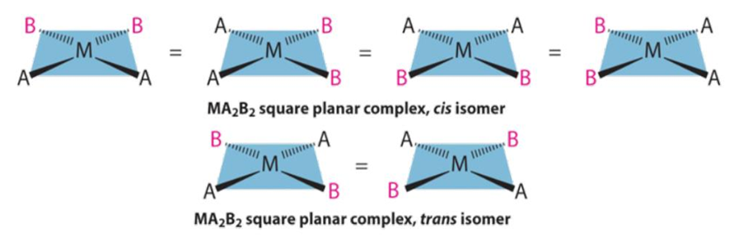

Slide 11
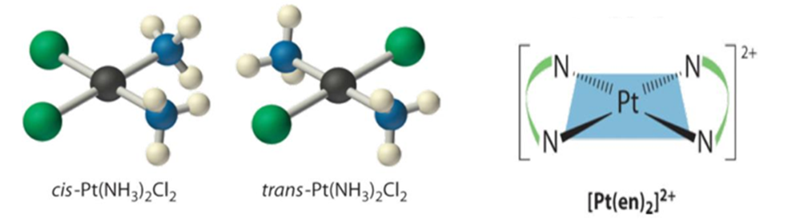

Slide 12
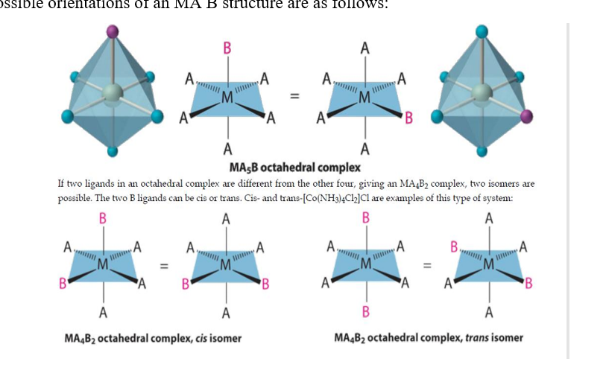
Octahedral Isomerism

