Slide 1
Ionic Liquid Synthesis

Slide 2
1- Introduction
Since the early 2000s, numerous room-temperature ionic liquids have become commercially available in gram to multi-ton quantities. In 2003, for example, Davis, Jr. and Fox compiled a list of some 110 com- mercially-availably low-melting salts of potential use as ionic liquids.' All the listed salts have melting points of 150 °C or less and many are liquid at room temperature. Four years later, Schubert observed that "some 500 ionic liquids are produced commercially on a lab scale for R&D purposes". He suggested that the number is likely to rise to tens of thousands as research interest and applications expand.

Slide 3
Until the late 1990s, room-temperature ionic liquids "were considered to be rare", according to Welton.' In those days, researchers generally had to synthesize the liquids they used themselves. Interestingly, for example, the synthesis of non-chloro aluminate ionic liquids with dialkyl- imidazolium cations was first reported in 1992. [C2mim][PF6] did not feature in the scientific literature until 1994. It would take another five years before these now widely-studied non-chloro aluminate dialkyl -imidazolium ionic liquids became commercially available. As the number of ionic liquids increases the variety of methods for synthesizing them is also increasing. Some of the most common methods of preparing ionic liquids are outlined below.

Slide 4
2- ALKYLATION
The alkyl cations of many ammonium, imidazolium, pyridinium and phosphonium ionic liquids are prepared by alkylation of a suitable precursor, a nucleophile, using an alkylating agent such a halogeno- alkane or a dialkyl sulfate. For example, [C2mim]CI (1) is prepared by the reaction of l-methyl- imidazole (2) and compressed gaseous chloroethane (Scheme 1). The reaction can be carried out in an autoclave without the addition of a solvent. [C4mim]CI has a melting point of 87 °C and is therefore solid at room temperature. As its melting point is below 100 °C, it is, by defini- tion, an ionic liquid. It is also a precursor for the synthesis of other imidazolium ionic liquids. Similarly, [Camim]CI is commonly used as a precursor for preparing other ionic liquids. It is obtained by the reaction of 1-methylimidazole and 1-chlorobutane. The salt, which has a melting point of 69 °C, is recrystallized using a solvent such as ethyl ethanoate.

Slide 5
The 1-alkylimidazoles that are used as starting materials for the synthesis of these and other imidazolium ionic liquids are readily pre- pared by alkylation of imidazole. Halogenalkanes are also used to alkylate pyridine in the preparation of alkylpyridinium salts. For example, [C2py]Br is prepared by the re- action of pyridine and bromoethane. Asymmetrical tetraalkylphosphonium halides are typically prepared by the nucleophilic addition of a tertiary phosphine to a haloalkane. For example, the room temperature ionic liquid trihexyl(tetradecyl) phosphonium chloride, [P6 6 6 14]Cl, is prepared by the reaction of tri- hexylphosphine, P(C6H13)3, and 1-chlorotetradecane, C14H29ClThe tertiary phosphines used for such reactions are synthesized by the addition of phosphine gas, PH3, to an x-olefin such as CH2=CH(CH2)3CH3.

Slide 6
3 - ANION EXCHANGE
Many ionic liquids, for example the commonly-studied tetrafluoroborate and hexafluorophosphate ionic liquids with dialkylimidazolium cations,
are synthesized in a two-step process. First the halide salt with the
required cation is prepared by alkylation (Section.2). The halide anion is then exchanged with the required anion, typically by anion metathesis. In anion metathesis preparations, anions are exchanged between an organic salt and an inorganic anion source such as a group 1 metal salt or a silver salt.

Slide 7
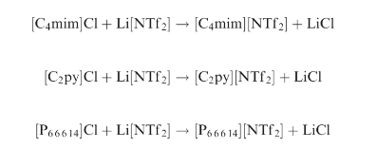
Ionic liquids with the [NTf2]- anion, for example, are prepared by the metathetic reaction between an organic halide salt and lithium bis[(tri-fluoromethyl)sulfonyl] amide. For example, the di alkyl imidazolium ionic liquid [C4mim][NTF2], the alkylpyridinium ionic liquid [C2py][NTf2] and the tetra alkyl phosphonium ionic liquid [P 6 6 6 14][NTf2] are prepared as follows:

Slide 8
Similarly, ionic liquids with the triflate anion can be prepared using sodium triflate, for example:-
[C4mim]Cl + Na[OTf]→ [C4mim][OTf]+NaCl
Silver nitrate and other silver salts are widely used to prepare a range of ionic liquids. For example, [C2mim][NO3] is prepared by the reaction of [C2mim]I and silver nitrate:
[C2mim]I + Ag[NO3] → [C2mim][NO3] + AgI
In 2005, Drake and co-workers reported the use of silver nitrate to prepare 1-alkyl-4-amino-1,2,4-triazolium nitrate ionic liquids such as 3.3 (Scheme 2).°

Slide 9
The metathesis reactions were carried out in hot methanol and the silver halides produced by the reactions were removed by filtration. Many of the ionic liquid products, notably those with shorter alkyl chains, were liquid at room temperature.
The 1-alkyl-4- amino-1,2,4-triazolium halide starting material (4) was prepared by the alkylation of 4-amino-1,2,4-triazole (5) with excess halogenoalkane, using a solvent such as acetonitrile.
In 2000, Reed and co-workers described the synthesis of dialkylimi- dazolium ionic liquids with carborane anions, such as [C2mim][CB11H12],

Slide 10
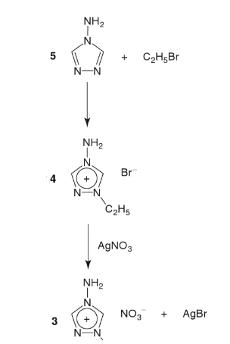
by anion metathesis using silver salts:
[C2mim]Cl + Ag[CB11H12] → [C2mim][CB11H12] + AgCl

Slide 11
The dialkyl imidazolium carborane ionic liquids prepared by the group have melting points in the range 45–156 °C. Carborane anions are of interest in the study of ionic liquids because they are among the most inert and least nucleophilic anions known. Di alkyl imidazolium ionic liquids with [PF6]- anions are prepared by reaction of a dialkyl imidazolium halide with an aqueous solution of the acid HPF6 or a neutral salt such as Na[PF6] or [NH4][PF6], for example:-
[C4mim]Cl + HPF6 → [C4mim][PF6] + HCI

Slide 12
As [C4mim][PF6] is immiscible with water, it forms a separate phase that can be readily separated from the aqueous layer. Ion-exchange resins can also be used to prepared ionic liquids. For example, the room temperature ionic liquid 1-ethyl-3-methylimidazolium vinyl sulfonate, [C2mim][CH2=CH-SO3], is prepared by flushing an aqueous solution of [C2mim]Br through a commercial ion exchange resin loaded with [CH2=CH-SO3] anions.

Slide 13
4 – MICROWAVE- AND ULTRASOUND-ASSISTED SYNTHESIS
In 2001, Varma and Namboordiri noted that the synthesis of di alkyl- imidazolium halides typically involves refluxing 1-methylimidazole and a large excess of the alkyl halide in an organic solvent such as toluene for several hours. The two researchers showed that this tedious procedure could be side-stepped by using microwave-assisted synthesis.
They prepared a range of dialkylimidazolium halides in an unmodified household microwave oven with reaction times of just a few minutes. The procedure avoids the use of solvents and a large excess of the alkyl halides. Varma subsequently showed that dialkylimidazolium ionic liquids with tetrafluoroborate anions, for example [C4mim][BF4], can also be synthesized in a microwave oven under solvent-free conditions:-
(C4mim]Cl + [NH4][BF4] → [C4mim][BF4] + NH4CI
In 2002, Lévêque and co-workers described the use of an ultrasonic reactor for the preparation of [C4mim][BF4], [C4mim][PF6] and related ionic liquids. The sonochemical synthesis resulted in yields of up to 90%, a “dramatic" reduction of the reaction time and improved quality of the products, according to the authors.

Slide 14
5 - HALIDE-FREE SYNTHESIS
As we saw above, the synthesis of non-haloaluminate ionic liquids typically involves two steps, the first of which uses a halogenoalkane as an alkylating agent. The second step, anion metathesis, generates un- wanted halide salts. Halogenoalkanes, particularly those with high boiling points, are difficult to separate from the products at the end of a reaction. In addition, halide salts produced by the metathesis reactions are likely to contaminate the ionic liquids, even after they have been precipitated from the reaction mixtures and removed by filtration. Such contamin- ation can have a dramatic impact on the physical properties of the ionic liquid. Halide salt impurities may also poison and

Slide 15
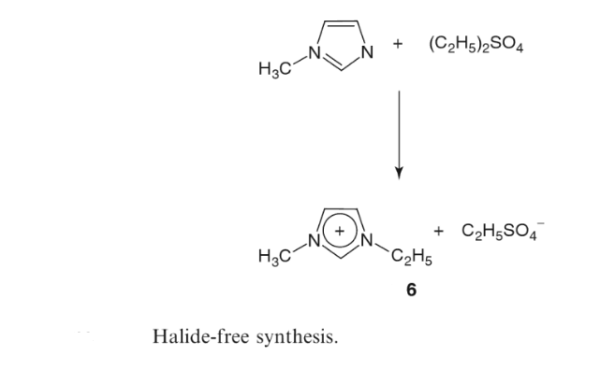

Slide 16
deactivate catalysts when ionic liquids are used as solvents for transition metal catalysis. Consequently, the possibility of developing halide-free syntheses of ionic liquids has been explored by several research groups since the early 2000s. In one such study, Holbrey and co-workers prepared several 1,3- dialkylimidazolium alkyl sulfate ionic liquids, e.g. 6, by the alkylation of alkylimidazoles with dimethyl sulfate or diethyl sulfate, (C2H5)2SO4 (Scheme 3.).
These two alkylating agents are commonly used in industry. Most alkyl sulfate ionic liquids are liquid at room temperature and stable at up to 370 °C or higher. The ionic liquids can be used to prepare other ionic liquids by metathesis. For example, Holbrey's team have prepared [C4mim][PF6] by the metathesis reaction of the methane- sulfonate ionic liquid [C4mim][CH3SO4] with hexafluorophosphoric acid, HPF6. Dimethyl carbonate, (CH3O)2CO, has also been used as an alkylating agent to prepare halogen-free ionic liquids.'3 The methylation of 1- ethyl-2-methyl-imidazoline (7), for instance, yields an ionic liquid (8) with the 1-ethyl-2,3-dimethylimidazolinium cation and the methyl monocarbonate anion (Scheme 4).

Slide 17
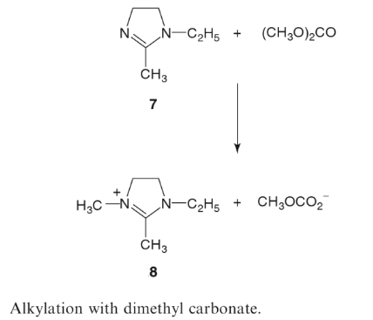
6- SYNTHESIS BY PROTONATION
Protic ionic liquids are prepared by protonation of a starting material such as an amine or phosphine. For example, ethyl ammonium nitrate is prepared by adding concentrated nitric acid to an aqueous solution of ethylamine, C2H5NH2. The water is removed by distillation. [C2H5NH3][NO3], like other protic ionic liquids, is subject to decomposition by deprotonation.

Slide 18
7- SYNTHESIS OF HALOALUMINATE IONIC LIQUIDS
Haloaluminate ionic liquids are prepared by the reaction of an organic halide salt with the required cation and a Lewis acid. Typically, a 1- alkyl-3-methylimidazolium chloride, [Cnmim]Cl, is mixed with Lewis acidic aluminium chloride:-

Slide 19
8 - SYNTHESIS OF TASK-SPECIFIC IONIC LIQUIDS
Ionic liquids with functionalized cations and/or functionalized anions have a wide range of potential applications. Functionalized ionic liquids, or task-specific ionic liquids as they are also known, are potentially useful as reaction media for chemical synthesis, as catalysts and as materials as diverse as lubricants, rocket propellants and active pharmaceutical ingredients. Their synthesis is therefore a rapidly growing area of research.
Various synthetic routes have been reported for the preparation of task-specific ionic liquids. Typically, functionalized halogenoalkanes are used to prepare ionic liquids with functionalized imidazolium, phosphonium and pyridinium cations. One of the earliest reports focused on the development of task-specific imidazolium ionic liquids for the
extraction of metal ions from aqueous solutions .

Slide 20
The authors of the report used 1-(3-aminopropyl)imidazole (9) as a starting material and a two-step procedure to synthesize six ionic liquids with cations functionalized with urea, thiourea and thioether groups. In the first step the amine group of the starting material was converted into the functional group. In the second step, the nitrogen atom at the 3- position in the imidazole ring was alkylated using an alkyl halide.

Slide 21
Various ionic liquids with functionalized anions have been prepared by anion exchange with commercially available alkali salts and acids. For example, in 2005 Ohno and co-workers described the preparation of room-temperature ionic liquids from 20 natural amino acids. 16 The team first prepared an aqueous solution of [C2mim][OH] (10) from [C2mim]Br using an anion exchange resin. The solution was then added to an aqueous solution containing a slight excess of the amino acid, e.g. alanine (11, Scheme.5). The water was then removed by evaporation and the excess amino acid by filtration. Other methods for functionalizing anions include transesterification. The method has been used to prepare ionic liquids with functionalized alkyl sulfate anions. Wasserscheid and co-workers used transesterification with ethylene glycol-based alcohols, such as 2-methoxyethanol, CH3O(CH2)2OH, under slightly acidic conditions to replace the alkyl

Slide 22
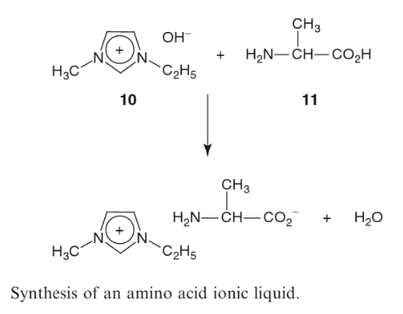

Slide 23
groups in the anions of [C2mim][CH3OSO3] and [C2mim][C2H5OSO3] with ethylene-glycol functionalities, for example:-
The ethanol was continuously removed by evaporation during the process. The ionic liquid, which does not evaporate because it has negligible vapour pressure, was produced in around 99% yield. It has a melting point of less than 0°C.

Slide 24
9 – CHIRAL SYNTHESIS
Chiral ionic liquids are potentially important as chiral solvents and catalysts in asymmetric synthesis. They are derived from the chiral pool. This pool consists of a wide range of chiral precursors that include synthetic enantiomers that are produced on a large scale industrially and chiral amino acids, carbohydrates, terpenes and other chiral compounds that occur naturally in animals and plants. Following the work by Ohno's group in 2005 (Section 8), amino acids have been exploited as a source of chiral anions for ionic liquids in various investigations. However, many of the syntheses of chiral ionic liquids have focused on ionic liquids with chiral cations. These ionic liquids are typically prepared by alkylation of a chiral precursor followed by anion exchange. In 2004, for example, Mauduit, Guillemin and co-workers reported the synthesis of a room-temperature ionic liquid consisting of chiral cations derived from the amino acid L-valine and [NTf2]- anions.8 The group used commercially available N-Boc-L-valine (12) as a starting material. Boc (tert-butyloxycarbonyl) is widely used as a protecting group for amine groups in peptide synthesis.

Slide 25
In a sequence of steps, the group coupled the protected amino acid and the substituted aniline 13 to form the enantiopure imidazoline 14. Alkylation of this compound with alkyl halides followed by anion exchange yielded a variety of chiral imidazolinium salts, some of which are solid at room temperature, but one of which, the [NTf2]- salt (15), is liquid (Scheme 3.6). Ionic liquids with both chiral cations and chiral anions have also been synthesized. In 2005, Machado and Dorta reported the synthesis of several chiral imidazolium salts, including the "first example of a 'doubly chiral' ionic liquid" The two chemists first prepared several

Slide 26
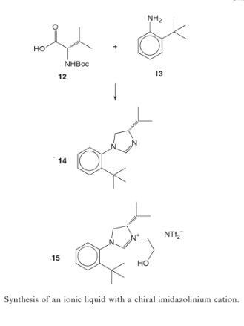

Slide 27
chiral imidazolium salts derived from the chiral pool precursors comphor, ß-pinene and tartaric acid. They included ionic liquids with chiral imidazolium cations and others with chiral anions such as (S)-10-cam- phorsulfonate. The two chemists prepared the doubly chiral ionic liquid 16 by passing an aqueous solution of an ionic liquid with chiral imi- dazolium cations and tosylate anions over an ion-exchange resin charged with (S)-camphorsulfonate anions. Stripping water from the resulting aqueous solution and drying under vacuum yielded a pale- yellow viscous oil.

