Slide 1
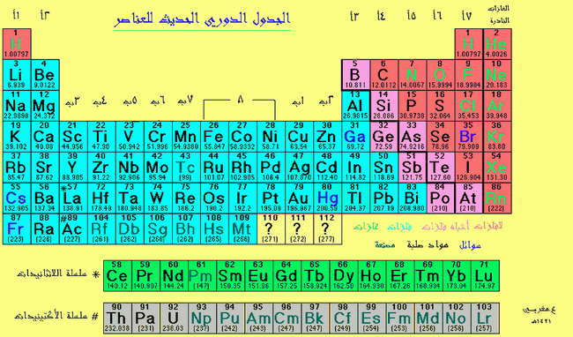

Slide 2
Nitrogen & The (VB)
Group Element
The electronic structure & the oxidation state
Oxidation state | Electronic state | Element
-III,-II,-I,0,I,II,III,IV,V | [He]2S²2P³ | N
The most III , V | [Ne]3S²3P³ | P
Abundant III, V | [Ar]3d¹⁰4S²4P³ | As
Stable III, V | [Kr]4d¹⁰5S²5p³ | Sb
III, V | [Xe]4f¹⁴5d¹⁰6s²6p³ | Bi

Slide 3
Nitrogen can fill the outer shell to be 8es by:
1.Gains 3es forming N³⁻ (Nitrides of alkaloids elements)
2.Forming single covalent. Bonds (e.g.NH₃) or multiple (e.g. N≡N).
3.Forming covalent. bonds with loosing e, e.g. [NH₄]⁺.
4.Forming covalent. bonds with gaining e, e.g. NH₂⁻ amide.
There will be stable nitrogen compounds, the outer shell of nitrogen is incomplete (e.g.NO or NO₂) each N contains one unpaired e. They have paramagnetic properties.
Nitrogen forms multiple bonds differing from the other gr. elements, so it likes C & O. The bond (N-N) is weaker than that in (C-C) because of the repulsion of the non –bonding electrons on the Nitrogen atoms.

Slide 4
It forms 78% by volume of the air around the earth crust. Nitrogen separated by fractional distillation of the liquefied air (B.P. of N₂=-195.8˚C), it contains traces of Ar. It has two isotopes N¹⁴ & N¹⁵ (N¹⁴/ N¹⁵ = 272)
N₂ 2N ∆H= 944KJ/ mole ( High to break N≡N bonds)
The most important reactions of N₂ at room temperature is will Li forming lithium nitride, this reaction increases with increasing temp. specially in presence of catalyst
N₂ Compounds:-
-NH₃ -NO -Mg₃N₂
N₂ + 3H₂ 2NH₃
N₂ + O₂ 2NO
N₂ + 3Mg Mg₃N₂

Slide 5
Nitrides
1- Ionic:-
e.g. Li₃N , nitrides of earth alkaloids .They produce by the direct reaction of the element and nitrogen , they have N⁻³ and hydrolyze by water forming Ammonia and hydroxide.
Li₃N + 3H₂O NH₃ + 3LiOH
2- Covalent:-
Covalent nitrides like BN, AlN , which have high melting .points. and like carbon in their crystalline structure , can be formed. BN have two forms, like diamond in one form and like graphite in the other. Also there are volatile nitrides like S₄N.
3- Transition Element Nitrides:-
They are like their iodides and carbides. Mostly nitrogen takes place in the cavities produced because of the packing of the metal's atoms. These nitrides are non-stoichiometric, nitrogen ratio is less in these compounds. They conduct electron current, chemically inactive and their melting points are very high e.g. VN (m.p.2570˚c).

Slide 6
Nitrogen and Hydrogen Compounds:-
Ammonia NH₃ (gas):-
The most one of these compounds, boils at -33.5˚c ,melts at -77˚c.
Preparation
A- In Laboratory :- From the reaction of ammonium salts with strong base:-
NH₄X + OH⁻ NH₃ +H₂O +X⁻
B- In Industry:- A very important produce millions of tons. According to
Haber Bosch Method by the direct reaction of N₂ and H₂ in presence of a catalyst and at high pressure (300 atm. Pres.) and temperature of 400- 550 ˚c:-
N₂+3H₂ 2NH₃ ∆H= -45 KJ/ mol, K25=103at m⁻¹
(N₂ from air, H₂ from water or hydrocarbons they are very cheap sources to produce NH3 for fertizers).
The structure of NH3 in pyramid , nitrogen atom on the top while hydrogen atoms are at the corners of the triangle below nitrogen atom.

Slide 8
Properties of NH₃
1- Ammonia considered as a solvent like water (polar) also because of their self-ionization .
2NH₃ NH₄⁺ + NH₂⁻ K₂₅= 10⁻³⁰
2H₂O H₃O⁺ + OH⁻ K₂₅= 10⁻¹⁴
acides bases
2- Ammonia strongly dissolves in water (727 l in one of H₂O at 15 ˚c), pH of the basic solution (10-11) .
NH₃ + H₂O NH₄⁺ + OH⁻ ( There are hydrogen bonds)
3- Ammonia burns with air giving N₂ and H₂O gases.
4NH₃ + O₂ 2N₂ + 6H₂O
4- Ammonia can be oxidized by O₂, using Pt as catalyst giving nitrite oxide (used in HNO₃ industry )
4NH₃ + 5O2 4NO +6H₂O
Compounds of Ammonia
Ammonium Salts
They are like K and Rb salts in their solubility and crystal structure. This is due to their near values of the radii of Rb⁺ , K⁺ and NH₄⁺ ions.
NH4⁺ ion is a weak acid compared with H₃O⁺. Its structure is Tetrahedral (sp3 hybridization ).
Note:- Vigorous heating of these salts produces an explosion ( that is why they used in explosives).

Slide 9
2. Hydrazine N₂H₄
Prepared by oxidation of NH₃ by hypochloric acid or sodium hypochlorite
2NH₃ + OCl H₂N –NH₂ + H₂O +Cl⁻
Enthalpy of formation ∆=50 KJ/ mol.
. Salts that contain N₂H₆⁺² are stable in acidic medium only (hydrolysis).
N₂H₆ ⁺² +H₂O N₂H₅⁺ +H₃O⁺
Hydrazine used against corrosion in low concentration in electricity stations and as fuel for rockets because of the large energy produced through the burning.
N₂H₄ +O₂ N₂ + 2H₂O ∆H = -622 KJ/ mol
Hydrazine in structure like H₂O₂ ,the two NH₂ groups does not rotate around the bond they are fixed as gauche shape,
The relation between the chemistry of N₂H₄ and NH₃ is as that between H₂O and H₂O₂ .
Hydrazine behave as an oxidizing agent with strong reducing agent and as a reducing agent toward the strong oxidation agents, so it like H₂O₂.

Slide 10
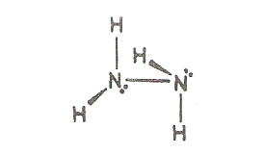
Hydrazine

Slide 11
3. Hydroxyamine NH₂OH:-
Prepared from reducing of nitrates or nitrides by SO₂. It is a solid , white substance, malting point 33 ˚c, unstable so that we find it as salts like (NH₃OH)₂SO4 and (NH₃OH)Cl.
Hydroxylamine less basic than ammonia.
NH₂OH + H₂O NH₃⁺OH + OH⁻ K25= 6.6×10-9
It behaves as oxidation – reducing agent as hydrazine, but is used as a reducing agent.
4. Hydrazoic acid HN₃:-
Prepared by oxidation of hydrazine using a strong oxidizing agent like HNO₂ in an acidic medium :
N₂H₅+ + HNO₂ HN₃ +H₃O⁺ + H₂O
HN3 is a colorless liquid, boils at 37˚c , high explosed .Weak salts are called azides (Explosives).
3NaNH₂ + NaNO₃ NaN3 +3NaOH + NH₃
_{Sod.amide azide}

Slide 12
Ionic azides are relatively stable because of the resonance energy of the azide ion .

Slide 13
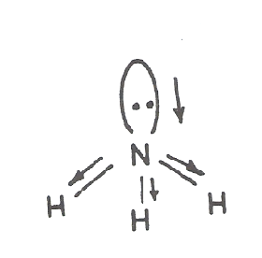
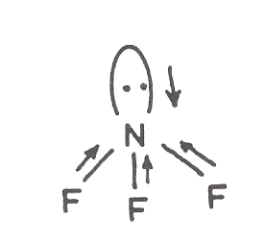
Nitrogen and Halogens Compounds:-
The most known pure compounds are :- NF₃ , N₂F₂, N₂F₄ and NCl₃. Compounds of Br₂ and I₂ with nitrogen are complexes , e.g. NBr₃.6NH₃, NI₃.6NH₃.
NF₃:- Prepared from F₂ with NH₃:-
4NH₃ + 3F₃ NF₃ + 3NH₄F
It’s a stable gas, colorless, odorless , m.p.-207˚c , b. p. -129˚c .It has the same structure as NH₃ , pyramid, but differs in many properties, it behave as Lewis base, having a dipol moment (D= 0.23) lower than that of NH₃ (D= 1.47) ,this is because of the direction of the dipoles of the three bonds in ammonia and NF₃ :-
D in the same direction D is in the opposite direction

Slide 14
NCl₃
N₂ + 3Cl₂ 2NCl₃
It is a deep yellow oil (b. p. 71˚c), decomposes with explosion when contacts impurities O₂ by stirring or exposuring to UV light.
2NCl₃ N₂ + 3Cl₂ ∆H = - 55 Kcal/mol
Dissolve in the polar solvents, hydrolysis by water as :-
NCl₃+ 3H₂O NH₃ + 3HOCl
Bromine and iodine complexes (with N₂) are unstable highly explosive materials.

Slide 15

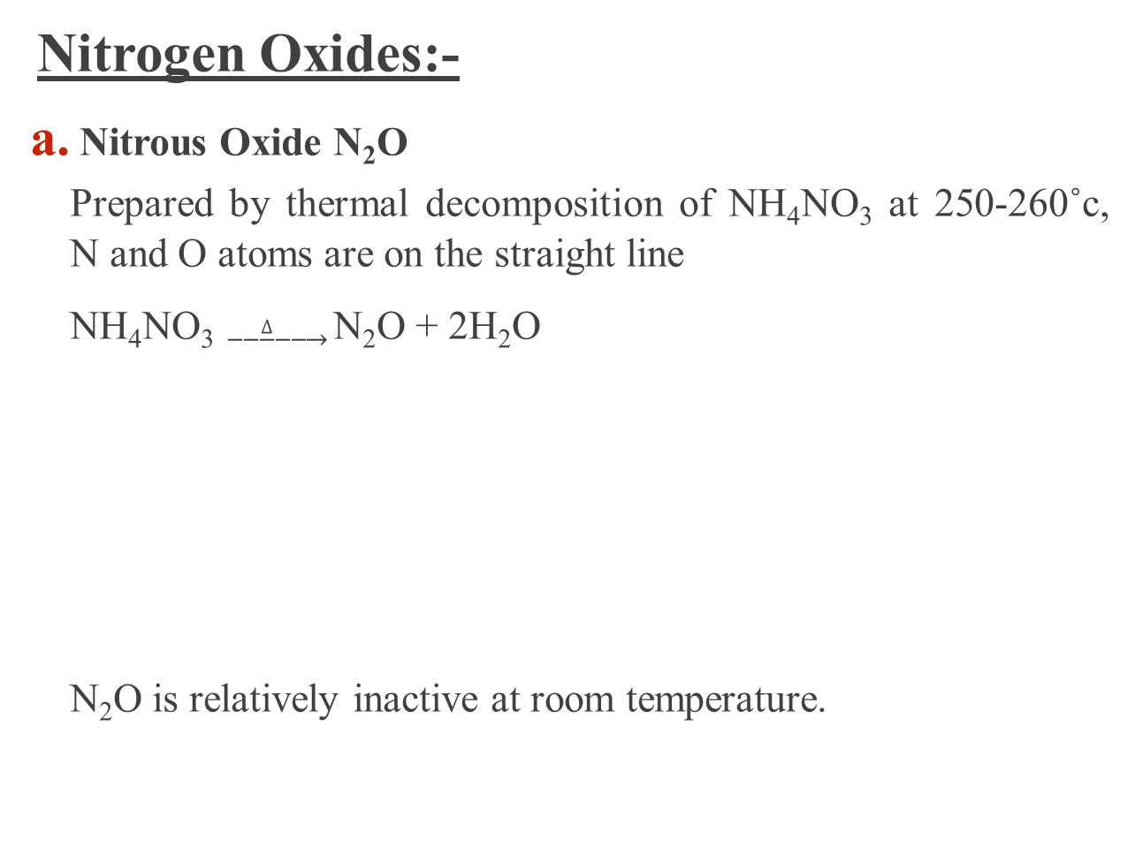
Nitrogen Oxides:-
Nitrous Oxide N₂O
Prepared by thermal decomposition of NH₄NO₃ at 250-260˚c, N and O atoms are on the straight line
NH₄NO₃ $\underset{→}{ ∆ }$N₂O + 2H₂O
N₂O is relatively inactive at room temperature.

Slide 16
b. Nitric Oxide NO
Prepared by many methods, one of them by reduction of HNO₃ by Cu or
reduction of nitrates by I₂:
8HNO3 + 3Cu 3Cu(NO₃)₂ +4H₂O +2NO
2NaNO₃ +2NaI +4H₂SO₄ 2NO +4NaHSO₄ +I₂ + 2H₂O
1.NO simultaneously oxidized by O₂ to NO₂,also by strong oxidizing
agents like KMO₄ forming HNO₃,
2.reduced in acidic medium to N₂O (SO₂ as a reducing agent) and gives
NH₂OH if Cr²⁺ is used as a reducing agent
The paramagnet properties of NO can be explained according to (MOT)
because of the un-paired electron in the π* orbital against the antibonding electron .The outer 11 electron are distributed as the following :-
σ2S², σ*2S², σ2S², π2P⁴, π*2P¹
NO lose the π* electron easily forming NO⁺ ion which forms some salts e.g. NO⁺[BF₄]⁻and NO[ClO₄] .

Slide 17
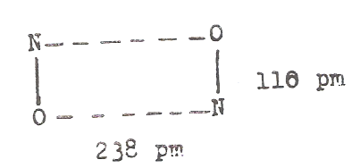
NO molecules bonded together in the liquid and solid state by weak bonds forming dimers.
c. Nitrogen Trioxide N₂O₃
It presents only in the solid state, decomposes at its melting point (-110˚c) to NO and NO₂.

Slide 18
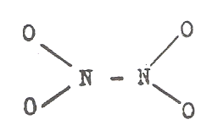
d. NO₂ and N₂O₄ Oxide
NO₂ is brown in color with paramagnetic properties, always in equilibrium with N₂O₄ (colorless with diamagnetic properties), this equilibrium effected by heat:-
2NO₂ N₂O₄
The equilibrium can be shifted to the right hand side in the solid state, while shifted to the left hand side in the liquid and gas state.NO₂ increased in the mixture with increasing temperature exceeding 90% at 100˚c.
N2O4 has 3 isomers (structures) which are similar, the most stable one that contains the N-N bond:-
The structure of NO₂ is bent , The angle is 134˚ bigger than that of O₃ (117˚) of NO⁻₂(116˚), the reason for that is the presence of an electron in SP² orbital (atomic nonbonding) of nitrogen, while such orbital contains 2e in O₃ and NO⁻₂ cases.
It is well known that one electron occupies less space than that occupied by two electrons.
NO₂ and N₂O₄ formed by the thermal 1.decompostion of the metal nitrates O₂ by 2.oxidizing NO and also by 3 Reducing of HNO₃. They are toxic gases, react with water to give HNO₃ and HNO₂.

Slide 19
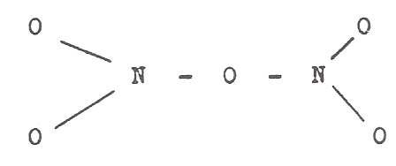
e. N₂O₅ Oxide
This one considered as a nitric acid anhydride, prepared by dehydration of HNO₃ by P₄O₁₀
4HNO₃ + P₄O₁₀ 4HPO₃ +2N₂O₅
Phosphorous pentaoxide
It is crystals (colorless, relatively unstable), hydrolyses in the solid state to NO₂⁺NO₃⁼, while in the gas state it has a planar structure:-

Slide 21
Oxo Acid of Nitrogen
1. Hyponitrous acid H₂N₂O₂
It is a weak acid (pH≈7), unstable white crystals, decomposed to NM2O and water. It's salts are prepared by reduction of nitrites by sodium amalgam, the free acid is prepared by acidifying the silver hyponirite (difficulty dissolve in water), which is a reducing agent, the hyponitrite ion has a trans structure:-
2. Nitrous acid HNO₂:-
It is not known in it's free form, it's solutions prepared by the action of acids on nitrites or by dissolving N₂O₃ in water, it decomposes by heat in these solutions.
3HNO₂ HNO₃ + 2NO + H₂O
HNO₂ is an oxidizing agent versus reducing agent, e.g. I⁻, Fe²⁺ and C₂O₄ ⁻².
It is a reducing agent against some of the oxidizing agents.
NO₃⁻ + 3H+ +2e HNO₂+ H₂O E˚= 0.94V.
.

Slide 22
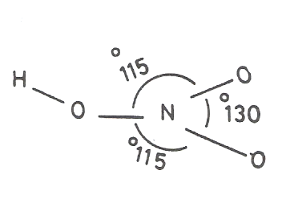
HNO₂ is used in organic chemistry to prepare diazonium salts and the nitrites derivatives are those in which NO₂ group is bonded through oxygen atom (RONO) white nitro derivatives are when NO₂ gr.is bonded through nitrogen atom
Also NO₂ bonded in the inorganic complexes by one of the two method before when it reacts as a ligand.
3. Nitric acid HNO₃
Liquid, colorless, m. p. -41.6˚c, b.p.83˚c.It is one of the most important acid, planar in structure

Slide 23
HNO₃ is prepared in industry by ammonia oxidation with O₂, using Pt as a catalyst. This reaction produces an intermediate compound. NO₂ or N₂O₄ which gives a mixture of HNO₂ and HNO₃ by dissolving in H₂O.
HNO₂ oxidizes by O₂ to HNO₃.
Pure nitric acid (without water) is prepared from the reaction of KNO₃ with concentration H₂SO₄ (100%) at 0˚c.It separated by vacuum distribution, it has a high degree of self-ionization
2HNO₃ H₂NO₃⁺ + NO₃⁻
H2NO₃⁺ H₂O + NO₂⁺
2HNO₃ NO₂⁺ + NO₃+H₂O
HNO3 is completely ionized in water into NO₃⁻ and N₃O⁺
It is an oxidizing agent, it's power increased with increased temperature. Metals are oxidized (except Ir, Rh, Pt and Au) by acid giving nitrates and H₂ .
Al , Fe and Cu react with HNO₃ forming a layer of oxide which protect them from reaction. This behavior is important to carry and transform HNO₃ acid in containers manufacture of these element.
A mixture of HNO₃ and HCl by volume((3:1) can dissolve Au and Pt (this called aquaregia). The extra ability of oxidation of this mixture is belong to Cl2 and NOCl which form according to the equation:-
HNO₃ + 3HCl NOCl + Cl₂ + 2H₂O

Slide 24
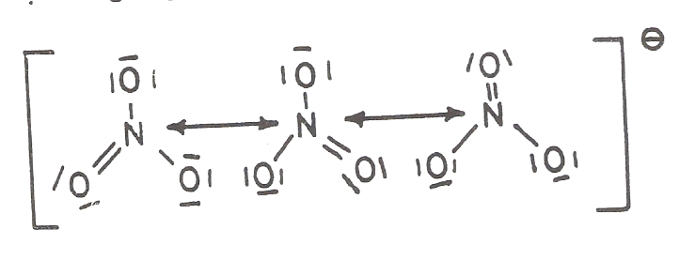
Nitrate ion has a planar structure, the ion (NO₃⁻) is more stable than acid, because of the resonance energy:-
All metal nitrates dissolve in water, some of them can be produced (or prepared) without water of crystallization which sublimate by heating in vacuum, without decomposition , while at high temperature the alkaloid nitrates decompose into nitrite and O2, others form oxides and oxygen, e.g. :-
2NaNO₃ 2NaNO₂ + O₂
2Pb(NO₃)₂ 2PbO + 4NO₂ +O₂

Slide 25
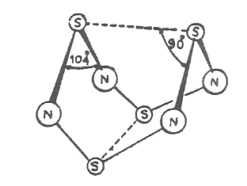
Nitrogen and Sulfur Compounds:-
Nitrogen forms with sulfur a lot of nitrides, one of the most important (known) is S₄N₄ which can be prepared by the reaction of SCl₂ or S₂Cl₂ with NH₃.S₄N₄ is orang crystal, melts at 187˚c, exploses by knocking. Its structure is like a cage:-
The nonbonding electrons on N₂ form Pπ-dπ bonds with d orbitals of sulfur atoms (the vacant orbitals).

Slide 26
P, As, Sb and Bi:-
Properties:-
There are big differences between the chemistry of nitrogen and these elements in spite of the same electronic configuration of the outer shell they have .The reason of that is ,the 1.nitrogen atom does not have d orbitals while the above elements have d orbitals, also 2. the max. coordination no. of nitrogen is (4) while others can use vacant d orbitals to form bonds which increase the number of electrons in their valance shells. Nitrogen can form double and triple bonds type (p-p).
Table giving the properties of the VB group elements which change systematically from P to Bi, some properties change in a disorder system like the tendency of some penta oxides to react as oxidizing agents.
Element | Atomic No. | Atomic Wight | Boiling point | Atomic radii (pm) | EV | EN
N | 7 | 14 | -195.8 | 74 | 14.5 | 3.0
P | 15 | 31 | 280.5 | 110 | 11.0 | 2.1
As | 33 | 75 | 610 | 121 | 10.0 | 2.0
Sb | 51 | 121.75 | 1380 | 141 | 8.64 | 1.8
Bi | 83 | 209 | 1450 | 152 | 8 | --

Slide 27
Phosphorous likes nitrogen (to be covalent character) in its compounds, while others like to form ionic compounds (increasing) from As to Bi, e.g. BiF3 is ionic.
Acidic and basic properties change for the group V. elements (specially oxides ) from acidic for P to basic for Bi. Oxidation state of these elements are trivalent or pentavalent, the stability of the trivalent oxidation state increases from P to As, Bi (III) is stable, but Bi₂O₅ (Bi V) is difficult to prepare and is the least stable oxide in this group.
Occurance in Nature:-
P is present as phosphate in many minerals like Apatite Ca₅(PO₄) (Cl, OH, F), As, Sb and Bi are rarely present in their elemental from mostly they present as sulfides.

Slide 28
a. Phosphorous:-
Prepared by reduction of phosphate rocks by coke and silica in an electrical furnaces, it evaporate as P₄ molecules, condensed under water forming white phosphorous:
(P4 molecule)
2Ca₃(PO₄)₂ + 6SiO₂ + 10C P₄ + 6CaSiO₃ + 10CO
Phosphorous has three allotropic forms ,white ,red and black, each form has many shapes (at least 11 shapes). White phosphorous presents in the liquid and solid states (P₄), it's structure is tetrahedral, the distance P-P is equal to 221 pm and the P-P-P angle is 60˚.
The total energy of the P₄ bonds (6 bonds) is less than the total energy of six (P-P) bonds have the same length of the bond (P-P) in P₄, so that the bonds of P₄ molecule are weak and easy to break, which explain the activity of white phosphorus.
Black phosphorous has double layers (coupled) in which each P atom bonded to other three atoms. It can be prepared in its crystalline form by heating the white phosphorous under high pressure at 220-370 ˚c, in presence of Hg as catalyst.
Red phosphorous produced from heating the white type for many hours at 400˚c. The activity of phosphorous depends on its form, the white is more active it burns when exposes to air so it must kept under water, white the black and red phosphorous are stable in air, the black one is the less stable.

Slide 29
b. As, Sb and Bi:-
We can prepare them by reduction of their oxides using carbon or hydrogen , a yellow form for As and Sb can be produced as As₄ and Sb₄ by fast condensation of the vapors, the yellow form can be converted to the stable state, for Sb at -90˚c, which is bright and gaseous appearance.
As, Sb and Bi are used with many metals to manufacture alloys, e.g. Sb(20%) with Pb form the alloy of typing letters, Bi with Pb and Sn form low melting point alloys

Slide 30
Compounds:-
Hydrides:-
All the group V elements form hydrides (MH₃), each one prepared from the reaction of MCl₃ and the metal hydride (to be wanted):-
4PCl₃ + 3LiAlH₄ 4PH₃ + 3LiCl + 3AlCl₃
Phosphine and Arsine are prepared by the reaction of phosphides and arsenides of the metals with acids. SbH₃ and BiH₃ are unstable with temperature. Generally the stability of hydrides decrease of the bond energy in the same direction.
E N-H= 391, E P-H=322, E As-H =247, E Sb-H=255 KJ/ mol
2-Phosphine PH₃:-
The pH₃ structure is pyramid, the HPH angle in 93.7˚ less than HNH in NH₃ and close to the angle formed because of the overlapping of P-orbitals of phosphorous with S-orbital of hydrogen (90˚) without hybridization of SP₃ for P. So that the non-bonding two electrons in phosphorous atom has the S character and they are distributed in a spherical shape around the nucleus of this atom (P), which retard the contribution of phosphine by these electrons to behave as a Lewis base on the contrary of NH₃ in which the HNH angle (107˚) and the nitrogen atom is hybridized (SP³) and the nonbonding pair of electrons is present in the hybridized SP³ orbital which directed from nitrogen to one corner of the tetrahedral shape of NH₃, that make it easy for NH₃ to give (donate) these electron to be a strong Lewis base.
The tendency of the hydrides as Lewis bases decreases decrease from
N Bi. Phosphonium salts can be prepared by reaction of phosphine with strong acids,
PH₃ + HI PH⁺₄I⁻
PH₄⁺ + H₂O PH₃+ H₃O⁺

Slide 31
Arsine AsH₃
Very toxic compound, easily hydrolyse by heat to its components, As precipitated as a mirror, this character is used to detect As, this test is called Marsh test. Stibine SbH₃ likes arsine AsH3 but it is less stable. All hydrides are reducing agents (strong), burn when contact air forming oxides.
Halides
Group V elements form two types of halides, trihalides (MX₃) and penta (MX₅).
MX₃
MX₃ of P, As, Sb and Bi (except PF₃) are prepared from halogens with enough (or excess) quantity of the metals while PF₃ is prepared by the reaction of ZnF₂ with PCl₃.
2PCl₃ +3Zn F₂ 2PF₃ + 3ZnCl₂
Trihalides are mostly covalent from which one can conclude that they have relatively low boiling and melting points. The ionic character of these halides increase from P to Bi and for the central atom from I to F.

Slide 32
MX₃ molecule have a pyramide structure in the gas state, hydrolyse easly in water to give HX and M(OH)₃ :- e.g.
PCl₃ + 3H₂O P(OH)₃ + 3HCl
SbX₃ and BiX₃ in water form SbO⁺ and BiO⁺ ions. SbF3 and AsF3 are used as fluorinating agents (Source of Flurine).
MX₅ pentahalides
The well-known are PF₅, AsF₅, SbF₅, BiF₅, PCl₅, PBr₅ and SbCl₅.
PCl₅ in the gas state have triganal bipyramide structure while the solid is composed of [PCl₄]⁺ [PCl₆]⁻ ions by transforming Cl ion in PCl₅ molecules to another molecule.
PBr₅:- In the solid state is of PB₄⁺Br⁻ structure PCl₅ liquid, yellow in color (milting point 6˚c, boiling point 79˚c), SbF₅ and SbCl₅ are strong Lewis acids.

Slide 33
Oxides:-
The group V elements have two types of oxides, tri and pentvalent oxides (+3 and +5), their basic properties increase with increasing the atomic no. P and As oxides are acidic, Sb oxides are amphoteric, while Bi oxides are basic.
Phosphorous oxides:-
They are prepared from the reaction of phosphorous vigorously with O₂, their formation depends on the O₂ quantity and P reacted. Increasing O₂ give P₂O₅ while increasing P gives P₂O₃.
Phosphorous atoms in P₄O₁₀ are occupying the corners of the tetrahedral shape while 6 oxygen atoms are at the sides (edges) of the tetrahedral, the other 4 oxygen atoms are bonded to P atoms along with the three axis. The 12 formed bonds between oxygen and phosphorous atoms are single ones, some others are double as in the structures:-

Slide 34
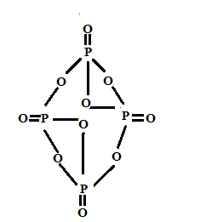
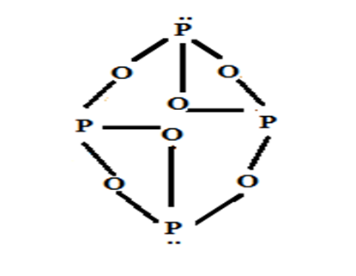
P₄O₆ P₄O₁₀
These bonds are produced from the overlapping of (Pπ-dπ) between the nonbonding electrons of oxygen with the vacant d orbitals of phosphorous atoms. P₂O₃ structure (P₄O₆ is one of its forms) likes the structure of P₄O₁₀ except the presence of the other 4 oxygen atoms.
P2O5 is strong absorb water due to the tendency of p- atom to accept electrons (in P₄O₁₀), electrophilic.
According to that, the P₂O₅ is used in drying of gases and organic compounds which do not react with it, also it does not absorb water from most of the anhydrous oxo acids and convert them to anhydrides.
P₂O₅ converts HNO3 to N₂O₅ and H₂SO₄ to SO₃. P₄O₁₀ dissolve in water forming phosphoric acid:-
P₄O₁₀ + 6H₂O 4H₃PO₄
P₂O₃ (or P₄O₆) trioxide forms phosphorous acid with water:-
P₄O₆ + 6H₂O 4P(OH)₃ H₃PO₄

Slide 35
b. Oxides of As, Sb and Bi
As₄O₆ produced from burning of As in oxygen (air) it's structure like P₄O₆, dissolves in many organic solvent and water forming Arsenous acid. As₂O₅ (pentaoxide) produced not from the direct reaction of As with O2, but by oxidation of As by HNO₃, then dehydration of Arsenic acid produced.
As₄O₁₀ + 6H₂O 4H₃AsO₄ ( dissolving the oxide in water)
Antimony trioxide Sb₂O₃ :-Prepared from the reaction of Sb and O_{2.} The structure of Sb₄O₆ likes P₄O₆ and As₄O₆ does not dissowe in water dissolves in HCl acid and in bases forming antimonates solutions
Sb₂O₅ prepared from Sb+HNO₃ reaction, losing O₂ to give Sb₂O₃ (trioxide)
The only known oxide for Bi is Bi₂O₃ which is a yellow powder, dissolves in acids forming Bi salts Bi(OH)₃ precipitated from Bi-salt solution by adding (-OH ). This oxide behaves as a base is its reactions.

Slide 36
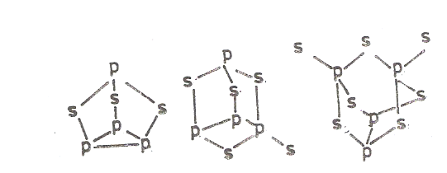
Sulfides:-
Phosphorous can combine with sulfur if a mixture of them heated over 100ºc giving many phosphorous sulfides depending on the ratio of P and S, e.g.:- P₄S₃, P₄S₅, P₄S₇, P₄S₁₀ which are covalent compounds, yellow in color, can be melted and distilled with decomposition.
P₄S₃ is used in match manufacturing, dissolves in organic solvents like benzene and CS₂. P₄S₁₀ likes P₄O₁₀ in structure.
Some sulfides structures:-
Phosphorous sulfides burn in air giving P₄O₁₀ and SO₂, hydrolyses in water to give oxo acids and H₂S.
Arsenic when melt with sulfur form As₄S₃, As₄S₄, As₂S₃ and As₂S₂. Arsenic sulfides do not hydrolyses in water to H₂S and oxo compounds.
Antimony with sulfur form compounds of the general formula (Sb₂S₃) and (Sb₂S₅) which have a polymeric structure, prepared from (1) direct reaction of Sb with S or (2) reaction of H₂S with antimonates and antimonites BiS₃ (deep brown ) produced from Bi (III) with H₂S.

Slide 37
Oxohalides:-
Phosphorous oxides POX₃ (X= F, Cl or Br) are the most important oxohalides of the group V elements. POCl3 prepared from
PCl₃ and oxygen reaction or by
2PCl₃ + O₂ 2POCl₃
PCl₅ and P₄O₁₀ reaction
6PCl₅ + P₄O₁₀ 10POCl₃
POX₃ has a distorted tetrahydral structure, P atom in the center and the O and the 3X atoms are at the corners. Also X₃PS compounds are known .
Compounds of P and N
Phosphor does not react directly with nitrogen, but oxides and sulfides react with ammonia at high temperature to form P₃N₅, P₂N₃ and PN which have a polymeric structure. A lot of compounds containing N-P bonds are known, two types of these bonds, P-N and P=N are known. Phosphazenes are important compounds. of (N and P) which are cyclic or chain compounds. They are 3parts:
Cyclic trimer compounds.
Cyclic tetramer compounds.
Oligmer and high polymer.
Bonds between (P and N) in phosphasines are equal in length and their bond order is 1.5, but they are mostly represented as P-N or P=N.

Slide 38
Organic Derivatives
There are a large number of organic derivatives of the group V elements which can be prepared in many methods, the simpler one is the reaction of halide or oxohalide of the element with Grignard reagent. Compound of the R₃MO types are stable, while R₃M types are easily oxidize. e.g. Me₃P burns when exposed to air oxygen.
R₃M (R=alkyl or phenyl, M=P As or Sb) form complexes with transition elements in which the atom (M) donates its nonbonding electron pair, while the (d) orbital in the valance shell of this atom (which is vacant) will accept electrons from the transition element. This type of ligand called (π-acid ligand), also R₃M form salts when react with alkyl or aryl halide –RX:
R₃M + R־X⁻ [R₃MR־] ⁺X⁻
These salts are called according to M atom, e. g. (C₆H₅).₄ As⁺ Cl⁻ compound. is called , tetraphenyl arsenium chloride.
Antimony only forms R₅M compounds of (t bp), aryl compounds are more stable than alky compounds. Antimony has derivatives of R₄Sbx, R₃Sbx_{2 ,} where
X=OH, OR or X or NO₃⁻ or ClO₄⁻ etc.

Slide 39
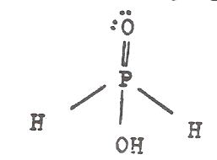
Oxo acids:
Phosphorous Oxo acids :
Hypophosphorous acid:
Ba(H₂PO₂)₂+H₂SO₄ 2H[H₂PO₂]+Baso₄
It is a colorless crystals , m. p. 26.5cº, the structure is:
monobasic acid (can lose H⁺ to give [H₂PO₂] ion)
as referred to it by (NMR) spectrum

Slide 40
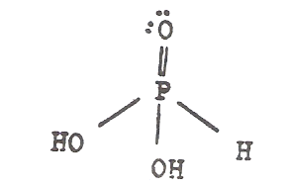
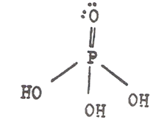
b. Phosphorous acid H₃PO₃
Is prepared from PCl₃ or P₄O₆ reaction with cold water. The pure acid melts at 70Cº (PK_{a}=1.8) it’s structure is:
dibasic acid (can lose two H⁺ to form [HPO₃]⁻² ion)
This acid and its salts are strong reducing agents.
c. Phosphoric acid H₃PO₄
The most of the phosphorous compounds, prepared from H₂SO₄ with phosphate rocks or from P₄O_{1O} with water reaction. This acid is tribasic, has three types of salts, M₃PO₄, M₂HPO₄ and MH₂PO₄. The free acid is solids, melts at 42.35 Cº.
.

Slide 41
d. Pyrophosphoric acid H₄P₂O₇
produced as:
H₃PO₄ + H₃PO₄ H₄P₂O₇+H₂O (m.61Cº)
Two molecules of phosphoric acid .

Slide 42
Phosphates:
A proximately all the metal elements have phosphates which used as fertilizers, e.g. Ammonium phosphate.
Other phosphate type is the condensed which are of three types:
Linear poly phosphate (e.g. M₄P₂O₇) (PnO_{3n+1})
Cyclic poly phosphate (P_{n}O_{3n})^{n}-,e.g. Trimeta phosphate M₃P₃O₉ and M₄P₄O₁₂ tetra…
Long chain metaphosphate , e.g. KPO₃.
Oxo acids of As, Sb and Bi
Examples:
As(OH)₃ Arsenous acid.
H₃A_{S}O₄ Arsenic acid.
H₇SbO₆ Antimonic acid (not know as free , but in solution).
Antimony salts are called Antimonite and Antimonate.
Bismothate are not known as pure but by the reaction of Cl₂ Bi(OH)₂ in strong basic solutions or by heating of Na₂O₂ with Bi₂O₂ to give NaBiO₃.
Bismothates are strong oxidizing agents.

