Slide 1
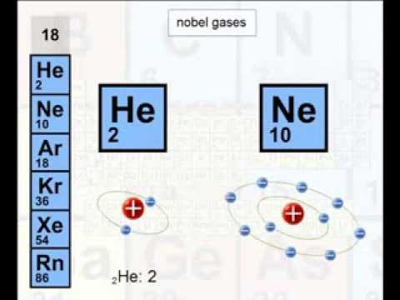
الغازات النبيلة

Slide 2
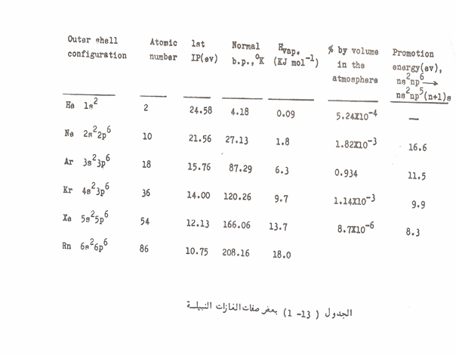

Slide 3

Fluorides

Slide 4


Xenon (II) Compounds
1- Xenon difluoride

Slide 5
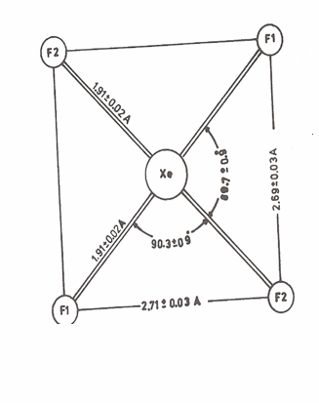
Xenon (IV) Compound
1- Xenon tetrafluoride

Slide 6





Slide 7
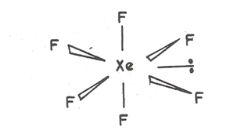
Xenon (VI) Compounds
1-Xenon hexaflouride

Slide 8
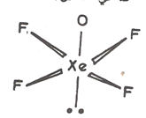

2-Xenon Oxide tetra Fluoride

Slide 9
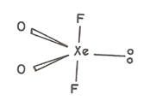

3- Xenon dioxide difuoride

Slide 10

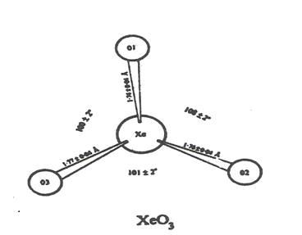
4- Xenon trioxide
5- Xanata (VI)

Slide 11

Xenon (VII) Compounds
1- Xenon Octafluorides
2-Xenon trioxide difluoride

Slide 12
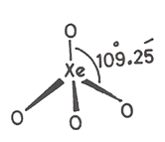
3- Xenon tetraoxide

