Slide 1
Blood urea
Clinical biochemistry laboratory
5th stage

Slide 2
Introduction
The Blood Urea Nitrogen BUN measures the amount of urea nitrogen in blood.
Urea is the main product of protein metabolism.
Urea is formed from NH3 and CO2 then transport by blood to kidneys for excretion.

Slide 3
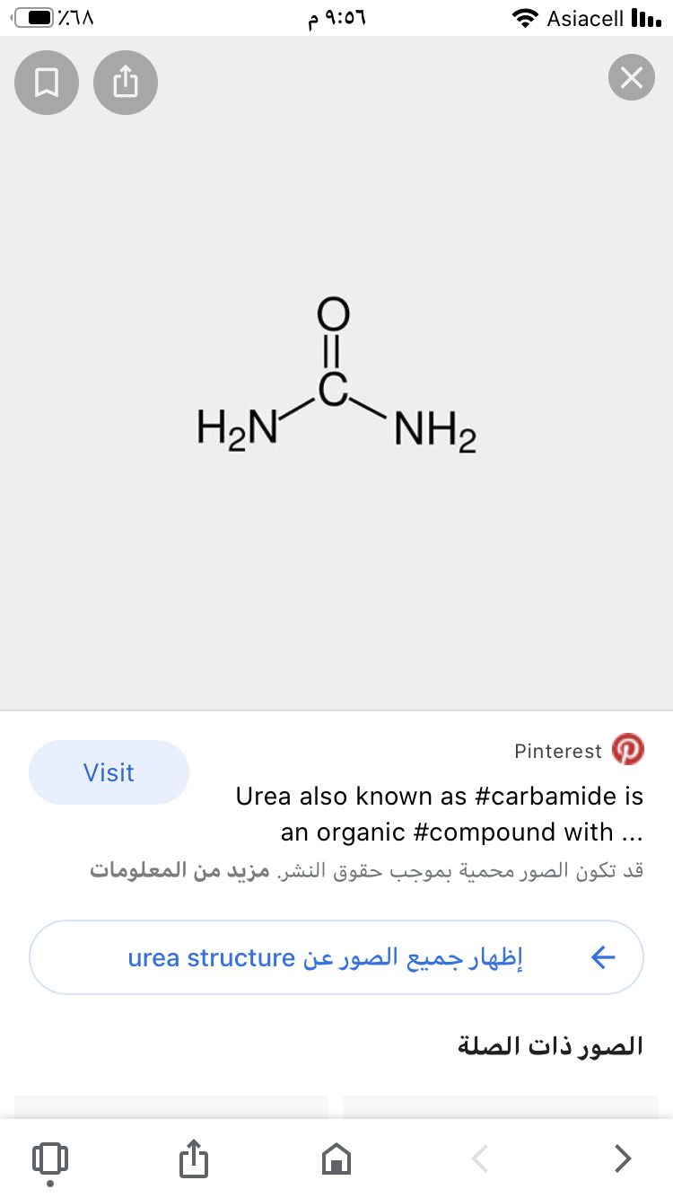
Structure of Urea

Slide 4
Causes of high urea level
Pre-Renal causes.
Renal causes.
Post renal disease.

Slide 5
Azotemia
Elevated level of blood urea nitrogen is referred to as Azotemia.
If urea > 36 mmol/l or >100 mg/dl indicates serious impairment of renal function.

Slide 6
Method used for estimation of blood urea
Nessler method
Diacetyl monoxime method
Urea kit( Brethelot test)

