Slide 1
The digestive system
Second Stage /2023-2024
By
Asst.Prof.Dr. Sawsan Kadhim Mashi

Slide 2
The digestive system consists of the parts of the body that work together to turn food and liquid into the building blocks and fuel that the body needs. The digestive system is made up of:
1-The gastrointestinal tract (GIT) also called the digestive tract. The GIT is a series of organs joined in a long, twisting tube from the mouth to the anus (mouth, esophagus, stomach, small intestine, large intestine which includes rectum and anus).
2-Accessories organs: liver, gall bladder, pancreas and salivary glands.
3-Bacteria found in GIT also called Gut flora or microbiome, it help with digestion.

Slide 3
The function of digestive system: It can be summarized as follows
1-Ingestion (eat food)
2-Digestion (breakdown food)
3-Absorption (extraction of nutrients from the food)
4-Defecation (removal of waste products)

Slide 4
According to the type of feeding some animals:
1-Herbivores eat plants.
2-Carnivores eat the herbivores.
3-Omnivores many animals feed on both animal and vegetable material
-Herbivores have an appendix which they use for the digestion of cellulose. Carnivores have an appendix but is not of any function anymore due to the fact that their diet is not based on cellulose anymore.

Slide 5
The mouth
The tongue: is a muscular organ moves food around the mouth and rolls it into a ball called (bolus) for swallowing.
Mastication (chewing): is the mechanical digestion. cheeks, tongue, and teeth involved in both voluntary and involuntary grinding, ripping, and tearing of foodstuff.
Taste buds: are located on the tongue and in dogs and cats it is covered with spiny projections used for grooming and lapping. The cow’s tongue is prehensile and wraps around grass to graze it.

Slide 6
Teeth: seize, tear and grind food
The Salivary glands: consist of the parotid, submandibular, and sublingual glands as well as numerous smaller buccal glands.
There are three types of salivary glands:
Most animals have three major pairs of salivary glands that differ in the type of secretion they produce:
1- Parotid glands: produce a serous, watery secretion.
2-sublingual glands: secrete saliva that is predominantly mucous in character.
3- Submaxillary (mandibular) glands: produce a mixed serous and mucous secretion.

Slide 7
Regulation of Salivary Secretion:
Salivation is controlled via the system from the salivary nuclei in the brain stem.
Factors that induce salivation include:
-Taste stimuli, especially sour taste
-Higher centers especially appetite anticipation, smells and visual clues
- Signals from the stomach and upper GI tract, particularly irritating stimuli.

Slide 8
Saliva components | Physiological function
Mucin | -lubricate food -Protect teeth against acid -Help protect against bacteria, viruses and fungi
Digestive Enzymes | -Amylase: digests starchs -Lipase : digests fats, antibacterial and oral hygiene -Protease: digests proteins of bacteria
Bicarbonate ions (HCO3) Phosphate ions, Proteins | Buffer: help in protect teeth and soft tissues against acidic conditions
Calcium ions, phosphate ions | Help in maintain mineral content of teeth enamel
Haptocorrin (R-Factor) | Help with the absorption of Vitamin B12

Slide 9
The pharynx
Deglutition (swallowing)
Step 1: Oral phase: (Voluntary) control by brain cortex. A mass of chewed, moistened food (a bolus), is moved to the back of the mouth by the tongue. In the pharynx, the bolus triggers an involuntary swallowing reflex that prevents food from entering the lungs, and directs the bolus into the esophagus.
Step 2: pharyngeal phase: brainstem reflex. Muscles in the esophagus push the bolus by waves of involuntary muscular contractions (peristalsis) of smooth muscle lining the esophagus.
Step 3: Esophageal phase: brainstem reflex .The bolus passes through the gastroesophageal sphincter called Lower Esophageal Sphincter (LES), into the stomach by primary peristaltic waves. A secondary peristaltic wave clears residual materials
Heartburn: results from irritation of the esophagus by gastric juices that leak through this sphincter.

Slide 10
The simple Stomach
The stomach is an expanded section of the digestive tube between the esophagus and small intestine. regions of the stomach: Cardia, Fundus, Body, Antrum and Pylorus. as food is liquefied in the stomach it passes through the pyloric canal into the small intestine. There are two sphincters:
Lower esophageal sphincter-
Pyloric sphincter-

Slide 11
Gastric secretion
1-Pepsin: It is produced by the chief cells in its inactive form pepsinogen. Pepsinogen is then activated by the stomach acid (HCl) into its active form pepsin. Pepsin breaks down the protein in the food into smaller particles such as peptide fragments and amino acids.
2-Hydrochloric acid (HCl): is produced by the parietal cells.
HCl functions:
1-denature the proteins ingested, to destroy any bacteria or virus that remains in the food.
2- Activate pepsinogen into pepsin.
Mechanism for HCl production:
The H+ is derived from H2O and CO2 reaction to form carbonic acid regulated by the enzyme carbonic anhydrase. In the cell, The Cl_ from the blood enters the cell in exchange with bicarbonate.

Slide 12
Stimulation of Gastric Acid secretion.
a- Histamin release by enterochromaffin-like cells (ECL).
b- Gastrin secreted by the G cells in the antrum of the stomach.
c- Acetylcholine release from the vagus nerve.
3-Intrinsic factor (IF): Intrinsic factor is produced by the parietal cells of the stomach then binds Vitamin B12, creating a Vit. B12-IF complex, this complex is then absorbed at the terminal portion of the ileum.
4-Mucin: secreting mucin and bicarbonate via its mucous cells, to protect lining of the stomach.
5-Gastrin: This is an important hormone produced by the "G cells" of the stomach.. Gastrin is an endocrine hormone and therefore enters the bloodstream and eventually returns to the stomach where it stimulates parietal cells to produce hydrochloric acid (HCl) and Intrinsic factor (IF).

Slide 13
6-Gastric Lipase: Gastric lipase is an acidic lipase secreted by the gastric chief cells in the fundic mucosa in the stomach.
Function of the stomach
1-Mechanical digestion
2-Secreation of acid (HCl) aid in activation of pepsinogen
3-Digestion of proteins by active pepsine
4-Absorbtion of water and electrolytes
5-Synthesis of gastric intrinsic factor (GIF), is a glycoprotein produced by the parietal cells of the stomach, It is necessary for the absorption of vitamin B12.

Slide 14
The small intestine
The small intestine is the site where almost all of the digestion and absorption of nutrients and minerals from food takes place. It consists of three segments forming a passage from the pylorus to the large intestine:
-Duodenum: a short section that receives secretions from the pancreas and liver via the pancreatic and common bile ducts.
-Jejunum: considered to be roughly 40% of the small gut in man, but closer to 90% in animals.
-Ileum empties into the large intestine; considered to be about 60% of the intestine in man, but veterinary anatomists usually refer to it as being only the short terminal section of the small intestine.

Slide 15
Physiological structure of small intestine
-Mucosal folds: The inner surface of the small intestine is not flat, but thrown into circular folds which aid in :
1- Increase surface area 2- Mixing the ingesta with digestive enzymes.
-Villi: The mucosa form multitudes of finger shape projection which protrude into the lumen and are covered with absorptive epithelial cells called Enterocytes.

Slide 16
The benefit of the villi:
Increase the internal surface area of the intestinal wall area to be available for absorptive which is useful because digestive nutrient (including sugar and amino acids) pass into the villi which is semi-permeable, through diffusion that effective only at short time.
-Microvilli: The lumenal plasma membrane of absorptive epithelial cells is studded with densely-packed microvilli.
Brush border: The microvillus border of intestinal epithelial cells are called brush border.
Enzymes of brush border: Maltase, Lactase, sucrase, Peptidase and Lipase.

Slide 17
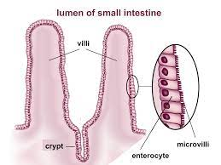

Slide 18
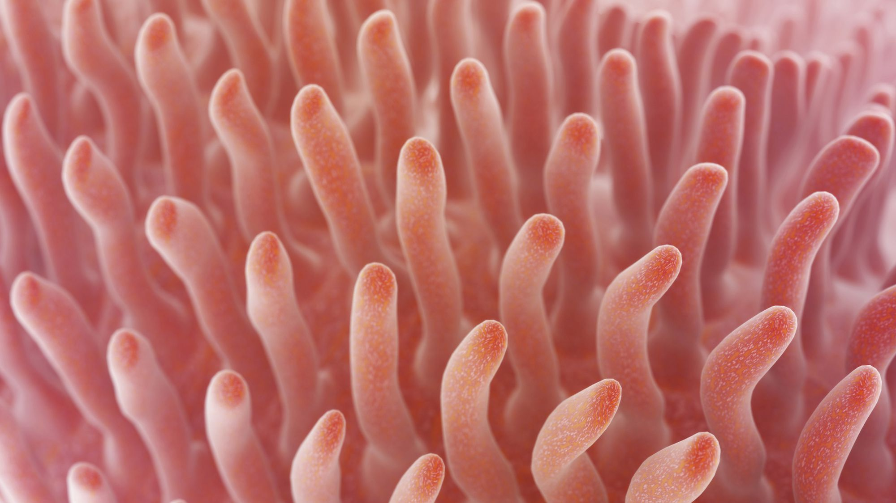

Slide 19
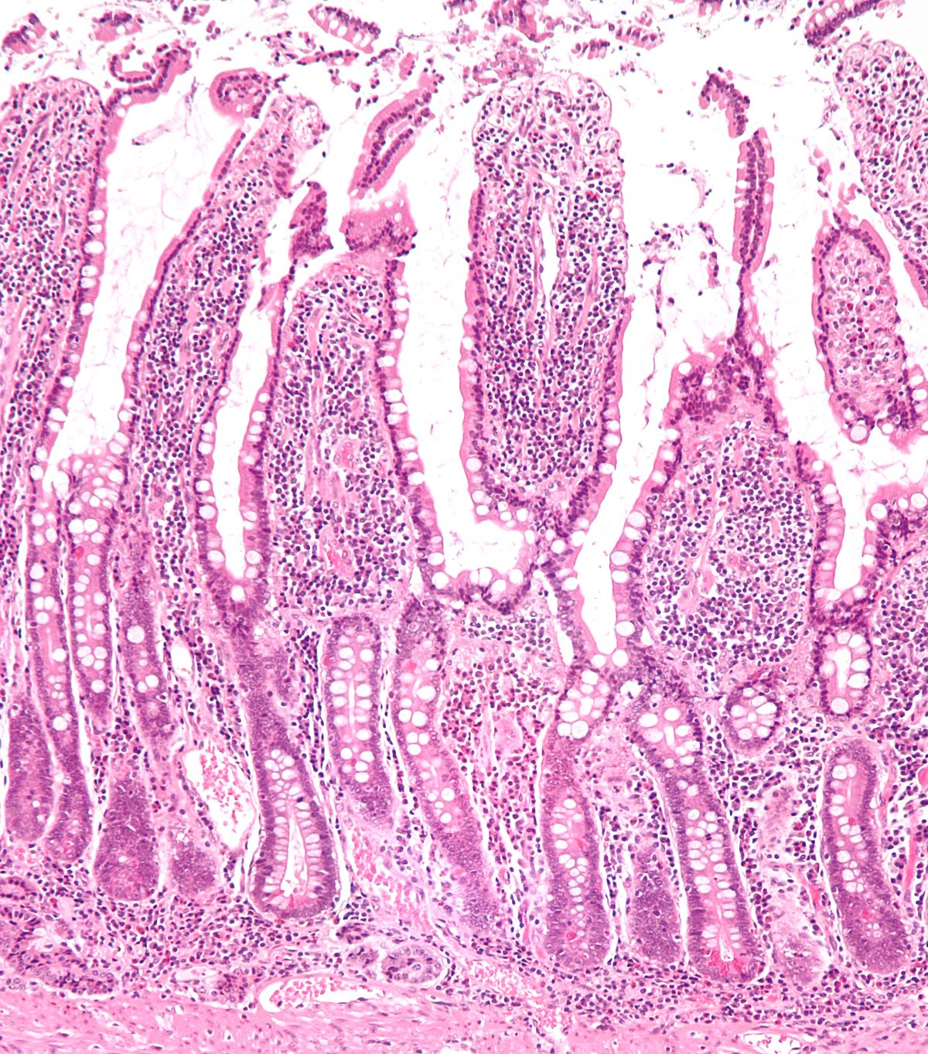

Slide 20
Intestinal functions:
1-Chemical digestion by digestive enzymes:
Pancreatic secretion
Intestinal secretion
Biliary secretion
2-Absorption
Enterocytes which mature into absorptive epithelial cells cover the villi these cells deliver into blood all nutrients from the diet.
3-Enteroendocrine cells: secret cholecystokinin (CCK) and Gastrin hormone, gastrin inter the blood then inter the stomach and stimulate the parietal cells to secret Hcl and If.

Slide 21
4-Lubrication the intestinal lumen: Goblet cells secret lubricating mucosa.
5-Antibacterial function: Paneth cells provide anti-microbial substances that protect the intestinal mucosa.
6-Stem cells: Allow rapid and constant turnover of small intestinal epithelial cells.

Slide 22
Large intestine
The waste products of the digestive process include undigested parts of food and older cells from the GI tract lining. Muscles push these waste products into the large intestine. The large intestine absorbs water and any remaining nutrients and changes the waste from liquid into stool. The rectum stores stool until it pushes stool out of the body during a bowel movement.

Slide 24
Pancreas
The pancreas is a gland located near the beginning of the duodenum (see diagram 1). In most animals it is large and easily seen but in rodents and rabbits it lies within the membrane linking the loops of the intestine (the mesentery) and is quite difficult to find. The pancreas makes pancreatic juice consisting of:
1- Enzymes (amylases, lipases, and proteases)
2- Bicarbonate, which helps neutralize acidic secretions produced during digestion

Slide 25
Regulation of pancreas secretion
The pancreas delivers the pancreatic juice to the small intestine, in response to a signal in three phases:
1. The cephalic phase: is elicited before food reaches the stomach. Olfactory signals (via the limbic system) as well as visual and tactile signals (via the thalamic relay station) are processed in the brain, and vagal signals reach the stomach mucosa, gastrin is released from G-cells. Gastrin induces the secretion of pancreatic juice.
2. The gastric phase: is elicited by the presence of food in the stomach. Gastric distension and more gastrin from the G-cells stimulate of pancreatic juice.
3. The intestinal phase: When chyme enters the duodenum both secretin and CCK is released. Secretin stimulates both the secretion of bicarbonate and water by pancreatic duct cells.

Slide 26
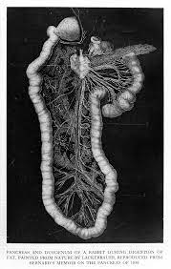

Slide 27
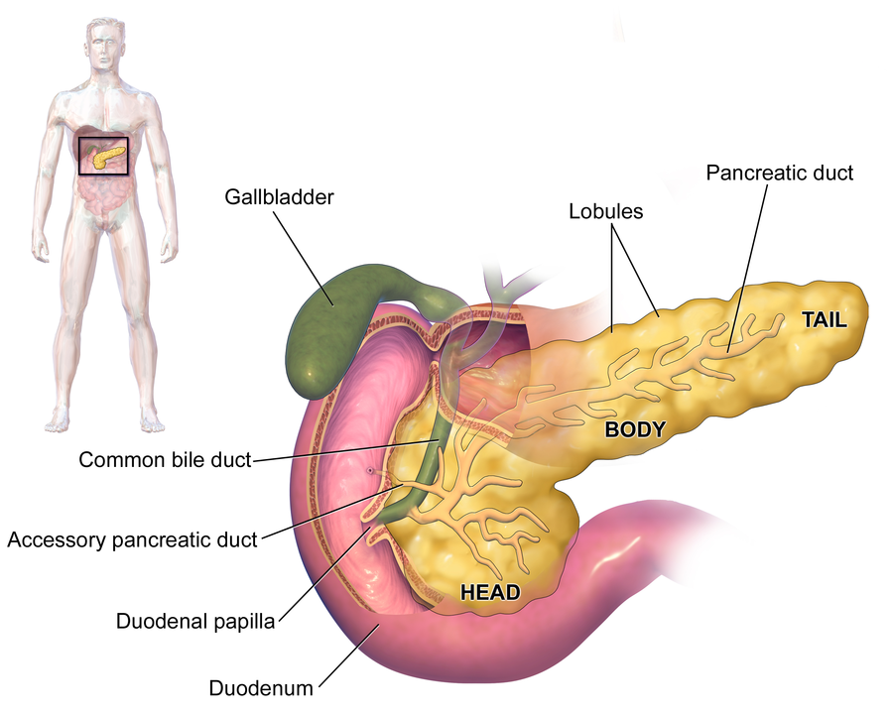

Slide 28
The Liver
The liver is situated in the abdominal cavity adjacent to the diaphragm. It is the largest single organ of the body and has over 100 known functions.

Slide 29
The liver, gall bladder and pancreas

Slide 30
The most important function of the liver:
1- The production of bile: an emulsifier, which enters the small intestine and prepares fats and oils for digestion. This bile is stored in the gallbladder prior to delivery to the small intestine. A hormone called cholecystokinin helps control the release of bile.
2-the control of blood sugar levels: glucose is absorbed into the capillaries of the villi of the intestine. The blood stream takes it directly to the liver via a blood vessel known as the hepatic portal vessel or vein (see diagram 2), the liver converts this glucose into glycogen which it stores. When glucose levels are low the liver can convert the glycogen back into glucose. It releases this back into the blood to keep the level of glucose constant.

Slide 31
control of blood glucose by the liver

Slide 32
4. Making the proteins that are found in the blood plasma (albumin, globulin and fibrinogen).
5. Storage iron.
6. Removing toxic substances like alcohol and poisons from the blood and converting them to safer substances.

Slide 33
Factors affecting bile secretion:
A-Choleretics: Choleretics are substances that increase bile secretion by the liver (Bile salts and the secretin hormone)
B-Cholagogues: These are substances that cause contraction of the gallbladder, thus increasing the bile flow into the duodenum (CCK).

Slide 34
Bile acids:
Are steroid acids found in the bile of mammals and other vertebrates. There are three types of bile acids:
1-Primary bile acids: are those synthesized by the liver.
2-Secondary bile acids: result from bacterial action in the colon.
3-conjugated bile acids: which conjugated with taurine or glycine in the liver forming bile salts.

Slide 35
Function of bile acids:
All their physiological functions are performed in the conjugated form:
1- They are the major route of the elimination of cholesterol from body.
2-Bile acids are strong surfactants.
3-At the intestinal level, they modulate the secretion of pancreatic enzymes and cholecystokinin (CCK).
4-In the small and large intestine they have potent antimicrobial activity.
5-They have regulatory role in the control of energy metabolism and in particular for hepatic glucose handling.

Slide 36
Digestion and absorption
Digestion: is the breakdown of food into smaller particles or individual nutrients.
There are two types of digestion: mechanical and chemical digestion
The process of mechanical digestion is relatively simple; it involves the physical breakdown of food but does not alter its chemical makeup. Chemical digestion, on the other hand, is a complex process that reduces food into its chemical building blocks, which are then absorbed to nourish the cells of the body.
Absorption: is the movement of molecules across the gastrointestinal (GI) tract into the circulatory system.

Slide 37
ANATOMICAL BASIS OF ABSORPTION
The total quantity of fluid that must be absorbed each day by the intestines is equal to the ingested fluid (about 1.5 liters) plus that secreted in the various gastrointestinal secretions (about 7 liters), which comes to a total of 8 to 9 liters, leaving only 1.5 liters to pass through the ileocecal valve into the colon each day.
The stomach is a poor absorptive area of the gastrointestinal tract because it lacks the typical villus type of absorptive membrane, and also because the junctions between the epithelial cells are tight junctions, while most absorption occurs in small intestine because the small intestinal mucosa have three main structures (Folds of Kerckring, Villi, and Microvilli) which are increase the surface area of absorptive mucosa nearly 1000- fold.

Slide 38
Digestion and absorption of lipids
Lipase, an enzyme in the pancreas and the small intestine and bile from the liver, break down lipids into fatty acids and monglycerides, these end-products then are absorbed through villi cells as triglycerides.

Slide 40
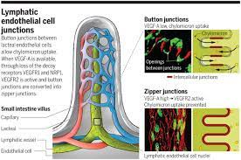

Slide 41
Lacteal: A lymphatic capillaries that absorbs dietary fat into the villi of small intestine.
Chylomicrons: Are lipoprotein particles that consist of triglycerides, phospholipids, cholesterol and proteins. They transport dietary lipids from small intestine to other locations in the body like adipose cells and liver.

Slide 42
Digestion and absorption of Carbohydrates
Dietary starches are composed of glucose units arranged in long chains called amylose, a polysaccharide. During digestion, bonds between glucose molecules are broken by salivary and pancreatic amylase, resulting in progressively smaller chains of glucose. This results in simple sugars glucose and maltose that can be absorbed by the small intestine. Carbohydrates, including both sugar and starch molecules, are broken down by enzymes in the intestine to disaccharides called sucrose, lactose, and maltose, and then finally into the end-products known as glucose, fructose, and galactose, which are absorbed mostly by active transport.

Slide 43
-Glucose and galactose: These are transported from the intestinal lumen into the cells by Na dependent co transport in the luminal membrane. This sugar is transported uphill and Na is transported downhill. These are then transported from cell to blood by diffusion Sodium ion moves laterally into the intercellular space From here , it is transported into blood by active transport In this process the energy is utilized which is liberated by breakdown of ATP.
-Fructose: It is absorbed into the blood by means of facilitated diffusion some molecules of fructose are converted into glucose, the glucose is absorbed by the small intestine.

Slide 44
Digestion and absorption of Proteins:
Proteins are broken down by proteases they are absorbed as dipeptides, tripeptides, and individual amino acids.

Slide 46
ISOSMOTIC ABSORPTION OF WATER
Water is transported through the intestinal membrane entirely by diffusion. Furthermore, this diffusion obeys the usual laws of osmosis. Therefore, when the chyme is dilute enough, water is absorbed through the intestinal mucosa into the blood of the villi almost entirely by osmosis Conversely, water can also be transported in the opposite direction—from plasma into the chyme. This type of transport occurs especially when hyperosmotic solutions are discharged from the stomach into the duodenum. Within minutes, sufficient water usually will be transferred by osmosis to make the chyme isosmotic with the plasma ( having the same osmotic pressure).

Slide 47
Absorption of Vitamins
1- The water-soluble vitamins (vitamin B and vitamin C) are absorbed easily along with the water in the small intestine, where they then travel through the body via the blood vessels.
2- Fat-soluble vitamins (vitamins A, D,E, and K) are absorbed just like the fat. Once absorbed. However, they are stored for long periods of time in cells called lipocytes. Water-soluble vitamins don't stay in your body for long. Extra amounts of these are usually eliminated in urine.

Slide 48
ABSORPTION IN THE LARGE INTESTINE
About 1500 milliliters of chyme normally pass through the ileocecal valve into the large intestine each day. Most of the water and electrolytes in this chyme are absorbed in the colon, usually leaving less than 100 milliliters of fluid to be excreted in the feces. Also, essentially all the ions are absorbed, leaving only 1 to 5 mEq each of sodium and chloride ions to be lost in the feces.
Most of the absorption in the large intestine occurs in the proximal one half of the colon, giving this portion the name absorbing colon, whereas the distal colon functions principally for feces storage until a propitious time for feces excretion and is therefore called the storage colon.

Slide 49
Maximum Absorption Capacity of the Large Intestine
The large intestine can absorb a maximum of 5 to 8 liters of fluid and electrolytes each day. When the total quantity entering the large intestine through the ileocecal valve or by way of large intestine secretion exceeds this amount, the excess appears in the feces as diarrhea.

