Slide 1

Applied Example
Linear Programming
$2^{nd}$ Class
Department of Mathematics
College of Science
University of Baghdad
Dr. Iraq Tareq Abbas

Slide 2
Applied Example
A company makes 2 types of computers x and y
The company can make a total of 80 computers per day
And it has 240 work hours available per day. It takes 2 work hours to make a computer x and 6 work hour to make a computer y.
The profit on computer x is 80$ and the profit on computer y is 120$.
How many of each should be made to Maximize the profit?

Slide 3



A company makes 2 types of computers x and y
Applied Example
The company can make a total of 80 computers per day
$x + y≤80.$
And it has 240 work hours available per day. It takes 2 work hours to make a computer x and 6 work hour to make a computer y.
$2x +6y≤240.$
The profit on computer x is 80$ and the profit on computer y is 120$.
$P=80x +120y.$
How many of each should be made to Maximize the profit?

Slide 4
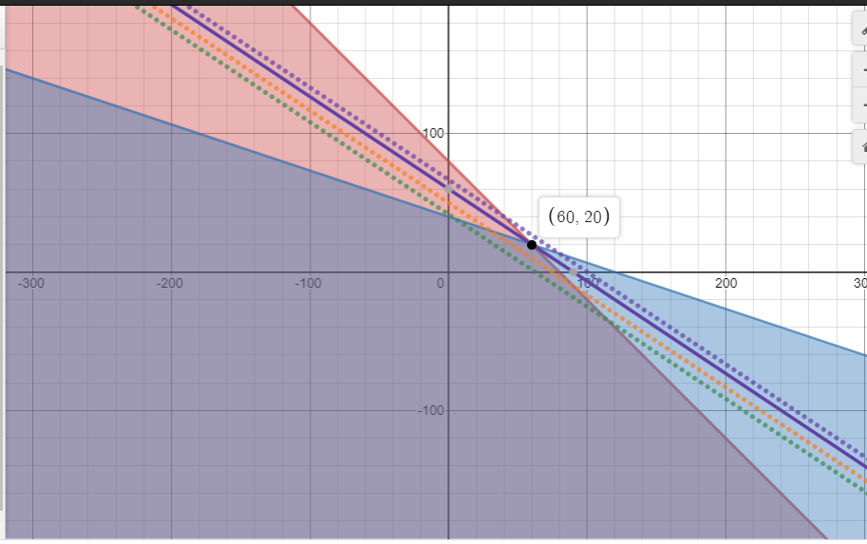
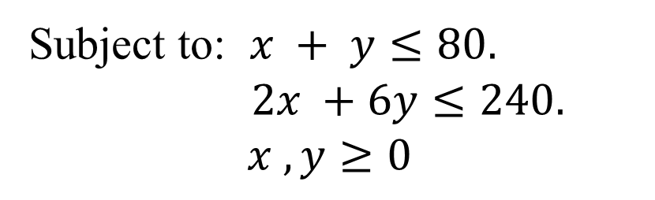
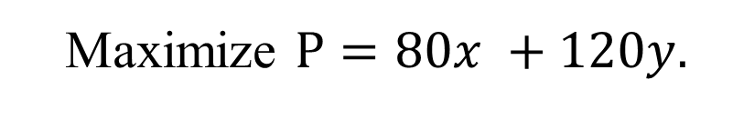


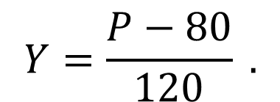
Solution:
Maximize $P=80x +120y.$
Subject to: $x + y≤80.$
$2x +6y≤240.$
$$x , y≥0$$
(0,80)
(0,40)
(80,0)
(120,0)
$$Y=\frac{P−80}{120} .$$
$$P=5000,6000 or 8000$$
$P=$7200

Slide 5
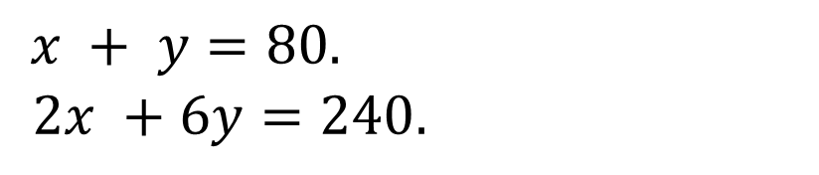
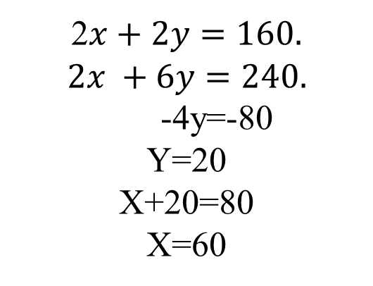
Solution:
$x + y=80.$
$2x +6y=240.$
2$x+2y=160.$
$$2x +6y=240.$$
-4y=-80
Y=20
X+20=80
X=60

Slide 6
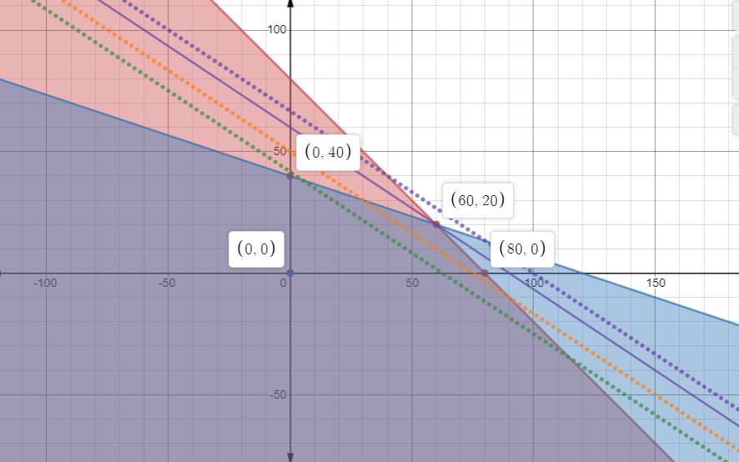
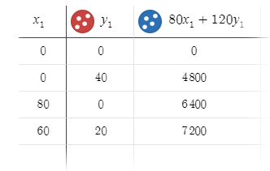
Solution:

Slide 7
Any Question
You can find me at
Iraq.t@uo.scbaghdad.edu.iq
Thank You

