Slide 1
Microprocessor 8086

Slide 2
Memory Write Operation
1. The word to be stored into the memory location is first loaded by the CPU into a specified register, called the memory data register (MDR).
2. The address of the location into which the word is to be stored is loaded by the CPU into a specified register, called the memory address register (MAR).
3. A signal, called write, is issued by the CPU indicating that the word stored in the MDR is to be stored in the memory location whose address in loaded in the MAR.

Slide 3
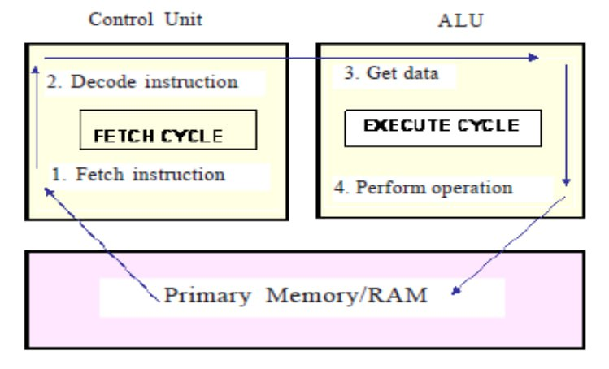

Slide 4
Microprocessor 8086
8086 microprocessor has a 16-bit data bus and 20-bit address bus. So, it can address any one of 2²⁰ =1048576=1 megabyte memory locations
INTEL 8088 has the same ALU, same registers and same instruction set as the 8086.But the only difference is 8088 has only 8-bit data bus and 20-bit address bus. Hence the 8088 can only read/write/ports of only 8-bit data at a time

Slide 5
Minimum mode and Maximum mode
The 8086 microprocessor can work in two modes of operations .
They are Minimum mode and Maximum mode. In the minimum mode of operation the microprocessor do not associate with any co-processors and cannot be used for multiprocessor systems. But in the maximum mode the 8086 can work in multi-processor or co-processor configuration. This minimum or maximum operations are decided by the pin MN/ MX.
When this pin is high 8086 operates in minimum mode otherwise it operates in Maximum mode

Slide 6
8086 Microprocessor features
1. It is 16-bit microprocessor.
2. It has a 16-bit data bus, so it can read data from or write data to memory and ports either 16-bit or 8-bit at a time.
3. It has 20 bit address bus and can access up to 2²⁰ memory locations (1 MB).
4. It can support up to 64K I/O ports.
5. It provides 14, 16-bit registers.
6. It has multiplexed address and data bus AD0-AD15 & A16-A19.
7. Pre-fetches up to 6 instruction bytes from memory and queues them in order to speed up the processing.
8. 8086 supports 2 modes of operation
a. Minimum mode
b. Maximum mode

Slide 7
Architecture of 8086 microprocessor
To improve the performance by implementing the parallel processing concept the CPU of the 8086 /8088 is divided into two independent sections .
They are Bus Interface Unit (BIU)
and Execution Unit (EU) as shown in figure 2.

Slide 8
Architecture of 8086 Microprocessor

Slide 9
Bus Interface Unit (BIU):
It provides a full 16 bit bidirectional data bus and 20 bit address bus.
the bus interface unit connects the microprocessor to external devices.
BIU performs following operations:
Instruction fetching.
Reading and writing data of data operands for memory.
Inputting/outputting data for input/output peripherals.
And other functions related to instruction and data acquisition.
To implement above functions, the BIU contains the segment registers, the instruction pointer, address generation adder, bus control logic, and an instruction queue.
.

Slide 10
Bus Interface Unit
The BIU uses a mechanism known as an instruction stream queue to implement pipeline architecture

Slide 11
Execution Unit (EU)
The Execution unit is responsible for decoding and executing all instructions.
The EU consists of arithmetic logic unit (ALU), status and control flags, general‐purpose registers, and temporary‐operand registers.
The EU extracts instructions from the top of the queue in the BIU, decodes them ,generates operands if necessary, passes them to the BIU and requests it to perform the read or write by cycles to memory or I/O and perform the operation specified by the instruction on the operands.
During the execution of the instruction, the EU tests the status and control flags and updates them based on the results of executing the instruction

Slide 12
Pipelining Architecture in 8086mp
While the EU is decoding an instruction or executing an instruction, which does not require use of the buses, the BIU fetches up to six instruction bytes for the following instructions.
• The BIU stores these pre-fetched bytes in a first-in-first-out register set called a queue.
• When the EU is ready for its next instruction from the queue in the BIU. This is much faster than sending out an address to the system memory and waiting for memory to send back the next instruction byte or bytes.

Slide 13
Pipelining Architecture in 8086mp
• Except in the case of JMP and CALL instructions, where the queue must be dumped and then reloaded starting from a new address, this pre-fetch and queue scheme greatly speeds up processing.
• Fetching the next instruction while the current instruction executes is called pipelining.

Slide 14
Register Organization
The 14 registers of 8086 microprocessor are categorized into four groups. They are general purpose data registers, Pointer & Index registers, Segment registers, Instruction register, and Flag register as shown in the table below

Slide 15
Register Organization

Slide 16
1. General Purpose Registers:
8086 CPU has 8 general purpose registers; these registers can be divided into:
a) Data registers: four 16 bits data registers
b) Pointer and index registers: two 16 bits pointer registers and two 16 bits index registers
a) Data Registers: they are four registers (AX, BX, CX, and DX) which used for arithmetic and data movement. Each register can be addressed as either 16-bit or 8 bit value. Example, AX register is a 16-bit register, its upper 8-bit is called AH, and its lower 8-bit is called AL. Bit 0 in AL corresponds to bit 0 in AX and bit 0 in AH corresponds to bit 8 in AX as shown in the figure below.

Slide 18
Accumulator register (AX): It is the accumulator register because it is favored by the CPU for arithmetic operations. Other operations are also slightly more efficient when performed using AX.
❖ Base register: The BX register can hold the address of a procedure or variable. Three other registers with this ability are SI, DI and BP. The BX register usually contains a data pointer used for based, based indexed or register indirect addressing. BX register can also perform arithmetic and data movement.

Slide 19
Count register: The CX register acts as a counter for repeating or looping instructions. These instructions automatically repeat and decrement CX.
❖ Data register: DX In integer 32-bit multiply and divide instruction the DX register contains high order word of the resulting number. DX register can be used as a port number in I/O operations.

Slide 20
b) Index and Pointer Register
There are four 16-bits registers two serve as pointers and two serve as indexes. These registers usually store offset address used for addressing within the segment

Slide 21
Index and Pointer Register
Source Index (SI): is a 16-bit register. SI is used for indexed, based indexed and register indirect addressing. As well as source data address in string manipulation instructions. Used in conjunction with DS register to point to data locations in the data segment.
❖ Destination Index (DI) is a 16-bit register. Used with the ES register in string operations. DI is used for indexed, based indexed and register indirect addressing, as well as a destination data address in string manipulation instructions.

Slide 22
Index and Pointer Register
Stack Pointer (SP): is a 16-bit register pointing to stack, it is used to hold the address of the top of the stack. The stack is maintained as LIFO with its bottom at the start of the stack segment (Specified by the SS segment register). Unlike the SP register, the BP can be used to specify the offset of other program segments.
❖ Base Pointer (BP): is a 16-bit register pointing to stack segment. It is usually used by subroutine to locate variables that were passed on stack by calling program. BP register is usually used for based, based indexed or register indirect addressing.

