Slide 1
GENETICS
Prof . Isam AL-Zwaini

Slide 2
Introduction
Genetics is a postmodern science, the applications of which are critical to all stages of life and to all manner of disease.
Genetic studies have many applications in clinical practice including:
Inherited component of common disease ( approach to diagnosis, genetic counseling, and screening of individuals at risk for genetic disease)
Congenital malformation
Cancer
The genetic abnormalities responsible for many acute and chronic diseases that have onset at different stage of life (fetal, at birth, childhood or adulthood). These genetic abnormalities might produce
Congenital malformation ( Down syndrome)
Metabolic disorder ( G6PD)
Single organ dysfunction ( VSD)
Sex differentiation abnormalities ( Turner and Klinefelter)

Slide 3
Cytogenetic

Slide 4
Principles of genetics - Cytogenetic
Cytogenetic is the study of genetic at chromosomal level.
Chromosomal anomalies occur in 0.4 % of all life birth and are a prevalent cause of:
Mental retardation.
Congenital anomalies at birth.
Abortion.
Still birth.
The nuclei of all normal human cells, with the exception of gametes, contain 46 chromosome (23 pairs), 22 of them are autosome (arrange according to their size) and 2 sex chromosome (XX or XY).
The 2 member of chromosome pair called Homolog chromosome. One homolog of each chromosome is maternal in origin (egg); the second is paternal (sperm). The egg and sperm each contain 23 chromosomes (haploid cells). During the formation of the zygote, they fuse into a cell with 46 chromosomes (diploid).

Slide 5
Chromosomal abnormalities
Abnormalities of chromosome number:
When human cells has 23 chromosome (ova, sperm), it is in the haploid state (n). After conception the cells (other than the reproductive one) has 46 chromosomes (diploid state; 2n).
Polyploidy: cells contain any number other than the usual diploid number of the chromosome.
Euploid : number is exact multiple of haploid ( 46;2n, 69; 3n, 92; 4n)
Aneuploid: deviation from the multiple of haploid (not euploid) which mean abnormal number of chromosome e.g. trisomy which mean the presence of 3 rather than 2 particular chromosome. This trisomy results from unequal division ( non disjunction) of chromosome into daughter cells e.g. Down syndrome, Edward syndrome and Patau syndrome

Slide 6
Abnormalities of the structure:
Deletion (del): absence of normal chromosome material. It may be terminal (at the end of chromosome) or interstitial (within the material). Writing is as the following:
46, XX, del (1) (p36.3): this chromosome nomenclature describe the loss of genetic material from the bond 36.3 of the short arm of chromosome 1. Example of this abnormality is Cri-du –cat syndrome which deletion of short arm of chromosome 5 (5p) characterized by unusual high pitched cry and dysmorphic features.
Duplications (dup): extra copy of a chromosomal segment can be tandem (genetic material present in the original direction) or inverted (in the opposite direction). Example is 22q11 which is the cat eye syndrome characterized by iris coloboma and anal or ear abnormalities.
Inversion (inv): arrange section of chromosome is inverted.
Ring chromosome (r): abnormalities cause circular chromosome characterized by growth retardation and mental retardation.
Translocation (tran): inter chromosomal rearrangement of genetic material. This could be balanced (no change in genetic material) or unbalanced (there is loss or gain of genetic material).
Insertion (ins): breakage within a chromosome at 2 points and incorporation of another piece of chromosomal material.

Slide 7
Sex chromosome anomalies:
These abnormalities include aneuploidy and mosaicim and are relatively common in general population. Examples include:
45X : turner syndrome in female
47 XXY: Klinefelter syndrome in male
47 XYY
Mosaicim:
Is the presence of 2 or more different chromosome constitution in different cells of same individual. Examples include:
46XX/47XX +21: mosaicim for trisomy 21
45X/46XX/47XXX: mosaicim for monosomy and trisomy 21
Mosaicim should be suspected in:
Milder cases of known suspected clinical syndrome or
If the patient skin shows patchy or streaky hypo or hyper pigmentation.
The prognosis is better.

Slide 8
Uniparental disomy (UPD):
Both copies of a particular chromosome are of the same parent.
It has been documented for human chromosome 7, 11, 15 and X.
It has been found in patient with Prader Willi, Angelman and Bechwith – Wiedemann syndromes.
Clinically it cause sever prenatal and post natal growth retardation.
Contiguous gene syndrome:
It results when a deletion causes the loss of genes adjacent to each other on a chromosome.
Examples are Prader Willi, Bechwith – Wiedemann, retinoblastoma and mental retardation and Wilms’ tumor with aniridia, genitourinary abnormalities and mental retardation.
Chromosomal fragility:
It is well known to be caused by radiation, certain chemical and viruses leading to chromosome breaks and re arrangements.
However, some autosomal recessive syndromes with DNA repair defects are associated with a greatly increased risk of chromosomal aberrations. Examples include:
Bloom syndrome: small stature and development of telangiectasias on exposure to sun light.
Fanconi anemia:
Ataxia telangiectasia (Louis – Bar syndrome): telangiectasias of skin and sclera and immune deficiency and progressive ataxia.

Slide 9
Chromosomal abnormalities in cancer :
Numerical and structural chromosome abnormalities are often identified in hematopoietic and solid tumor neoplasm in individuals with otherwise normal chromosome, it could be :
Primary: their presence is necessary for the initiation of cancer e.g. 13q- in retinoblastoma.
Secondary: abnormalities appear in somatic cells de novo only after the cancer has developed e.g. Philadelphia chromosome t {9; 22} {q34; q11} in acute and chronic myeloid leukemia.
The primary and secondary chromosomal abnormalities are specific for particular neoplasm and can be used for diagnosis or prognosis e.g. Philadelphia chromosome is good prognostic sign in chronic myelogenous leukemia and indicate a poor prognosis in ALL.

Slide 10
Down syndrome trisomy 21

Slide 11
Occur in about 1/600 newborns (the commonest autosomal trisomy). The risk is greater among children of mothers older than age 35 years.
Mental retardation is characteristics. The IQ is between 20 and 80 but usually between 45 -55.
Physical findings :
Small brachiocephalic head, characteristic facies which include up slanting of palpebral fissure, epicanthic folds, mid face hypoplasia, small dysplastic pina.
One third has congenital heart disease. The commonest is endocardial cushing defects or other septal defects.
Fifteen percent have abnormalities of GIT involving duodenum and esophageal atresia.
Generalized hypotonia.
Retarded sexual development: the male is always sterile.
Prolong physiological jaundice, polycythemia and transient leukemoid reaction in newborn.
Increase tendency to thyroid dysfunction, hearing loss, celiac disease and atlanto axial instability.
Simian crease, short broad hand, hypoplasia of middle phalanx of 5th finger (clinodyctaly).
Toes shows wide space between 1st and 2nd (sandal toes).
Increase risk for congenital dislocation of hip and hernia.

Slide 12
Increase susceptibility to infections especially recurrent chest infection. The reasons are:
Congenital heart disease.
Hypotonia.
Feeding difficulties.
Defective neutrophil functions.
Increase risk of leukemia: 10 – 20 times than unaffected children.
Risk according to maternal age:
30 years: 1/1000
35 years: 1/365
40 years: 1/100
45 years: 1/50
Risk of recurrence :
In chromosomal normal women;
< 40 years: 1%
> 40 years: increase more as a function of maternal age.
Mother has translocation; 10%
Father has translocation ; 3 – 5%

Slide 13
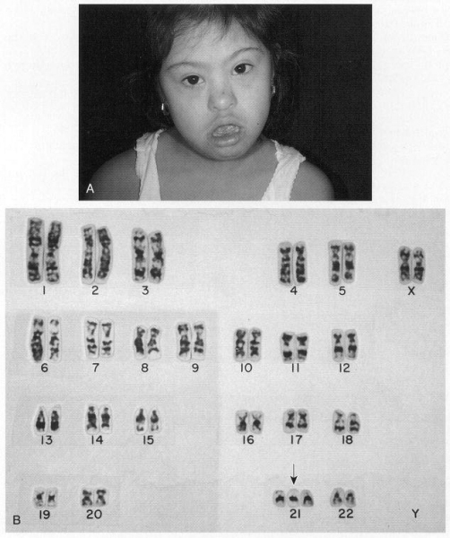

Slide 14
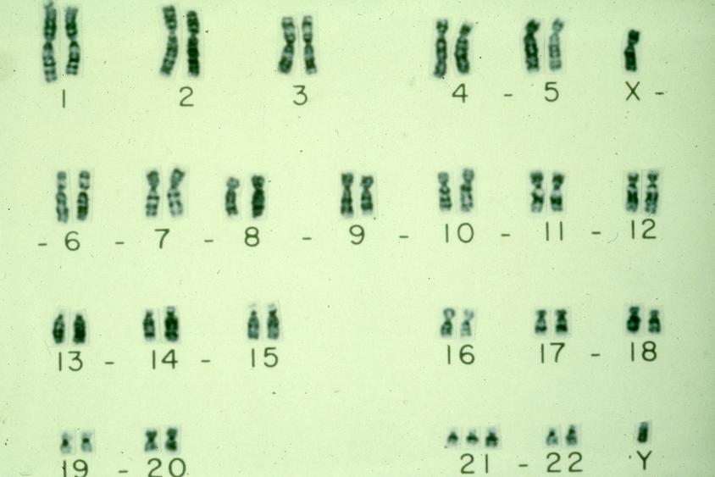

Slide 15
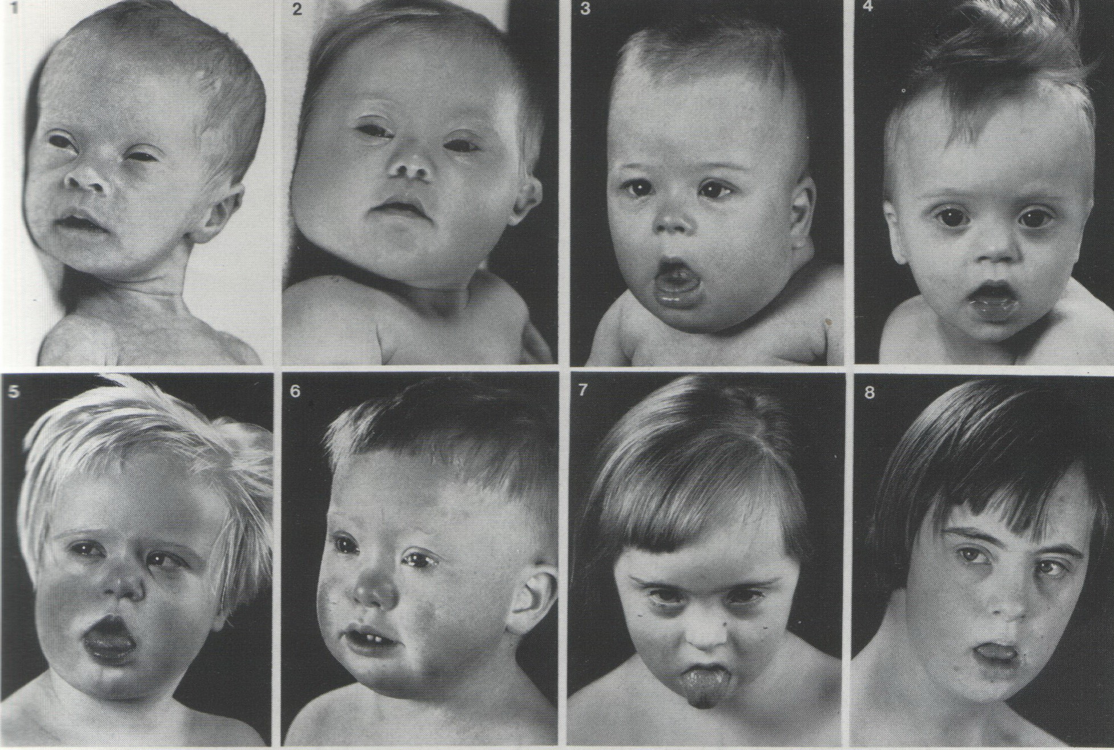

Slide 16
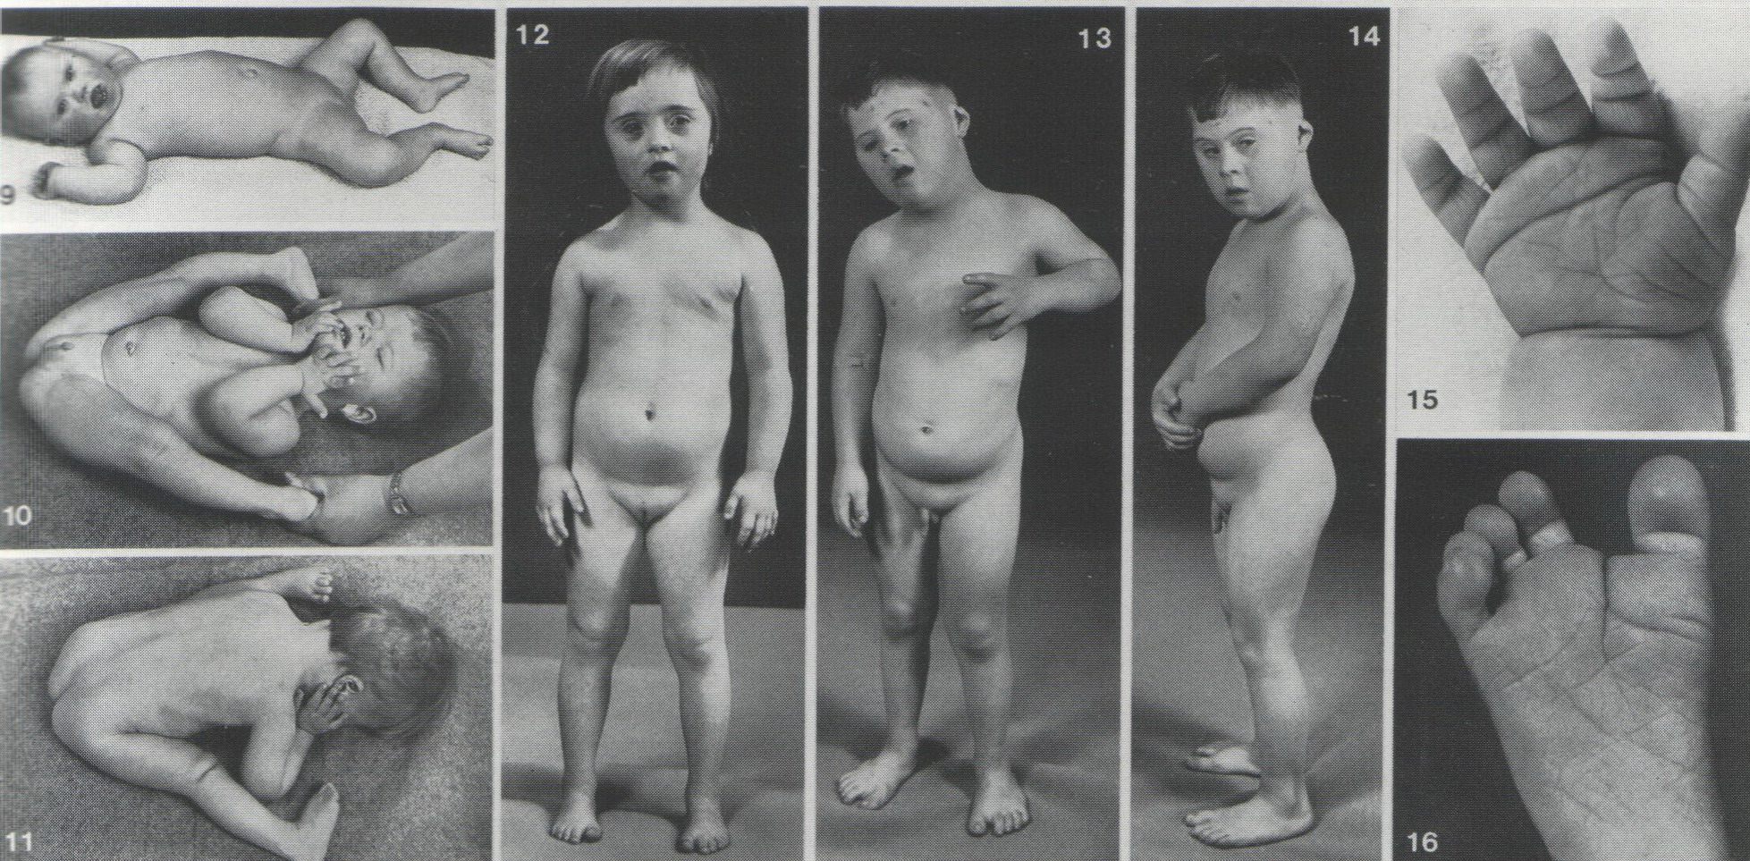

Slide 17
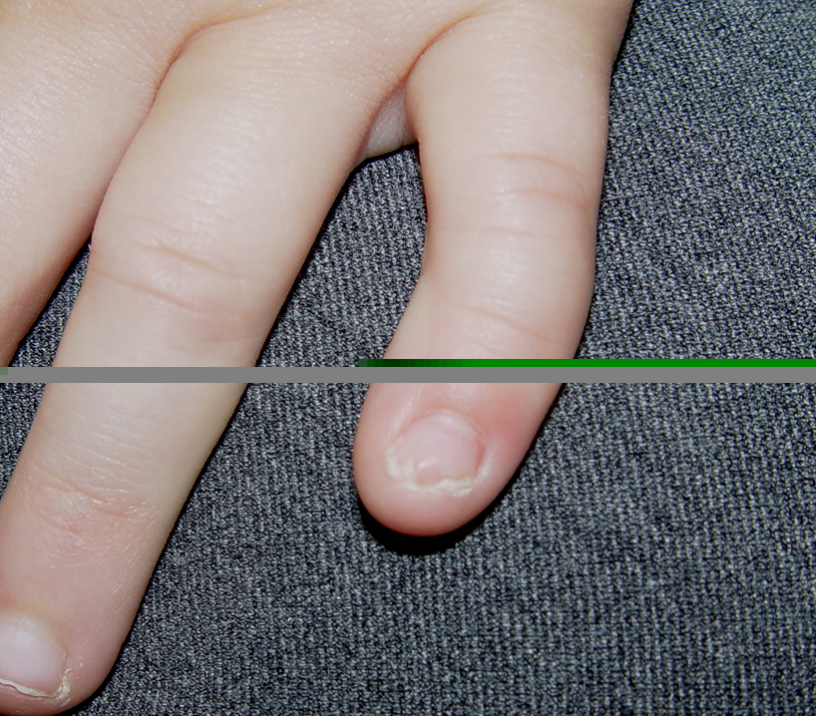
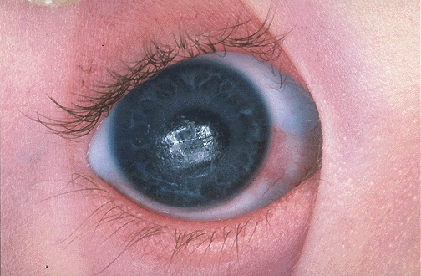
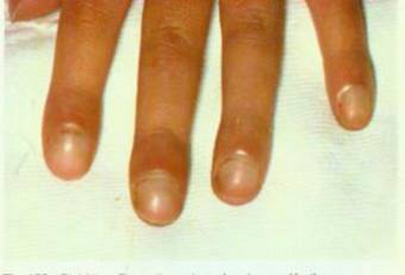
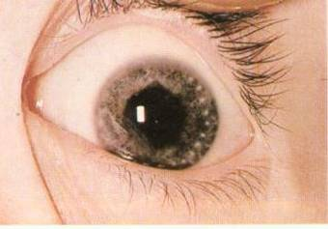

Slide 18
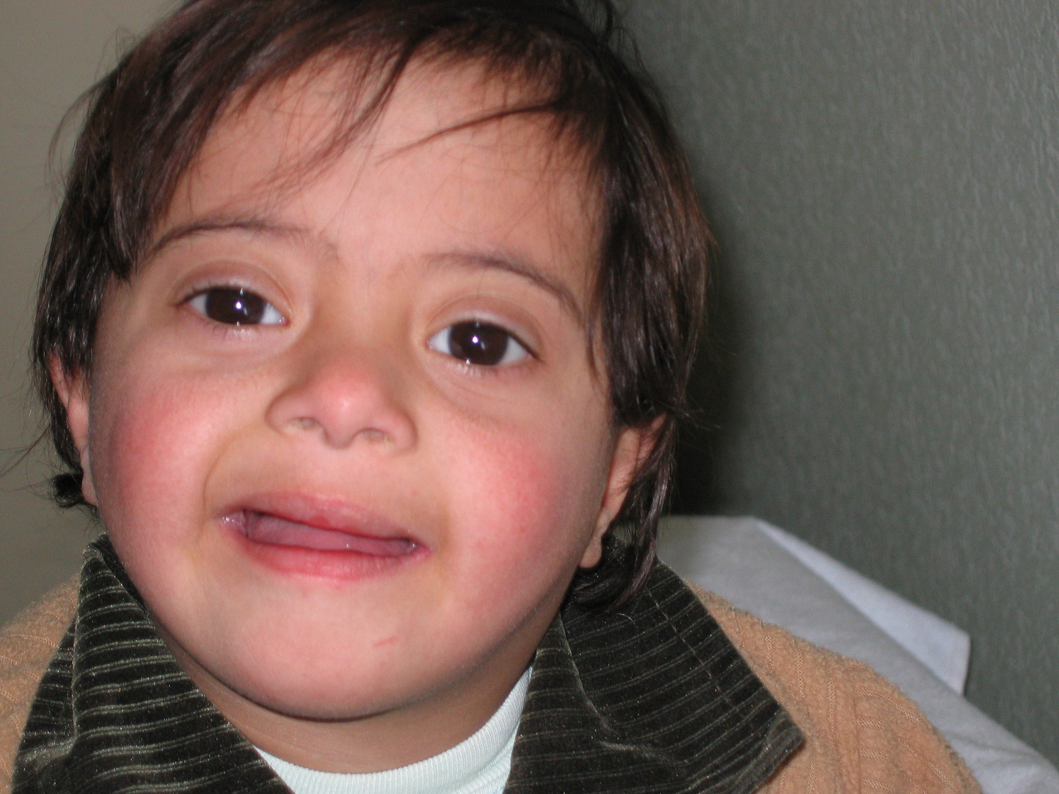

Slide 19
EDWARD SYNDROME
(trisomy 18)

Slide 20
Incidence is 1/4000 live birth.
Male : female ratio affected is 1: 3.
Physical findings:
Pre and post natal growth retardation
Hypertonia, closed fists with index fingers overlapping the 3ed digit and the fifth digit overlapping the 4th, narrow hip with limited abduction.
Short sternum , rocker bottom feet
Microcephaly , prominent occiput
Cardiac and renal anomalies ( horse shoe kidneys)
Mental retardation
Ninety five percent of cases are lethal in the first year.

Slide 21
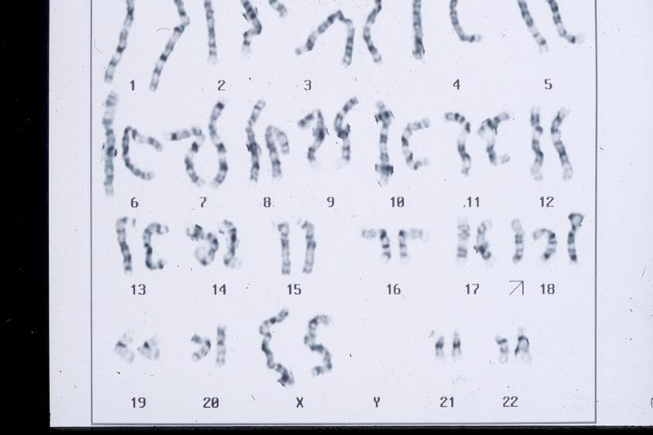

Slide 22
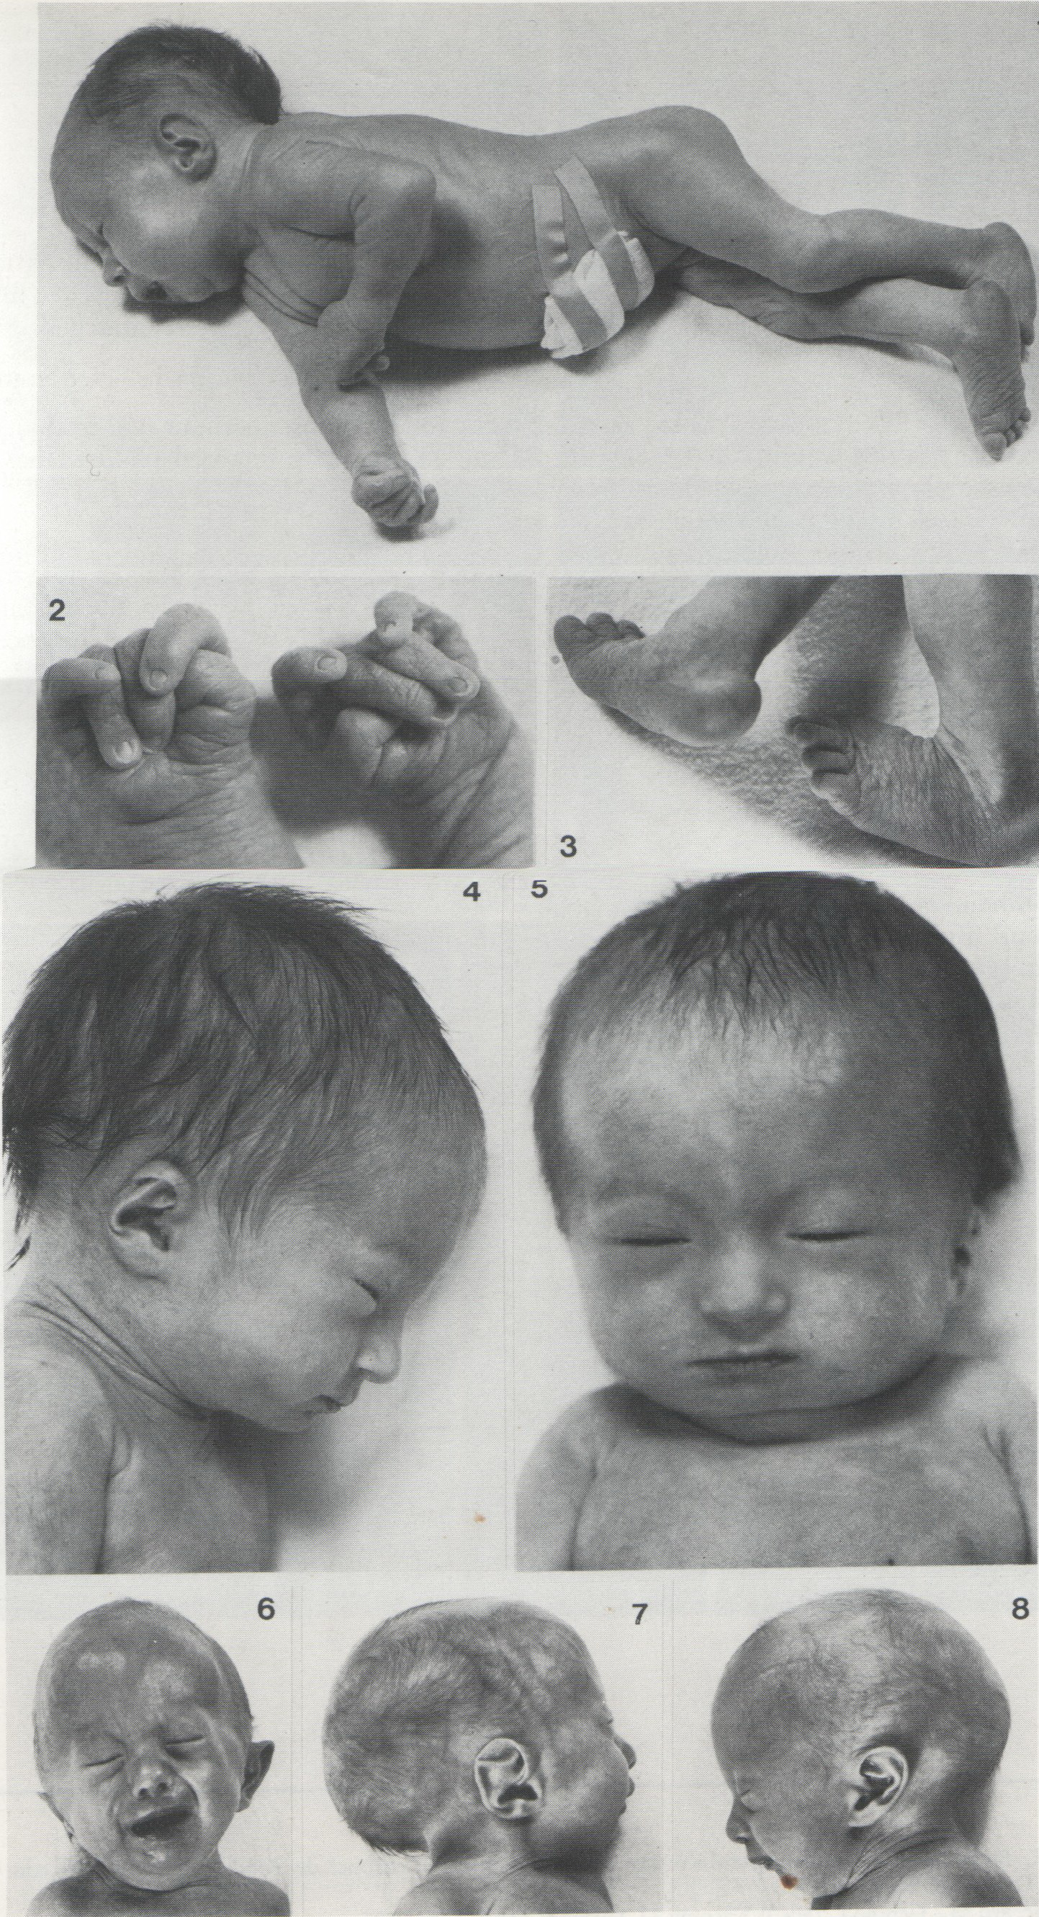

Slide 23
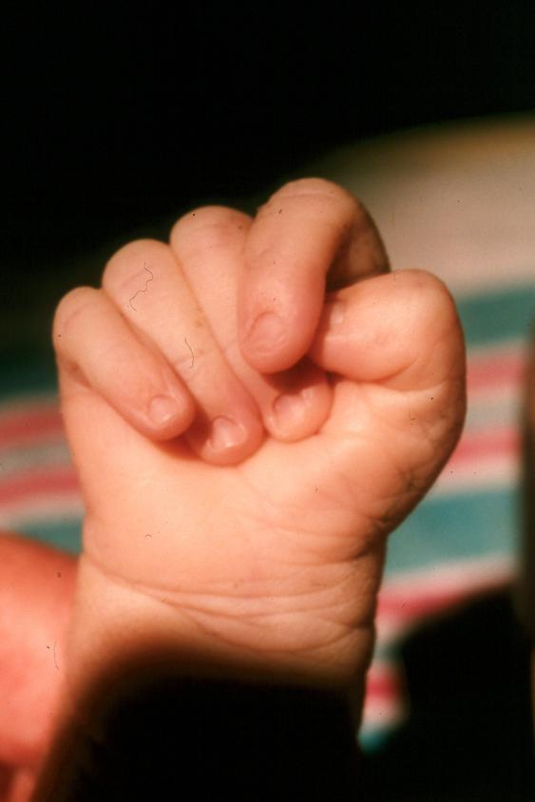

Slide 24
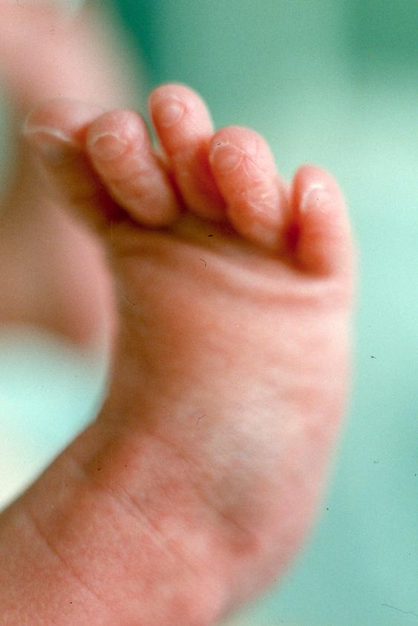

Slide 25
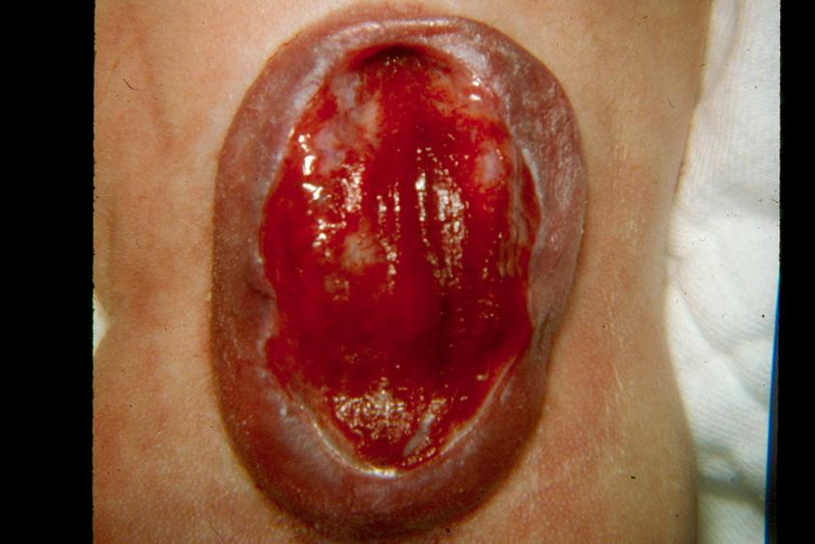

Slide 26
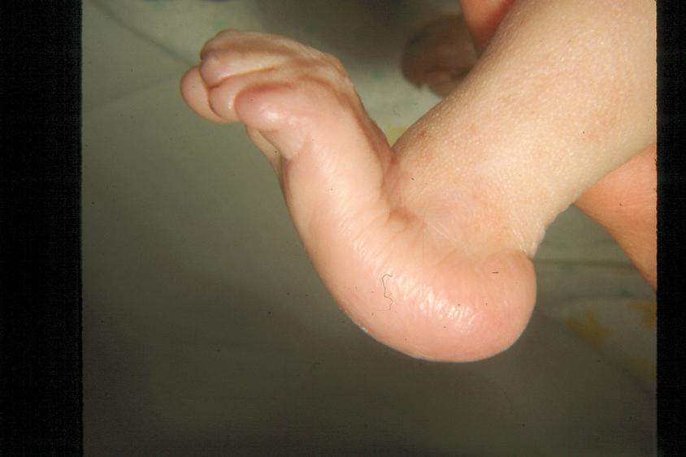

Slide 27
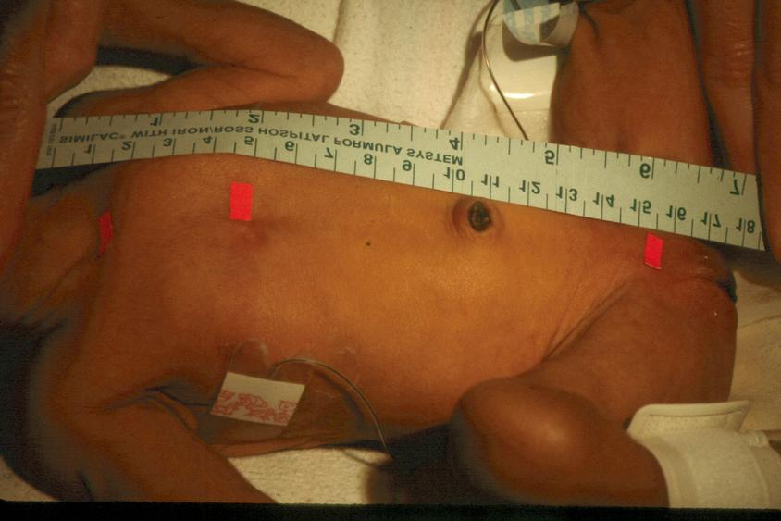

Slide 28
PATAU SYNDROME
(trisomy 13)

Slide 29
Incidence is 1/12000 live birth with 60% female.
The mean maternal age is increased.
Physical findings :
Pre and post natal growth retardation ( but may appear to have normal birth weight unlike Edward syndrome)
CNS malformation
Eyes malformation
Cleft lip and palate
Scalp defect ( aplasia cutis )
Polydactyly or syndactyly
Congenital heart disease usually VSD
Death usually in the first year or second year commonly as a result of heart failure or infection.

Slide 30
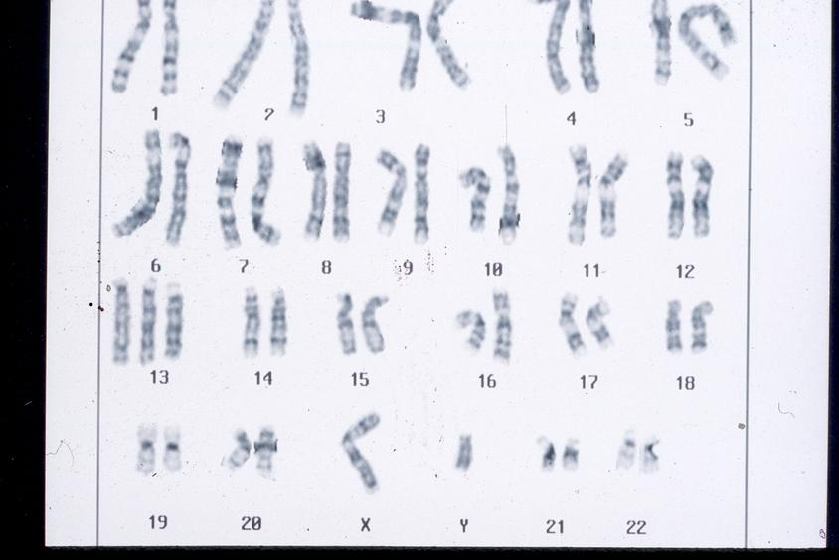

Slide 31
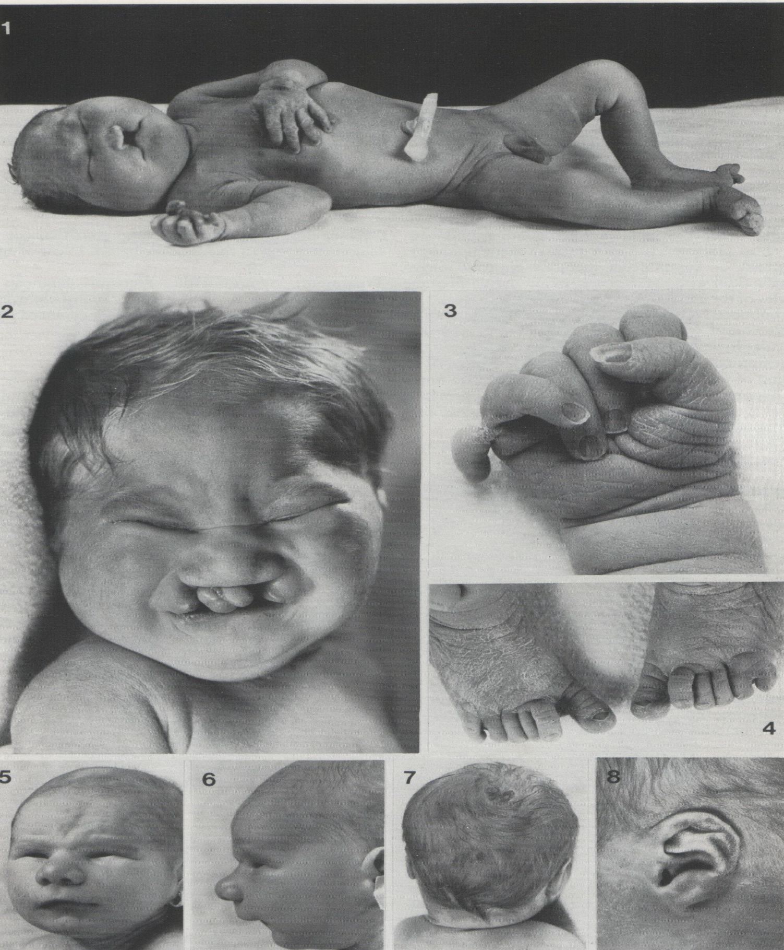

Slide 32
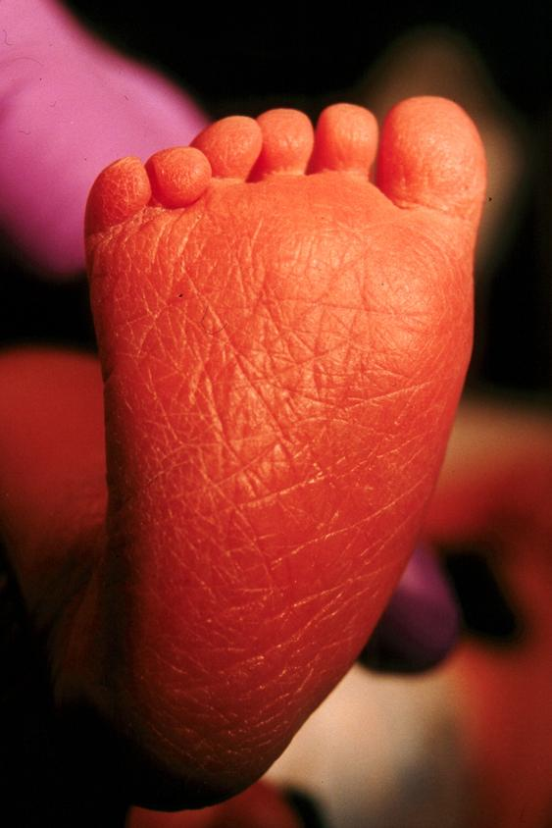

Slide 33
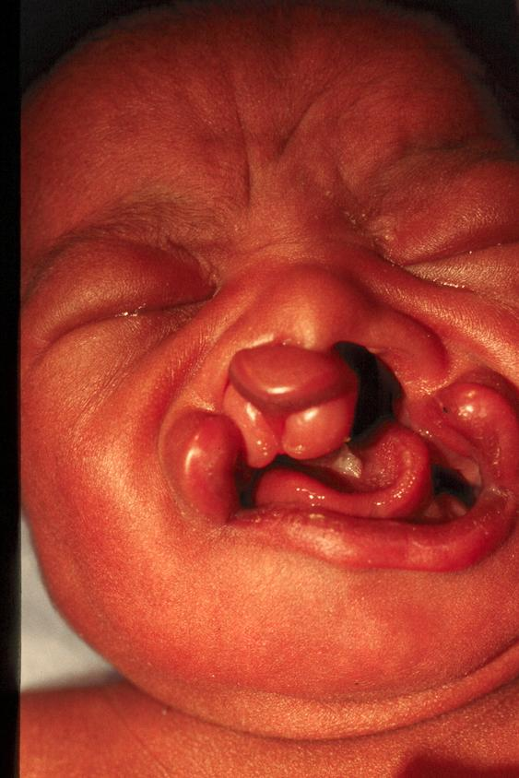
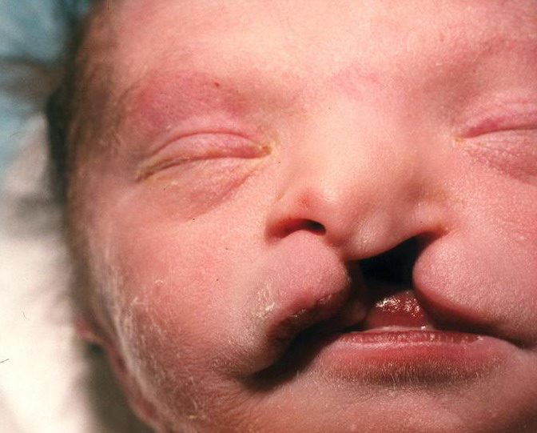
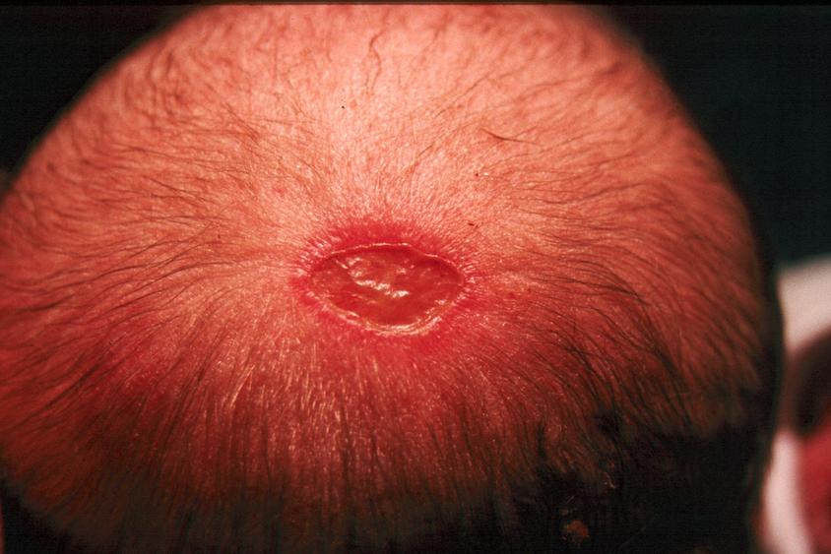
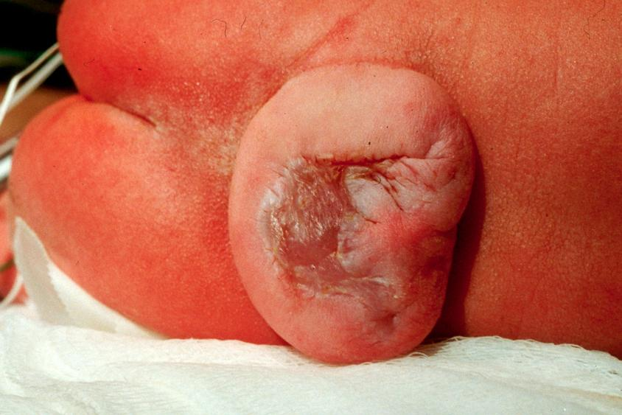

Slide 34


Slide 35
TURNER SYNDROME
(monosomy X, gonadal dysgensis)

Slide 36
The incidence is 1/10000 female. It is estimated that 95% of conceptuses with monosomy X are miscarried and only 5% are live born.
Physical findings :
Webbed neck
Edema of hand and feet
Characteristics triangular facies
Coarctation of aorta
Shield chest with widely set nipples and cubitus valgus
Hyperconvex fingernails.
Low posterior hairline
Short stature
Streak ovaries, amenorrhea and infertility
Absence of secondary sex characteristics
Complications related primarily to coarctation of aorta when present. Rarely dysgentic gonads may become neoplastic (gonadoblastoma).

Slide 37
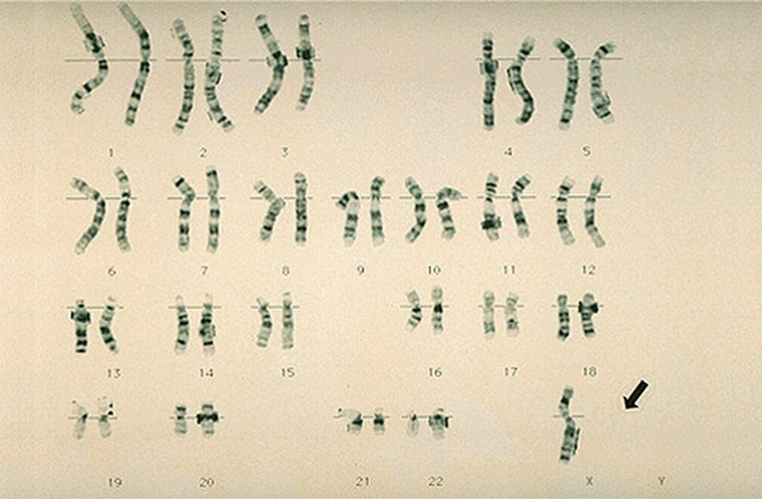

Slide 38
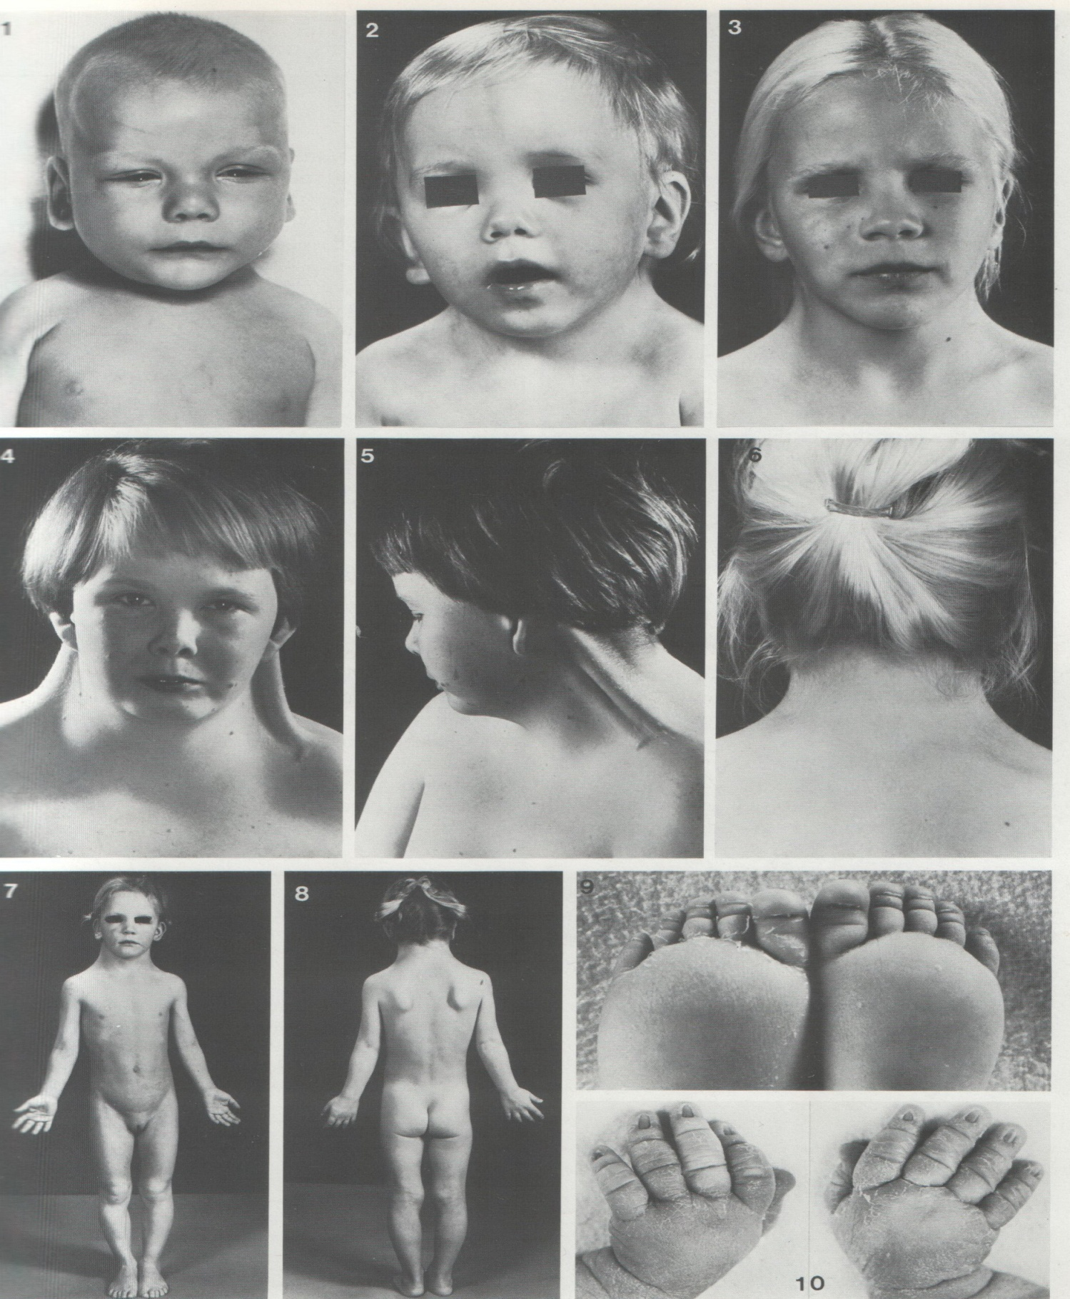

Slide 39
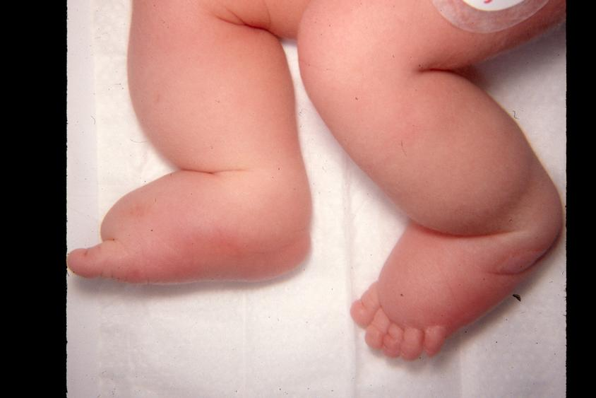

Slide 40
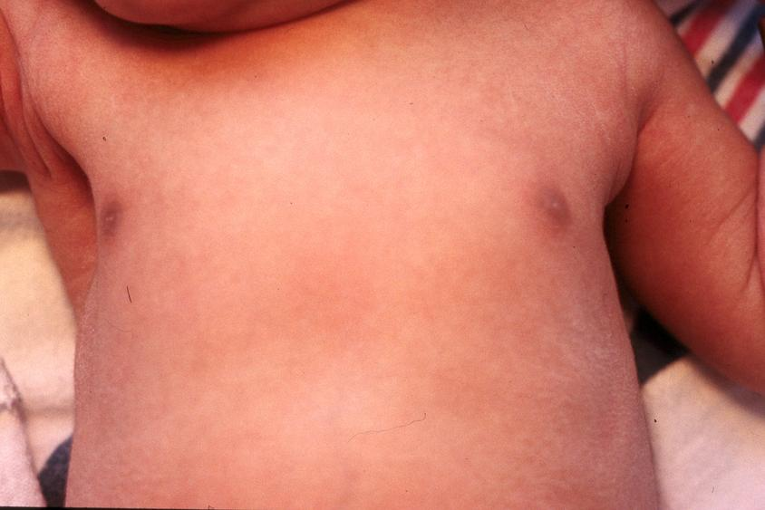

Slide 41
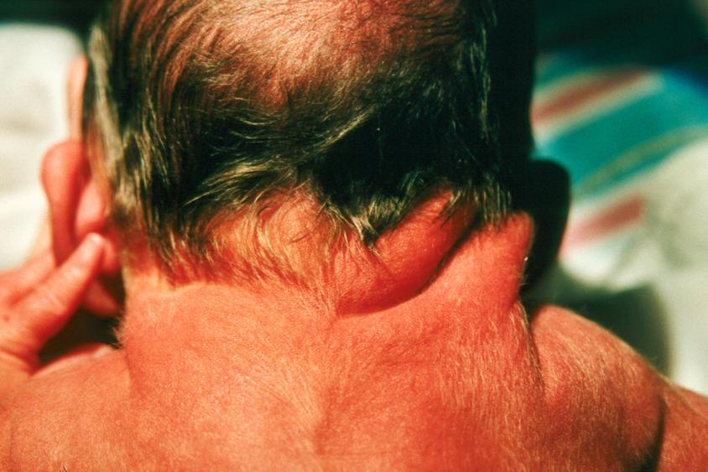

Slide 42
KLINEFELTER SYNDROME
(XXY)

Slide 43
The incidence is 1/1000 of newborn but it is about 1% among mentally retarded male and 3 % among male seen in infertility clinics.
Maternal age at birth is often advancing.
It is rarely cause abortion (unlike turner).
Diagnosis rarely before puberty (unless prenatal diagnosis).
Pre puberty is normal phenotypic.
Physical findings:
Micro orchidism associated with normal external genitalia
Azospermia , sterility and gynecomastia
Normal to borderline IQ
Diminished facial hair
Lack of libido and potency
Tall eunchoid built
In those with XXXY and XXXXY, mental retardation is sever and radioulnar synostosis may be present plus anomalies of external genitalia and cryptorchidism.

Slide 44
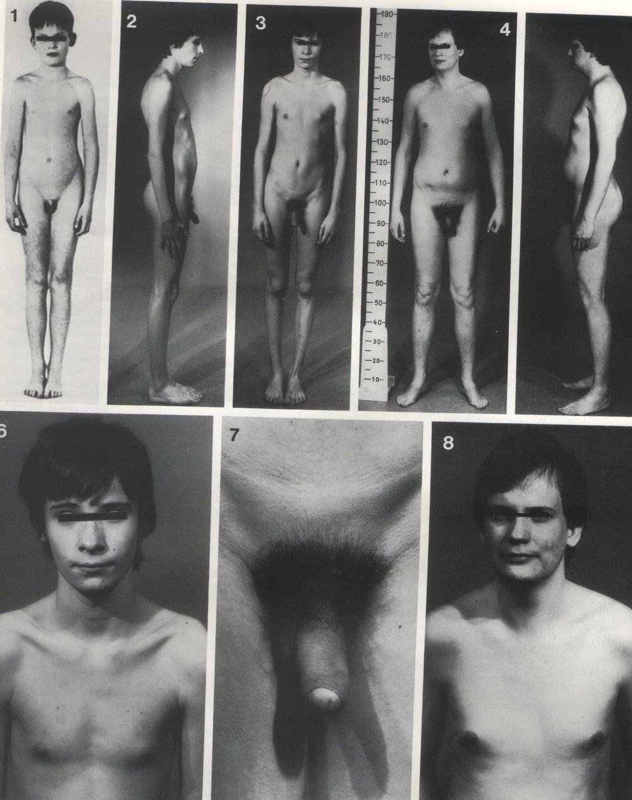

Slide 45
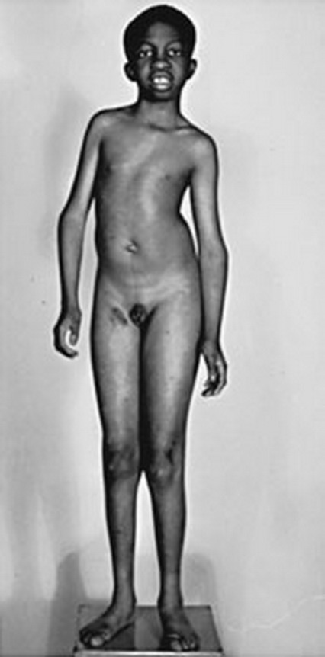

Slide 46
Molecular genetics

Slide 47
Each human somatic cell contains 2 copies of the entire human genetic program, or genome, amounting to 3 billion base pair (bp) of DNA.
The gene is the functional unite of information..
Genetic diagnosis can be performed by:
Direct detection: possible only when the gene causing the disease and the nature of mutation is known. It requires the affected person only.
Restriction analysis
Single strand conformational polymorphism analysis(SSCP)
Direct sequences with a assistance of PCR
Hetro duplex assay
Protein truncation assay
The molecular mechanisms causing human disease include protein mutation, deletions and insertion.
Example of diseases diagnosed by these mechanisms and for which direct detection is available are congenital adrenal hyperplasia,, cystic fibrosis, hemophilia A&B, muscular dystrophy and fragile X syndrome.

Slide 48
Indirect detection:
Is used when the gene is known but there is extensive heterogencity of the molecular defect between families or when the gene responsible for a disease is unknown but it’s chromosome location is known.
The method used her is linkage analysis by which linkage traces the inheritance of the abnormal gene between members of kindred.
This method requires that the affected individual to be studied, with parents and perhaps other relatives, both affected and unaffected.
Example of disease in which both direct and indirect assay may be used in neurofibromatosis.
Traditionally, autosomal single gene disorders follow the principles explained by Mendel’s observation.

Slide 49
AUTOSOMAL DOMINANT INHERITANCE

Slide 50
Affected individuals in the same family may experience variable expressivity.
Non penetrance is common and the penetrance rate varies for each dominantly condition. {Penetrance refers to the proportion of individuals with a particular genotype that express the same phenotype. It range from 0 to 1.0 (0 – 100%). Hundred percent penetrance rate means the penetrance is complete. If some mutant individuals do not express the phenotype means the penetrance is incomplete or reduced}. Dominant conditions with incomplete penetrance, therefore, are characterized by skipped generations with unaffected obligate gene carrier.
Both male and female can pass on the abnormal gene to children of either sex, but the manifestation may vary according to sex e.g. baldness affect male only although it dominant condition.
It is vertical i.e. the condition pass from one generation to the next in a vertical fashion (figure).
Family history might be negative and the individual seems to be the first affected individual (new mutation). Mutation rate varies with each dominant condition and in some cases mutation increase with advancing paternal age e.g. achondroplasia.
As a general rule; dominant trait are more often related to structural abnormalities of protein e.g. Marfan syndrome.
Risk of having affected baby when a parent is affected is 50% or 1: 2.
Prevention options available for future pregnancy e.g. prenatal diagnosis, artificial insemination and egg donation depending on which parent has the abnormal gene.
Examples include neurofibromatosis 1, Marfan syndrome, achondroplasia, osteogenesis imperfecta and crainosynostosis.

Slide 51
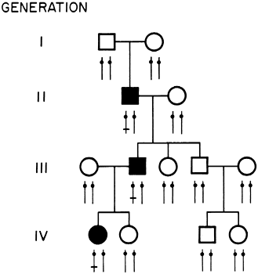

Slide 52
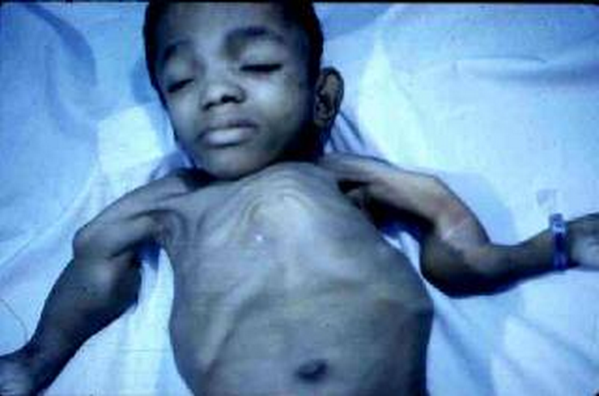
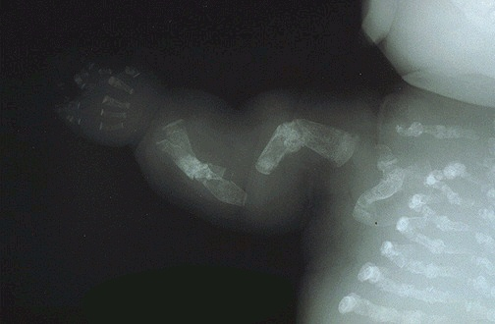

Slide 53
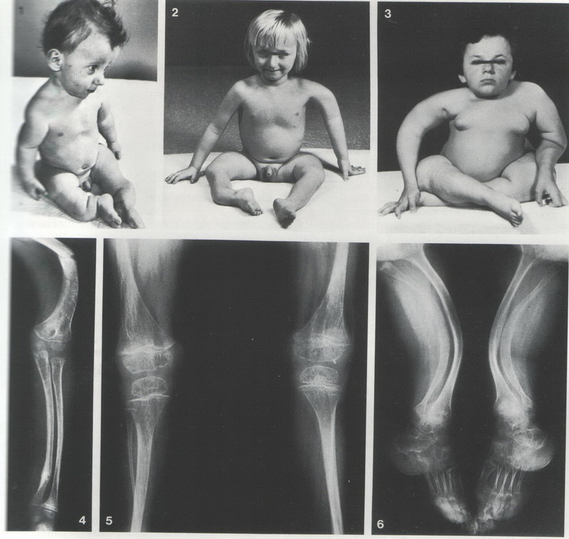

Slide 54
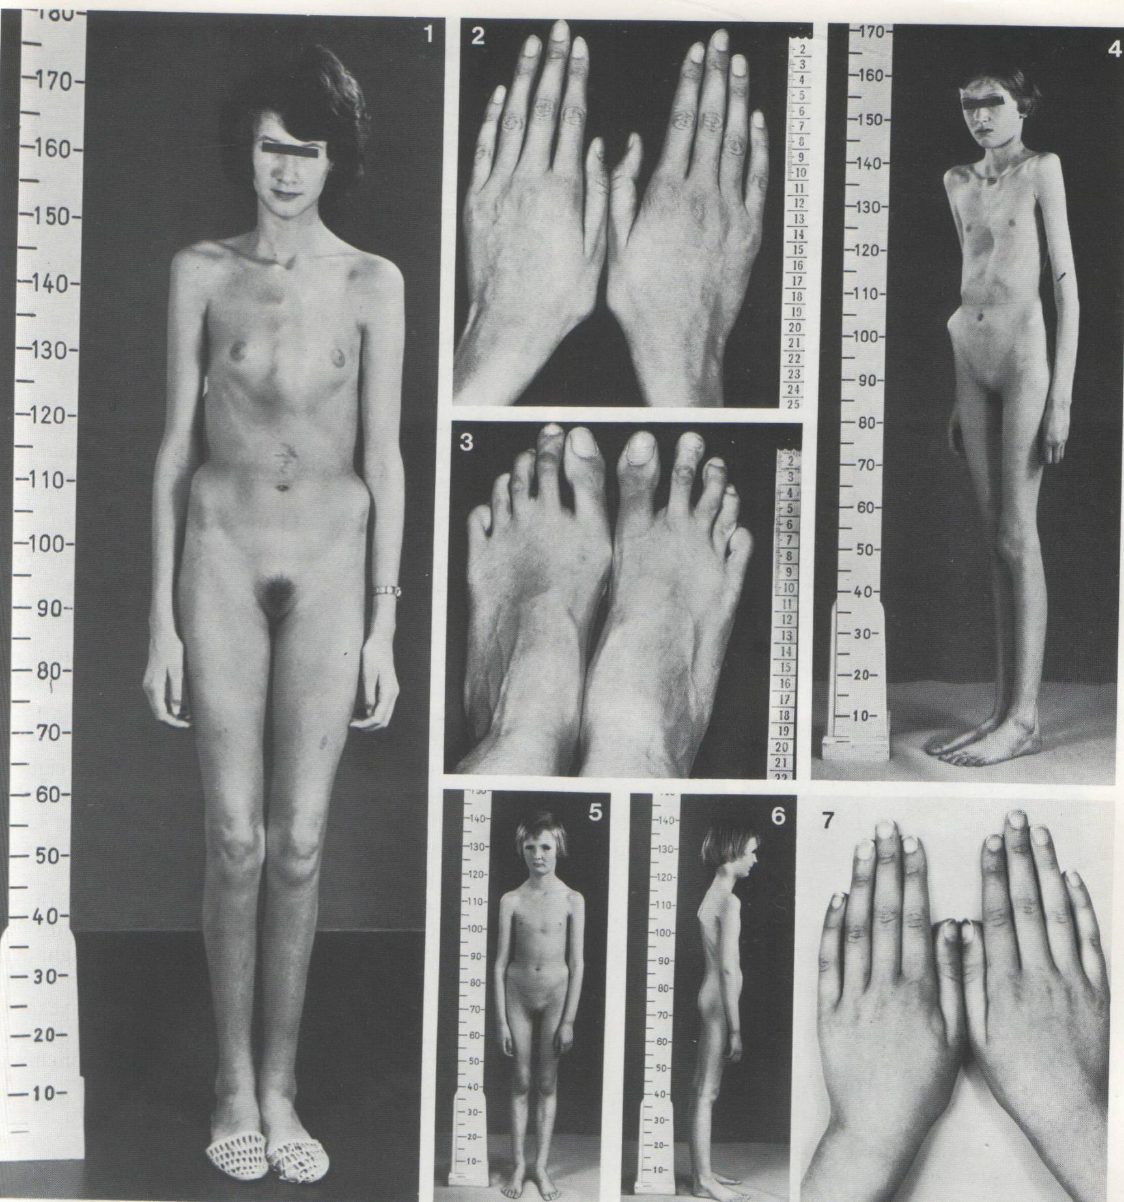

Slide 55
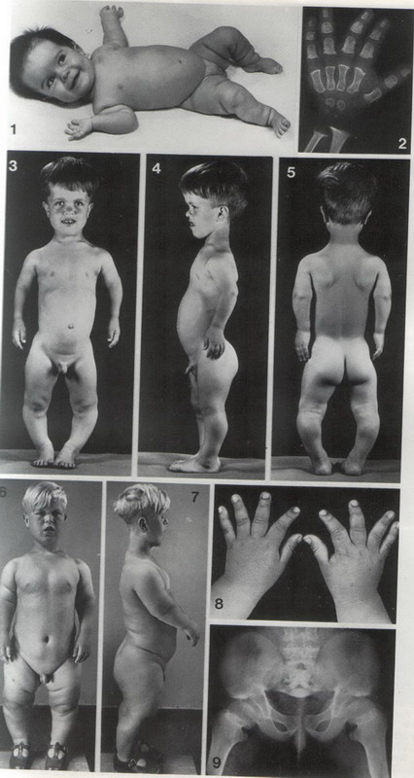

Slide 56
AUTOSOMAL RECESSIVE INHERETENCE

Slide 57
Parents are carriers and are clinically normal. There is exceptions e.g. sickle cell trait which may be symptomatic in hypoxia.
There is less variability among affected persons.
Male and female are equally affected.
Horizontal inheritance ; siblings may be affected
Autosomal recessive conditions are usually rare. The rare the condition, the more likely it is that consanguinity is present (a child whose parent are related presents with an unrecognized abnormalities, a recessive condition must be suspected).
The family history is usually negative, with the exception of siblings. However, in common condition e.g. cystic fibrosis, a 2nd or 3ed degree relative may be affected.
Recessive conditions are frequently associated with enzymatic defects.
The recurrence risk for parents of an affected child is 25% or 1:4 for each pregnancy.
Options available for future pregnancies include prenatal diagnosis in many cases and artificial insemination.
Examples include cystic fibrosis, smith –lemli – optiz syndrome ( primordial growth deficiency, MR with microcephaly, genital anomalies in male) , sensorineural hearing loss, spinal muscular dystrophy and metabolic disorder mostly inborn error of metabolism.

Slide 58
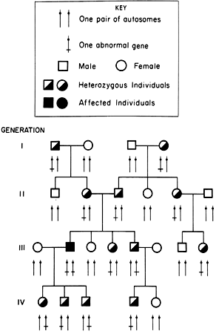

Slide 59
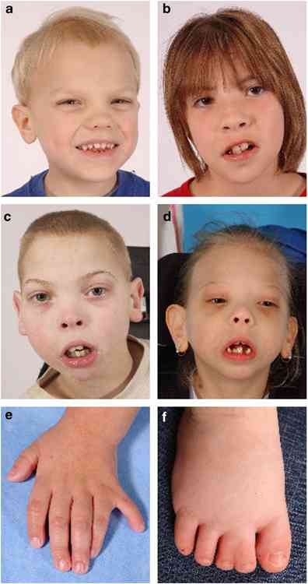

Slide 60
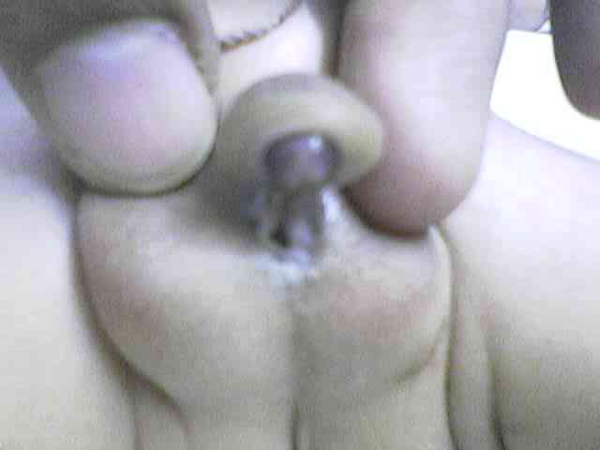

Slide 61
X LINKED RECESSIVE INHERITANCE

Slide 62
Male are affected and heterozygous female is either normal or have mild manifestations.
Inheritance is diagonal through the maternal side of the family( figure)
A female carrier has 50% chance that each daughter will be a carrier and 50% that each son will be affected.
All daughters of an affected male are carrier and none of his sons are affected.
Mutation rate is high in some X linked disorder.
On rare occasions, a female may be fully affected. possible mechanisms include:
Unfavorable lionization
45X karyotype
Homozygosity for the abnormal gene
An X autosome translocation
Non random inactivation
Uniparental disomy
Gene frequency is very high in the community that a carrier female marry affected male
Examples include DMD, hemophilia, Alport syndrome, metabolic disorders like adrenoleukodystrophy.

Slide 63
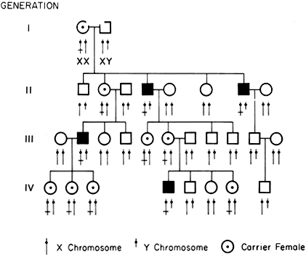

Slide 64
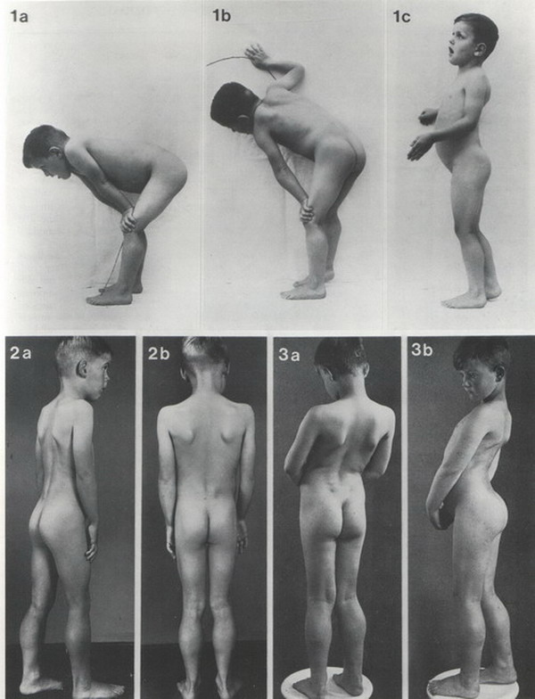

Slide 65
X LINKED DOMINANT INHERITANCE

Slide 66
Much less common than X linked recessive type.
The heterozygous female is symptomatic and the disease is twice as common in female (2 X chromosome).
Clinical manifestations are more variable in female than male
The risk for the offspring of heterozygous female to be affected is 50% regardless the sex.
All of the daughter but non of the sons of the affected male will have the disorder
A homozygous female is possible, she would be severely involved. All of her children would be affected but more mildly.
Some conditions are lethal in male (incontinentia pigmenti) also in homozygous female.
Examples include incontinentia pigmenti and hypophosphatemic or vitamin resistant rickets.

Slide 67
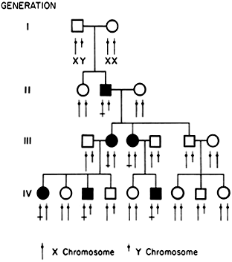

Slide 68
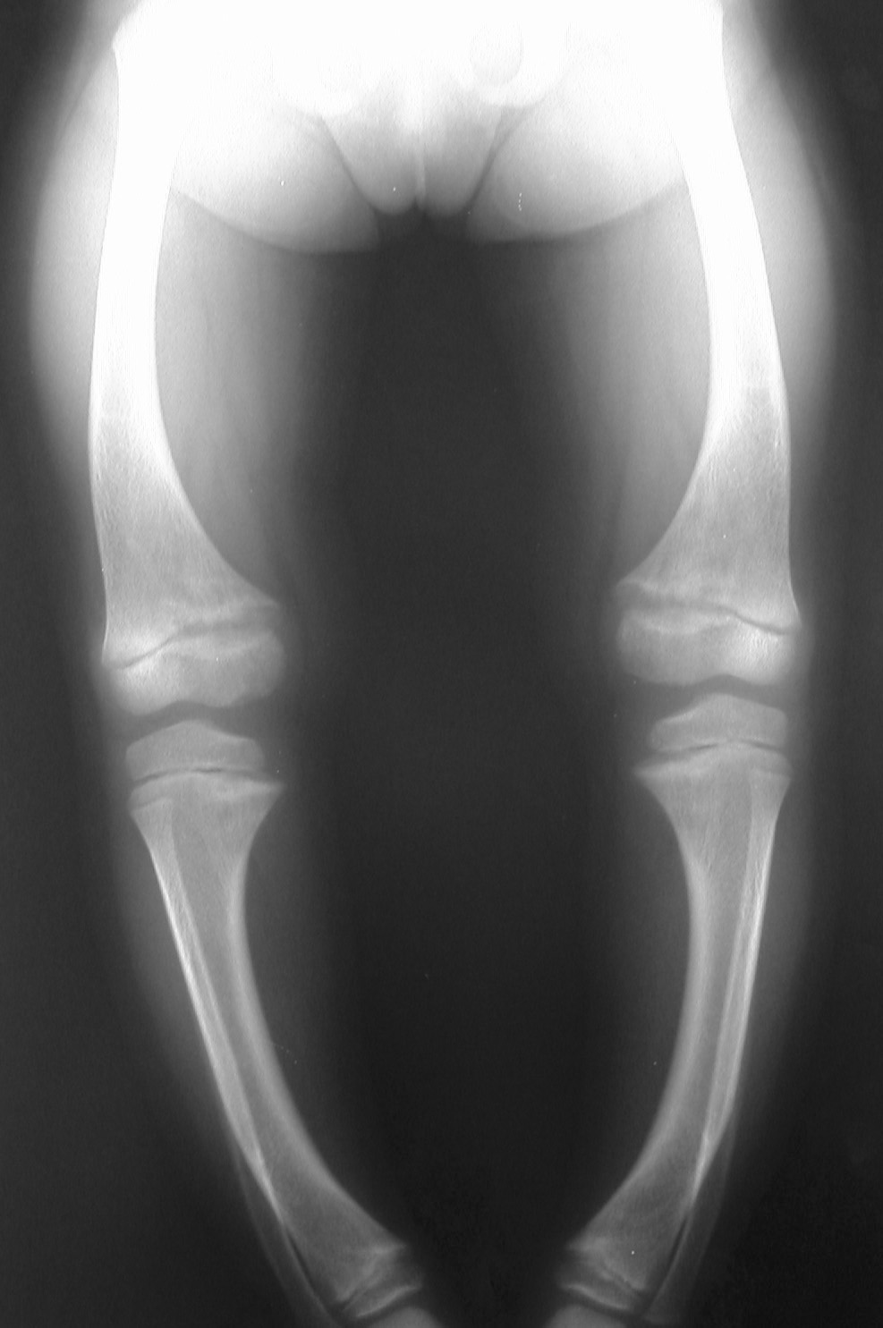
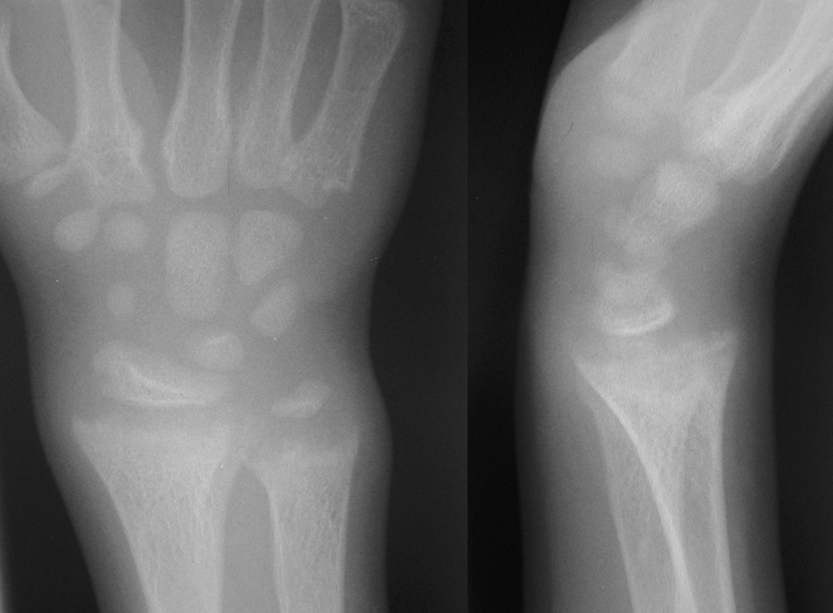
Hypophosphatemic
Vitamin D resistant rickets
The most commonly encountered non-nutritional form of rickets D
Some mothers of affected children exhibit clinical evidence of disease such as bowing or short stature, whereas others show only fasting hypophosphatemia
Autosomal recessive and sporadic forms have also been reported.
Present with bowing of the lower extremities related to weight bearing at the age of walking
Tetany is not present, and the profound myopathy, rachitic rosary, and Harrison groove (pectus deformity) characteristic of calcium-deficient rickets are not evident
Waddling gait, smooth (rather than angular) bowing of the lower extremities, coxa vara, genu varum, genu valgum, and short stature
The adult height of untreated patients is 130–165 cm.
Normal or slightly reduced serum calcium level
A moderately reduced serum phosphate level (1.5–3 mg/dL)
Elevated alkaline phosphatase activity
Urinary phosphate excretion is large
Oral phosphate supplements coupled with a vitamin D

Slide 69
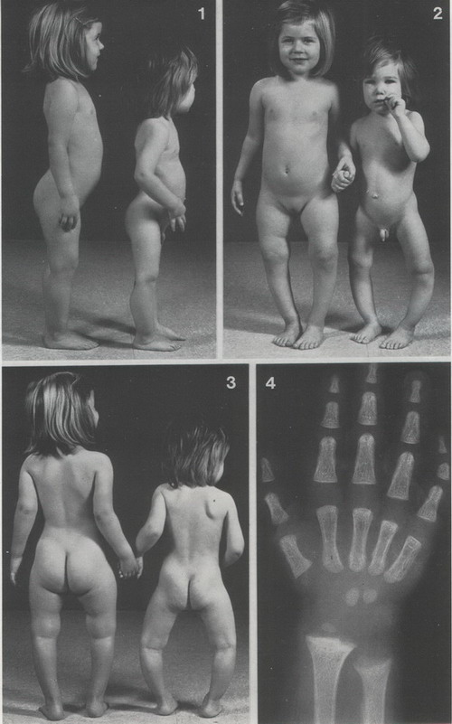

Slide 70
MULTIFACTORIAL INHERITANCE

Slide 71
Many common conditions, like the height, are familial and are the results of action of multiple rather than single gene.
Environmental factor e.g. diet also contribute to the traits
In polygenic conditions, the concordance rate for identical twins is higher than that seen in dizygotic twin but still not 100% indicating both genetic and environmental factors.
The risk of relatives of affected persons is increase and the risk is higher for first degree relative and lower for more distant relatives (the risk for those is higher than the general population).
The risk of recurrence varies with the number of affected family member e.g.
one child born with open neural tube defect: the risk 2-3 %
second child affected : the risk become 10 – 12%

Slide 72
The risk of recurrence is higher if the defect is more sever e.g. in Hirschsprung disease, the longer the aganglionic segment, the higher the recurrence risk.
Sex ratio may not be equal. If a marked discrepancy exists, the recurrence risk is higher if a child of less commonly affected sex has the disorder e.g. pyloric stenosis is more common in male if the first affected child is a female, the recurrence risk is higher than if the child is male.
Examples include anencephaly and spina bifida, hydrocephalus, CHD, CDH, club foot and pyloric stenosis.

