Slide 1
Identification of Alcohols

Slide 2
Alcohols are organic compounds that may be considered as derivatives of water.
One of the hydrogen atoms of water molecule (H-O-H) has been replaced by an alkyl or substituted alkyl group.
R−OH

Slide 3
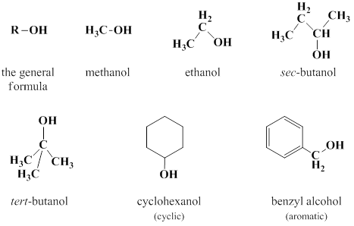
The alkyl group could be primary, secondary, or tertiary, and may be open chain or cyclic.

Slide 4
Physical properties
Alcohols are colourless liquids with a special faint odour. Benzyl alcohol and cyclohexanol have characteristic odours.
Aliphatic alcohols burn with blue flame (without smoke) while aromatic alcohols burn with yellow smoky flame.

Slide 5
Boiling points of alcohols are considerably high (being associated liquids); they increase as the molecular weight (number of carbons) increases.
Alcohols are miscible with water except benzyl alcohol, cyclohexanol, and sec-butanol (which is very slightly soluble in water.

Slide 6
Solubility classification
As the hydroxyl group /hydrocarbon ratio of alcohols increases, their water solubility increases and vice versa.

Slide 7
Therefore, alcohols that are soluble in water and ether are classified under class S₁ such as ethanol and methanol. Alcohols that are insoluble in water are related to class N such as benzyl alcohol, sec-butanol, and cyclohexanol.

Slide 8
Chemical properties
Alcohols are neutral compounds that don’t change the colour of litmus paper.
All reactions of alcohols are related to its active hydroxyl group and are of two types:

Slide 9
Removal of the hydroxyl itself as in the reaction with hydrogen halides to form alkyl halides or in the dehydration reaction to form a double bond.
Removal of the proton only from the active hydroxyl as in the formation of esters or in the reaction with active metals such as sodium.

Slide 10
General test :
(Ceric ammonium nitrate reagent)
Ceric ammonium nitrate (yellow soluion) is an oxidizing agent that reacts with alcohols to give a red complex and with phenols to give a brown to greenish brown precipitate.

Slide 11


Slide 12
The red coloured complex is an intermediate for the oxidation of alcohols by the Ce (IV) solution. This red colour disappears after a reasonable time due to completing the oxidation of this intermediate and the reduction to the colourless Ce (III) solution producing the corresponding aldehyde or ketone.

Slide 13
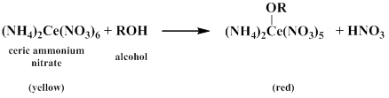

Slide 14
Procedure
Water soluble (miscible) alcohols;
mix two drops of the alcohol with one drop of ceric ammonium nitrate solution. A red complex indicates a positive test.
Water insoluble (immiscible) alcohols;
mix two drops of the alcohol with 0.5 ml dioxane, shake well, and add one drop of the reagent to get a positive red complex.

Slide 15
This test gives positive results with primary, secondary, and tertiary alcohols (up to 10 carbons), poly hydroxylated compounds such as carbohydrates, and hydroxylated carboxylic acids, aldehydes and ketones.

Slide 16
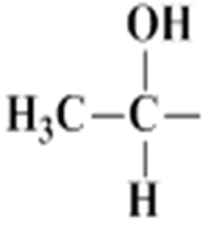
Specific tests
a) Iodoform (Haloform) test
This test is specific for alcohols which have a free methyl group and a hydrogen attached to the carbon bearing the hydroxyl group such as ethanol and sec-butanol.

Slide 17

The overall reaction is:
Tertiary alcohols show –ve result.

Slide 18
The alcohol is oxidized to the corresponding aldehyde or ketone by the action of the produced oxidizing agent 'sodium hypoiodite', which also causes the aldehyde or ketone to be tri-iodinated on the terminal methyl group producing iodoform as a yellow precipitate.

Slide 19
The mechanism of this reaction involves many steps, the first of which is the formation of the oxidizing agent sodium hypoiodate (NaOI).
I₂ + 2NaOH NaOI +NaI + H₂O

Slide 20

The next steps are:
Oxidation of the alcohol to the corresponding aldehyde or ketone.

Slide 21

Halogenation of the produced aldehyde or ketone with three moles of sodium hypoiodate to form the triiodo derivative.

Slide 22

Cleavage of the triiodo derivative by NaOH to an acid containing one less carbon atom than the starting alcohol.

Slide 23
Procedure
Dissolve about 3 drops of the alcohol in about 2 mL of distilled water (or 2 mL of dioxane for water insoluble compounds).
Add about 1 ml of 10% sodium hydroxide solution.

Slide 24
Add iodine solution drop wise with shaking until either a yellow iodoform precipitate is formed(test is positive and is completed) or the dark colour of the iodine solution is present.
Allow the solution to stand for 3 minutes during which period check for the appearance of the yellow precipitate at the bottom of the test tube.

Slide 25
If there is no precipitate
Warm the solution in water bath (60 ˚C) for about 3 minutes with shaking from time to time and check for the yellow precipitate.
During warming, if the colour of iodine disappears, add few additional drops of iodine solution with shaking until either the yellow precipitate is formed or the dark iodine colour persists, and then complete warming

Slide 26
Get rid of the excess iodine by the addition of 10% sodium hydroxide solution drop wise with shaking to obtain the yellow precipitate.
If the precipitate is not formed, allow the solution to stand for 10 minutes to get the positive result.

Slide 27
Finally if no precipitate is formed after the 10 minutes- standing period, dilute the solution with an equal volume of distilled water to obtain the iodoform precipitate.
It is important to proceed through all these steps so that only at the final step you can say that the test is negative.

Slide 28
Both ethanol and sec-butanol give positive iodoform test and they can be differentiated only by testing their solubility in water; sec-butanol is less soluble in water than ethanol.

Slide 29
b) Lucas test:
provides classification informations on alcohols.
Distinguish between the different types of alcohols (primary, secondary, or tertiary).
It depends on the formation of alkyl chloride as a second liquid phase.

Slide 30
Lucas reagent is prepared from anhydrous zinc chloride and concentrated hydrochloric acid. Zinc chloride is added to increase the ionization of hydrochloric acid.

Slide 31
The reaction depends on the formation of a stable carbonium ion. The more stable the carbonium ion formed, the faster the reaction is.
The rate of the reaction among different alcohols is shown below: benzyl alcohol>allyl alcohol>tert–alcohol>sec–alcohol> –ve primary alc.

Slide 32
All alcohols follow S_{N}1 mechanism except methanol and most primary alcohols that follow S_{N}2 mechanism

Slide 33
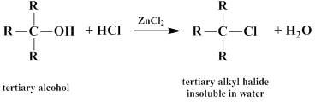
Benzyl alcohol shows the fastest positive result. Tertiary alcohols are faster in the formation of conjugated halides than secondary alcohols. Primary alcohols and methanol don’t react and don’t form two layers.

Slide 34
Procedure
Mix 2-4 drops of the alcohol with few
drops of Lucas reagent and observe the
results:
Benzyl alcohol gives immediate result as shown by the appearance of two phases.

Slide 35
Tertiary alcohols give two phases that separate within 2-3 minutes.
Secondary alcohols give two phases that separate after 15-20 minutes (giving a cloudy solution).
In primary alcohols one layer appears.

