Slide 1
Identification of Phenols

Slide 2
Phenols are organic compounds with a hydroxyl group attached directly to benzene or substituted benzene. They have the general formula Ar-OH. Examples of them include phenol (also known as carbolic acid), hydroquinone, resorcinol, o-cresol, m-cresol, p-cresol, β-naphthol, and α-naphthol.

Slide 3
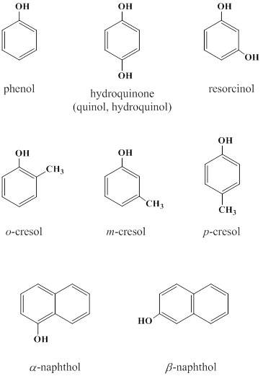

Slide 4
Physical properties
Phenols are liquids (e. g., o- and m-cresol) or solid crystalline compounds(e. g., phenol and resorcinol).
They are coloured due to air oxidation and have a special odour. Pure compounds are colourless.
They have high boiling points because of intermolecular hydrogen bonding.

Slide 5
Phenol itself is soluble in water due to its ability to form hydrogen bonding with water. For other phenols the solubility in water decreases by increasing the molecular weight. (cresols and naphthols are insoluble in water).
Phenols burn with a yellow smoky flame due to the presence of aromatic ring.

Slide 6
Chemical properties
Phenols are weak acidic compounds, so they are soluble in strong alkaline solutions only (e. g., sodium hydroxide solution). For this reason, they fall into solubility class A₂.
The presence of electron withdrawing group at the phenyl ring strengthens the acidity of the phenol making it of solubility class A₁ (e. g, nitrophenol). However, phenol itself is of solubility class S₁ since it is water soluble.

Slide 7
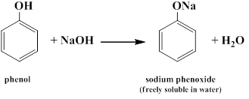
Types of phenols reactions
Reactions at the phenolic hydroxyl group (-OH); e.g., ether formation and salt formation:
Phenol reacts with sodium hydroxide to form sodium phenoxide.

Slide 8
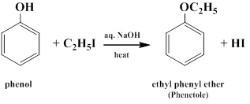
Ethyl phenyl ether is formed when phenol reacts with ethyl iodide.

Slide 9
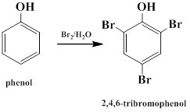
2-Substitution at the aromatic ring; e.g., bromination and nitration reactions:
-reaction with bromine water.

Slide 10
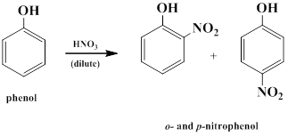
reaction with dilute nitric acid.

Slide 11

Chemical reactions
Reaction with ferric chloride
Phenols react with ferric chloride to give coloured compounds due to the presence of the enol group. This reaction is considered as a test for any compound with enol group.

Slide 12
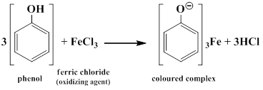

Slide 13
Procedure
To a very dilute aqueous solution of the phenol (30-50 mg in 1-2 mL water) or to a few crystals of the solid phenol (50-100 mg) dissolved in water add 1 drop of ferric chloride solution and observe the resulting colour.
compound | colour
phenol, m-cresol, resorcinol | violet or blue
o- and p-cresol | greenish blue
hydroquinone | deep green
α- and β-naphthol | no special colour

Slide 14
Hydroquinone undergoes oxidation in the presence of ferric chloride resulting in a deep green solution (crystals may separate) and, on further addition of ferric chloride solution, a yellow solution of p-benzoquinone is produced:

Slide 15
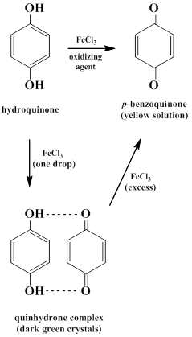

Slide 16
2-Reaction with bromine water
This reaction is an example of substitution reaction at the phenyl ring (mentioned earlier).
Procedure
To a concentrated aqueous solution of the phenol or to the phenol itself, add bromine water gradually. At first the bromine is decolourized and then, on adding an excess, a white or yellowish-white precipitate of a poly bromo-derivative is produced with all except hydroquinone and α- and β-naphthol.

Slide 17
On gradually adding bromine water to a solution of hydroquinone, a deep red coloration is produced, followed by the separation of deep green crystals which then dissolve giving a yellow solution.
The naphthols decolourize bromine water, but usually no precipitate of the bromo compound can be obtained.
This test is not very satisfactory with those phenols which are insoluble in water, owing to the difficulty of distinguishing the bromo compound from the original phenol.

Slide 18
3-Phthalein test
Many phenols yield phthaleins which give special colours (sometimes with fluorescence) in alkaline solutions when reacted with phthalic anhydride and a little amount of concentrated sulphuric acid. Phenol and resorcinol are examples.

Slide 19
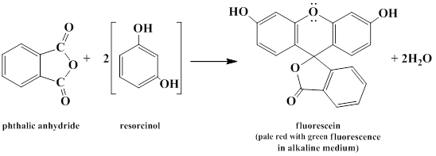
The fluorescence of resorcinol is due to the presence of an oxygen linkage between the two phenolic nuclei (in basic medium).

Slide 20
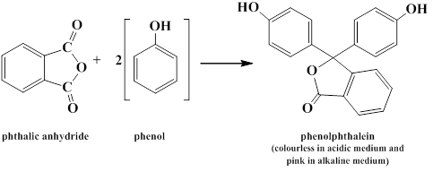

Slide 21
Procedure
In a dry test tube put about 0.1 g of the phenol and an equal amount of phthalic anhydride or phthalic acid, mix well, and add 1-2 drops of concentrated sulphuric acid. Heat gently on a direct flame for 1 minute until the crystals of the mixture melt and fuse. Then cool the test tube and add excess of 10% sodium hydroxide solution. Results should be as follows:

Slide 22
compound | colour
α-naphthol | green colour
β-naphthol | very pale green with slight fluorescence
phenol | red to pink
o-cresol | red-violet
m-cresol | blue to pink
p-cresol | no change
resorcinol | pale red colour with green fluorescence
hydroquinone | violet colour
If the resultant colour is not so clear you can dilute with water.

Slide 23
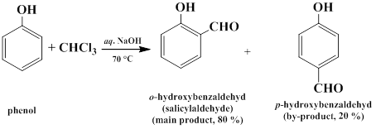
4-Reimer-Tiemann reaction
Treatment of phenol with chloroform and aqueous sodium hydroxide solution introduces an aldehyde group (-CHO) into the aromatic ring at the ortho- or para-positions:

Slide 24
Procedure
To about 0.2 g of the phenol add 1mL of 30% sodium hydroxide solution and 1 mL of chloroform, heat on water bath, and observe the colour of the aqueous layer:

Slide 25
compound | colour
phenol | yellow or no colour
resorcinol | red colour with weak fluorescence
α-naphthol | dark green
β-naphthol | deep blue that turns to green
o-cresol | deep orange
m-cresol | pale orange
p-cresol | yellow
hydroquinone | deep brown

Slide 26
5-Reduction of potassium permanganate
Phenols reduce potassium permanganate solutions and undergo oxidation to quinones. The manganese is reduced from +7, which gives a purple solution, to +4, which is brown. This test is highly successful with dihydroxylated phenols than phenol itself.

Slide 27
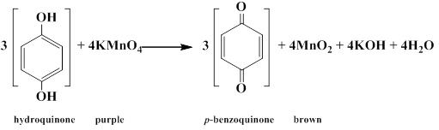

Slide 28
Procedure
Add 0.1 g or 0.2 mL (3-4 drops) of the compound to 2 mL of water or ethanol. Add 2% aqueous potassium permanganate solution drop by drop with shaking until the purple colour of the permanganate persists. If the permanganate color is not changed in 0.5-1 minutes, allow the mixture to stand for 5 minutes with occasional vigorous shaking. The disappearance of the purple color and the formation of a brown suspension, which is manganese (II) oxide, at the bottom of the test tube is a positive result for the presence of phenols.

