Slide 1
DETERMINATION OF SOLUBILITY CLASS

Slide 2
It is important to know:
The type of the functional group.
The polarity of the compound.
The molecular weight.
The nature of the compound (acidic, basic, neutral).

Slide 3
Solvents that are used in the determination of the solubility class are:
Water
Ether
5% NaOH
5% NaHCO₃
5% HCl
Conc. H₂SO₄

Slide 4
Generally, and for solubility classification purposes, the compound is said to be soluble in any solvent if it dissolves to the extent of about 3 % (0.1 gm/3 ml or 0.2 mL/3 mL).
This is achieved by dissolving about 0.1 gm of the solid compound or 3-4 drops of the liquid compound in gradually increasing volumes of the solvent up to 3 ml (max. allowed volume is 3 ml) with shaking.

Slide 5
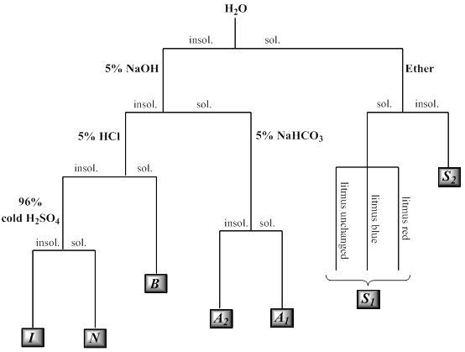

Slide 6
Discussion on solvents
*Water
A polar solvent with a dielectric constant
equals to 80.
It has the ability to form hydrogen bonding
Act either as an acid or a base.

Slide 7
Therefore, it can dissolve:
Salts of ammonium ion (RNH₄⁺) or organic acids salts with alkali metal cations (RCOO⁻).
Ionic compounds.
Polar compounds “like dissolves like”.
Organic compounds with low molecular weight (less than 5 carbon atoms) such as alcohols, aldehydes, ketones, and carboxylic acids.

Slide 8
Water is useful to determine the degree of acidity of a compound, even if the compound is insoluble in water, using litmus paper (acidic, basic, or neutral).
Water is the first solvent used to determine the solubility class of a compound. If the compound is water soluble, the next step is to test its solubility in ether.

Slide 9
Ether
A non-polar solvent having a dielectric constant of 4.3.
it cannot form hydrogen bonding (unassociated liquid).
Therefore, it differs from water in that it cannot dissolve ionic compounds such as salts.
It dissolves most water insoluble compounds; therefore, in the determination of solubility class, the importance of ether is for water-soluble compounds only and no further solubility tests using the remaining solvents are to be done.

Slide 10
Accordingly, two probabilities are there:
compounds soluble in both water and ether.
These compounds:
Are non-ionic.
Contain five or less carbon atoms.
Contain an active group that is polar and can form hydrogen bonding.
Contain only one strong polar group.
This division of compounds is given S₁ class and includes, e.g., aldehydes, ketenes, and aliphatic acids of low molecular weight.

Slide 11
compounds soluble in water only (but not in ether).
These compounds:
Are ionic.
Contain two or more polar groups with no more than four carbon atoms per each polar group.
This group is classified as S₂ class and includes ionic salts such as salts of carboxylic acids and amines and compounds with more than one active group such as poly hydroxylated compounds and carbohydrates.

Slide 12
Note that solubility in ether is tested only for water-soluble compounds. For water insoluble compounds use the left side of the solubility classification scheme, i.e. test solubility in sodium hydroxide rather than ether.

Slide 13
*5% NaOH & 5% NaHCO₃
Water insoluble compounds must be tested first in 5% sodium hydroxide solution which is a basic solvent. It reacts with water insoluble compounds that are capable of donating protons such as strong and weak acids. The stronger the acid, the weaker the base it can react with. Water insoluble compounds that dissolve in 5% sodium hydroxide solution must also be tested for solubility in 5% sodium bicarbonate solution.

Slide 14
Therefore, for water insoluble acidic compounds sodium hydroxide solution is considered as a detecting solvent whereas sodium bicarbonate solution is called as a sub classifying solvent since it can react with strong acids only. That is, these two solvents give an idea about the acidity degree of the compound.
Note that testing solubility in 5% sodium bicarbonate solution is not needed if the compound is insoluble in 5% sodium hydroxide solution, but rather, 5% hydrochloric acid solution should be used.

Slide 15
Two probabilities are there:
compounds soluble in both bases.
This group is given class A₁.
This class includes strong acids that have the ability to react with weak bases (carboxylic acids) and phenols with electron withdrawing groups (e.g., –NO₂). Protons are weakly attached and can be given easily.

Slide 16
compounds soluble in 5% sodium hydroxide solution only.
This group is given class A₂
This class includes phenols, amides, and amino acids (weak acids).

Slide 17
5% HCl
If the compound is insoluble in water and sodium hydroxide solution (and, hence, insoluble in sodium bicarbonate solution too), this means that the compound is not an acid but, rather, is either a basic compound or a neutral compound.
5% hydrochloric acid solution, which can dissolve basic compounds such as amines (RNH₂), is used for such a compound. If the compound is soluble in this solvent, then it is given class B. This class includes primary, secondary, and tertiary amines.

Slide 18
Cold concentrated H₂SO₄
If the compound is insoluble in water, 5% sodium hydroxide solution, and 5% hydrochloric acid solution, solubility in cold concentrated sulfuric acid should be tested. If the compound is soluble in this acid, it belongs to class N which includes neutral compounds such as high molecular weight alcohols, aldehydes, ketones, esters, and ethers (more than four carbon atoms), unsaturated hydrocarbons.

Slide 19
On the other hand, compounds that are insoluble in cold concentrated sulfuric acid belong to class I which includes inert aliphatic (saturated) hydrocarbons, aromatic hydrocarbons (benzene), halo alkanes, and aryl halides.

