Slide 1
Identification of Aldehydes and Ketones

Slide 2
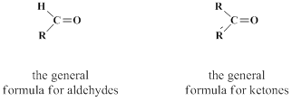
Aldehydes are compounds of the general formula RCHO; ketones are compounds of the general formula RŔCO. The groups R and Ŕ may be aliphatic or aromatic, and in one aldehyde, formaldehyde, R is hydrogen.

Slide 3
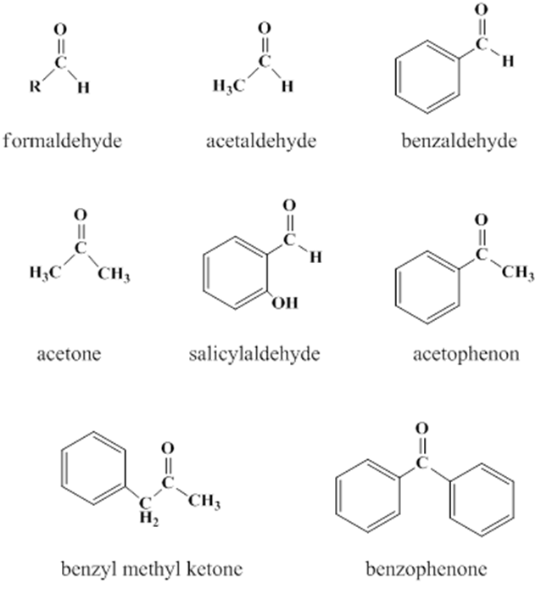
Both aldehydes and ketones contain the carbonyl group, C=O , and are often referred to collectively as carbonyl compounds. It is this carbonyl group that largely determines the chief chemical and physical properties of aldehydes and ketones.

Slide 4
Aldehydes and ketones differ from alcohols in having two less hydrogen atoms. Removal of these two hydrogens from a primary alcohol as a result of oxidation yields an aldehyde; where as their removal from a secondary alcohol gives a ketone. The relation between these carbonyl compounds and alcohols is, therefore, oxidation-reduction relation. Tertiary alcohols can’t undergo this reaction.

Slide 5
Physical properties
All aldehydes and ketones are liquids except formaldehyde, which is gas (boiling point -21˚C), and benzophenone, which is solid (melting point 48˚C). Formaldehyde is handled either as an aqueous solution (formalin, an aqueous solution of 40% formaldehyde and 15% methanol.) or as one of its solid polymers: paraformaldehyde, (CH₂O)_{n}, or trioxane, (CH₂O)₃.

Slide 6
Low molecular weight aldehydes and ketones (less than 5 carbons) are appreciably soluble in water, although they do not have the ability to form hydrogen bonds (unlike alcohols), aromatic ones are insoluble in water, and all of them are soluble in organic solvents.
They are colorless except benzaldehyde, which has a pale yellow colour (due to oxidation) with a characteristic odour.

Slide 7
The boiling points of aldehydes and ketones are lower than those of the alcohols from which they are derived; isopropyl alcohol boils at 82.5˚C while its oxidation product, acetone, boils at 56˚C, ethanol boils at 78˚C while its oxidation product, acetaldehyde, boils at 21˚C.
Aliphatic aldehydes and ketones burn with a blue flame (without smoke) while aromatic ones burn with a yellow smoky flame.

Slide 8
Solubility classification
Aldehydes and ketones that are soluble in water are soluble in ether too and are classified under class S1(e.g., formaldehyde and acetone).Aldehydes and ketones that are insoluble in water are classified under class N such as benzaldehyde and benzophenone.

Slide 9
Chemical properties:
All reactions of aldehydes and ketones are related to the carbonyl group (the active group).
Aldehydes contain a hydrogen atom attached to its carbonyl while ketones don’t. This difference in the chemical structure affects their chemical properties in two ways:

Slide 10

Aldehydes are easily oxidized to the corresponding acids and have reducing properties while ketones are not oxidized under similar conditions and do not show reducing properties.
Aldehydes are usually more reactive than ketones towards nucleophilic addition, the characteristic reaction of carbonyl group.

Slide 11
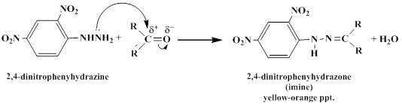
Both aldehydes and ketones are neutral compounds that don’t change the color of litmus paper.
1-General test (2,4-Dinitrophenylhydrazine reagent)
Both aldehydes and ketones give yellow or orange precipitate with 2,4-dinitrophenylhydrazine reagent.

Slide 12
Procedure
To 2 drops of the compound add 3 drops of the reagent, a yellow or orange precipitate will be formed. If the compound is insoluble in water, dissolve it in 1 mL of methanol and then add the reagent.

Slide 13
2- Differentiation between aldehydes and ketones
Differentiation between aldehydes and ketones is achieved by taking the advantage of the fact that aldehydes can be easily oxidized while ketones cannot (they need stronger oxidizing agents).Two reagents can be used for this purpose, Tollen’s reagent or Fehling’s reagent. Only aldehydes give positive results with these two reagents.

Slide 14
a) Tollen's test (Reduction of ammoniacal silver nitrate)
Tollen’s reagent is the combination of silver nitrate solution with ammonium hydroxide in the presence of sodium hydroxide solution.
Aldehydes show positive result with this reagent because the reaction between them involves the oxidation of the aldehyde to the corresponding carboxylic acid with an accompanying reduction of the silver ions from this reagent to silver element in the form of silver mirror on the inner side of the test tube.

Slide 15
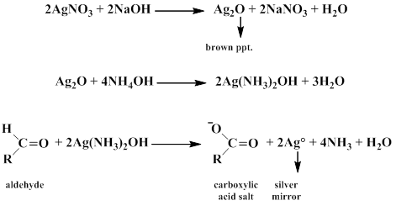

Slide 16
The oxidation process requires an alkaline medium; therefore, sodium hydroxide solution is used, and in order to overcome the formation of the brown silver oxide precipitate (Ag₂O), ammonium hydroxide is used to serve as a complexing agent for this precipitate making it a water soluble complex. Note that since the medium is alkaline, salts of the produced carboxylic acid are formed rather than the acid itself.

Slide 17
Procedure
Preparation of Tollen’s reagent
To 3mL of silver nitrate solution add 2-3 drops of 10% sodium hydroxide solution, and then add drop wise very dilute ammonia solution with continuous shaking until all the brown precipitate of silver oxide is dissolved. This reagent should be freshly prepared before use.

Slide 18
Add 2-3 drops of the compound to 2-3 mL of Tollen’s reagent, a silver mirror will be formed. If no reaction occurs, warm the test tube in water bath for few minutes (note that excessive heating will cause the appearance of a false positive test by decomposition of the reagent).
The formed silver mirror can be washed using dilute nitric acid.
A negative result indicates that the compound is a ketone.

Slide 19
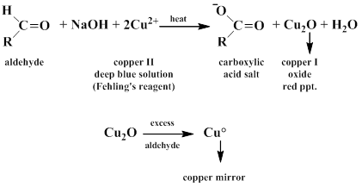
b) Reduction of Fehling's reagent
This test, like Tollen’s test, is used to distinguish aldehydes from ketones. Only aldehydes can reduce Fehling’s reagent (a deep blue solution) to give a red cuprous oxide precipitate.

Slide 20
Procedure
Preparation of Fehling's reagent
Fehling’s reagent is prepared by mixing exactly equal volumes of Fehling’s A and Fehling’s B solution in a 1:1 ratio immediately before use (usually 1 mL of each).Fehling’s A solution is an aqueous solution of copper sulfate pentahydrate (CuSO₄.5H₂O) with few drops of concentrated sulfuric acid whereas Fehling’s B solution is an aqueous solution of potassium sodium tartrate (C₄H₄KNaO₆,4H₂O) and sodium hydroxide.

Slide 21
Add 5 drops of the compound to 1 mL of Fehling’s solution, and then heat in water bath for 5 minutes (with shaking for water insoluble compounds).
Aldehydes change the color of Fehling’s solution from blue to green, orange precipitate, and then red precipitate or copper mirror. Ketones don’t change the color of this reagent. On the other hand, this test does not give a sharp result with aromatic aldehydes.

Slide 22

3-Special tests for aldehydes and ketones containing a terminal methyl group
These compounds include acetaldehyde, acetone, acetophenone, and benzyl methyl ketone. All of them have a methyl group attached to the carbonyl group:

Slide 23


a) Iodoform (Haloform) test
Follow the same procedure of iodoform test mentioned earlier (identification of alcohols).

Slide 24
b) Sodium nitroprusside test
To few drops of the compound add 1 mL of sodium nitroprusside (Na₂[Fe(CN)₅NO].2H₂O) solution and excess of 30% sodium hydroxide solution, a red color complex is a positive test.

Slide 25
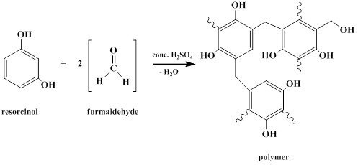
4- Polymerization reaction
To 0.5 mL of formaldehyde or salicylaldehyde add 0.2 gm of resorcinol and drop-by-drop concentrated sulfuric acid to get a red or reddish violet color, or a white ring that changes to a reddish violet ring.

Slide 26

5- Cannizzaro reaction
Benzaldehyde, salicylaldehyde, and formaldehyde can undergo Cannizzaro reaction because they do not have an alpha hydrogen atom.

Slide 27
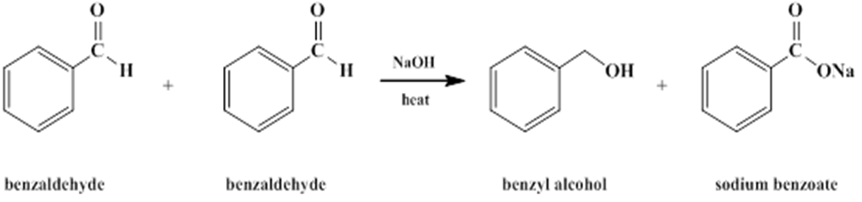
In this type of reactions the aldehyde undergoes a self oxidation-reduction in the presence of a strong basic medium to yield a mixture of the corresponding alcohol and the salt of the corresponding carboxylic acid (or the acid itself). Therefore, one molecule of the aldehyde serves as the oxidizing agent while the other serves as the reducing agent.

Slide 28
Procedure
To few drops of benzaldehyde (or the other aldehydes) add 0.5 mL of 30% sodium hydroxide solution and heat gently on a water bath with shaking for five minutes. A precipitate of sodium benzoate is produced. Dissolve this precipitate by adding few drops of distilled water, and then add drops of concentrated hydrochloric acid to liberate benzoic acid as a white precipitate

Slide 29
The other product is benzylalcohol which is liquid (immisible with water) and can not be recoginized easily.
As mentioned earlier formaldehyde can undergo this reaction; however, this reaction can't be relied on for testing formaldehyde since the acid produced, formic acid, and the alcohol produced,methanol, both of them are liquids (both are missible with water) that can't be observed separately as compared to the solid benzoic acid resulted from benzaldehyde.

