Slide 1
Phylum Nematoda “Greek nema a thread” Dr. Wasan Addai Al-Marsomy

Slide 2
General Characteristic of Nematoda
1. Most of member are small and free living, terrestrial (soil), aquatic (fresh water and marine) and parasitic (on plants and animals)
2. The body is cylindrical, this is the reason for their common name, round worms.
3. Bilateral symmetry.
4. Are pseudocoelomate; the mesoderm is only associated with the outer body wall (ectoderm). The mesoderm never splits and never located next to the inner endoderm.

Slide 4
General characters
5- The epidermis is mass of cellular material and nuclei without separated membranes. This epidermis secretes a thick outer cuticle, the cuticle is shed during the life of a nematode as it grow, usually four times before reaching the adult stage. This feature shared with Arthropoda called ecdysozoa.
6. The body wall only contains longitudinal muscle .
7. The muscle are activated by two nerves that run the length of the nematodes on both dorsal and ventral side. The ventral nerve has a series of nerve centers along and both nerves to a nerve ring and additional nerve centers located near the head.

Slide 6
8-The digestive tract is complete, consisting of mouth, intestine and anus. Some round worm are predators feeding on small animals. Other are scavengers feeding on dead tissue.
9. Nutrient and west are distributed in the body cavity, whose contents are regulated by an excretory canal along side of the body.
10.Reproductive organs lie in the fluid body cavity. Nematodes are dioecious (separate sex) and exhibit sexual dimorphism (male & female body distinct). Males are smaller, shorter and thinner and have a pronounced hook at the posterior end. The females are larger, longer and fatter

Slide 8
11- Free living forms have a simple life cycle involving 4 juvenile instars on the path from egg to adult. Parasitic species have developed a wide rang of variations.
12.The anterior and posterior ends of the body often have cephalic and caudal papillae, which also contain cilia and are believed to be sensitive to mechanical stimulation.
13.Many nematodes are able to suspend their life processes completely when conditions become unfavorable, and then return to life when favorable conditions return this is known as cryptobiosis
14.Sense organs, many species have simple, pigmented light receptors (ocelli). The major chemosensory organs called amphids (chemoreceptors), are anteriorly located pits. Similar structure called phasmids (chemoreceptors) are located at the posterior ends of the some nematodes.

Slide 10
Classification of Nematoda 1- Class Adenophorea (A phasmidia)
Excretory organ, is a glandular renette gland cell in the pseudocoel near the pharynx. It has a necklike duct that opens ventrally on the midline as an excretory pore.
Usually possess numerous epidermal glands, as well as caudal glands that open on the tip of the tail.
Lack phasmids (paired caudal saensilla).
Male usually have two testes

Slide 11
G. Trichinella spiralis is a nematode parasite, occurring in rats, pigs, bears and humans, and is responsible for the disease trichinosis. It is sometimes referred to as the "pork worm" due to it being found commonly in undercooked pork products.

Slide 12
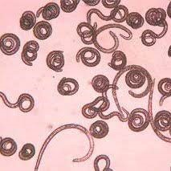
G. Trichinella spiralis

Slide 13
2- Class Secernentea (phasmidia)
Have lateral excretory canal opening by anterior ventral pore
With paired phasmids
Lack epidermal glands and caudal glands
Males always have a single testis

Slide 14
A- Order Ascaridida : Ascaris lumbricoides (intestinal worm) is the giant roundworm of humans. An ascarid nematode, it is responsible for the disease ascariasis in humans, and it is the largest and most common parasitic worm in humans. One-sixth of the human population is estimated to be infected by this parasite. Ascariasis is prevalent worldwide and more so in tropical and subtropical countries. It can reach a length of up to 35 cm.

Slide 15
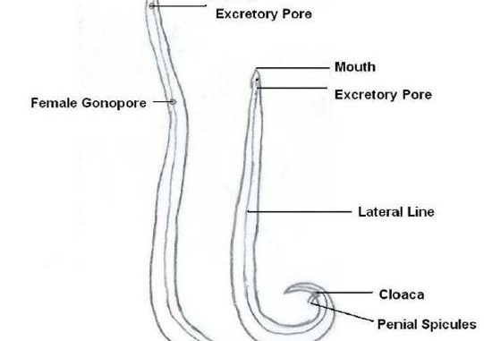
Ascaris lumbricoides

Slide 16
B- Order Rhabditia : Rhabditis A genus of small nematodes (family Rhabditidae), some of which are free-living, others parasitic on plants and animals; by dwelling on decaying organic matter, some species have been viewed as parasitic.

Slide 17
G: Rhabditis

Slide 18
C- Order Strongylida: Ancylostoma duodenale The hookworm is a parasitic nematode that lives in the small intestine of its host, which may be a mammal such as a dog, cat or human. Two species of hookworms commonly infect humans, Ancylostoma
duodenale and Necator americanus.

Slide 19
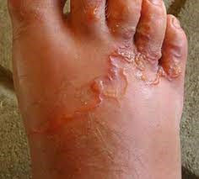
Ancylostoma sp.

