Slide 1
Phylum Annelida "Annelus. Little ring" Dr. Wasan Addai Al-Marsomy

Slide 2
General characters
1. Body metamerically (homologous segments) segmented (Metamerism).
2- Bilaterally symmetrical and vermiform.
3- Body wall with outer circular and inner longitudinal muscle layers; outer transparent moist cuticle secreted by epithelium.
4- Body cavity is a true coelom, often divided by internal septa.
5- Body possesses 3 separate section, head, trunk and pygidium. The head consist of two segments prostomium (1st. Segment) and peristomium (2ed. Segment).

Slide 3
General characters
6-Circulatory system is closed.
7- Digestive system complete.
8- Respiration through body wall or gills on parapodia (locomotion organs).
9- Excretory system typically consists of a pair of nephridia per segment
10- Nervous and sensory systems present.
11- Hermophroditic or dioecious, asexual reproduction.
12- Chaetae. A distinctive feature of annelids chaetae also called setae.
Parapodia (para, beside + podia, feet), singular parapodium, are paired un-jointed lateral outgrowths. They are characteristic of Polychaeta

Slide 4
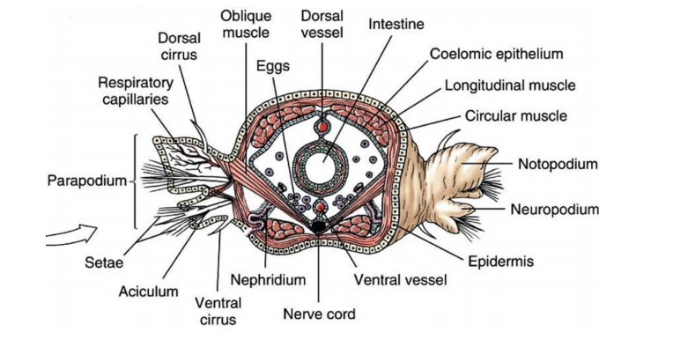
13- Parapodia are either uniramous or biramous. In the latter case, the dorsal lobes or branches are called notopodia and the ventral branches neuropodia..

Slide 5
Classes of Annelida 1- Class Polychaeta (sand worm, tube worm and clam worm)
Marine
• Prostomium with two pairs of tentacles and palps.
• Pairs Parapodia each segment.
• Parapodia consist of upper division (notopodium) and ventral division (neuropodium) with cirrus (cirri).
• Dioecious, external fertilization, with a free-swimming trochophore larva Trochophore larvae (ciliated structure feed on zooplankton).

Slide 6
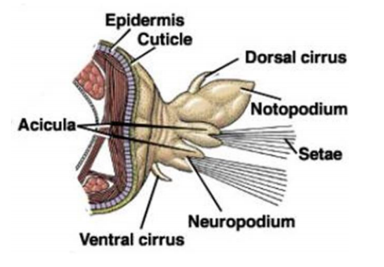
Polychaeta

Slide 7
2- Class Clitellata a- Subclass Oligochaeta (Earthworms and Freshwater Worms
Their name means few hairs
All bear setae, but the number of setae present is much smaller than in polychaetes.
Head without antennae and palps.
They differ from polychaetes in that they possess permanent sex organs.
Respiration through body wall.
No parapodia.
Hermaphrodites, development direct, eggs are deposited in a cocoon by clitellum.
Feed on detritus and algae.
They help to aerate soil and increase soil productivity.

Slide 8
Earthworms (Digestive system)
Mouth is the beginning of the digestive tract. Pharynx is located in segments 1-6. the esophagus in segments 6-13 acts as a passageway between pharynx and crop. The crop stores food temporarily. The mixture that the earthworm ingests is ground up in the gizzard. In the intestine, which extends over two-thirds of the body length. Digestion and absorption take place. Soil particles and undigested matter pass out of the worm through the rectum and anus.

Slide 9
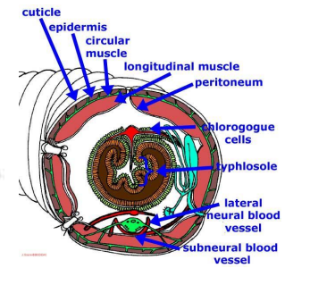
A typhlosole is an internal fold of the intestine. In earthworm it is a dorsal flap of the intestine that runs along most of its length. Its function is to increase intestine surface area for more efficient absorption of digested nutrients.

Slide 10
Earthworms (Reproduction)
The Clitellum is a swelling of the body found in sexually mature worms and is active in the formation of an egg capsule or cocoon .
Eggs are produced in the ovaries and pass out body through female genital pores.
Sperm are produced in the testes pass out body through male genital pores.
During mating, sperm from one worm travel along the sperm grooves to the seminal receptacles of another worm.
Fertilization of eggs take place outside the body as the cocoon moves forward over body, picking up the eggs of one worm and the sperm of its mate.

Slide 11
Earthworms (Reproduction)

Slide 12
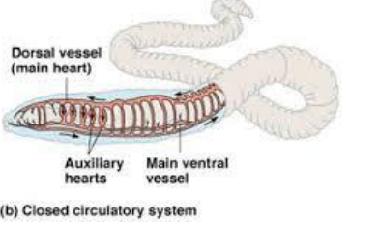
Earthworms (Circulatory system)
The pumping organs of the circulatory system are five aortic arches. Circulatory fluids travel from the arches through the ventral blood vessel to capillary beds in the body. The fluids then collect in the dorsal blood vessel and reenter the aortic arches.

Slide 13
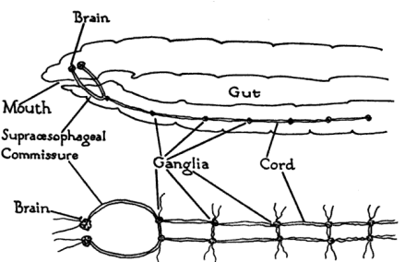
Earthworms (Nervous system)
The nervous system consists of the ventral cord, which travels of the worm on the ventral side, and a series of ganglia, which are masses of tissue containing many nerve cells. The nerve collar surrounds the pharynx and consists of ganglia above and below the pharynx. Nervous impulses are responsible for movement and responses to stimuli. Each segment contains an enlargement or ganglion along ventral nerve cord.

Slide 14
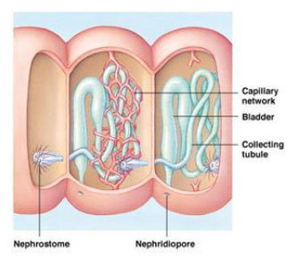
Earthworms (Excretory and circulatory systems)
Excretory functions are carried on by nephridia, which are found in pairs in each body segment. They appear tiny white fibers on the dorsal body wall. The earthworm has no gills or lungs. Gases are exchanged between the circulatory system and the environment through the moist skin.

Slide 15
b- Subclass Hirudinea (Leeches)
They have a fixed number of segments (usually 34)
Both an anterior and posterior sucker
No parapodia, and usually setae
Anterior sucker is small and contains the mouth and posterior
sucker is for attachment
The coelom is not subdivided by septa in most species, and it has been filled with muscle and connective tissue.
Leeches are hermaphorditic.
Freshwater habitats, few marine and some are
terrstrial
Most are either carnivorous or external parasites on
fishes, frogs

Slide 16
(Leeches)

Slide 17
Medicinal Leeches ( G:Hirudo medicinalis)
The salivary glands excrete hirudin which prevents the blood from coagulating .
May also secrete an anaesthetic and substance to dilate small blood vessels.
Blood is broken down by symbiotic bacteria that is then used by the leeches
Leeches were commonly used in the 19th century for bloodletting
Recent medical uses are to relieve pressure after vascular tissue is damaged.

