Slide 1
Phylum Platyhelminthes (Flatworms) (Greek platy = flat and helmins = worms) Dr. Wasan Addai Al-Marsomy

Slide 2
General characters
1. Bilaterally symmetrical.
2. Cephalization-head ( concentration of nervous tissue)
3. Triploblastic- 3 cell layers (Ectoderm, Mesoderm, Endoderm )
4. Acoelomate, no internal cavity .
5. Possesses a blind gut (i.e. it has a mouth but no anus)
6. Excretion and osmoregulation by flatworms is controlled by "flame cells" located in protonephridia (these are absent in some forms.)
7. Has normally a nervous system of longitudinal fibers rather than a nervous net.
8. Generally dorsoventrally flattened.

Slide 3
General characters
6. All are hermaphrodites. Parasitic species (flukes and tapeworms) have complex
lifecycles, with various hosts and several different larval stages.
10.Incredible powers of regeneration.
11.many as parasites of other animals. Some are free living.
12.Flatworms lack a respiratory or circulatory system; these functions take place by
absorption through the body wall.
13.In some flatworms, the process of cephalization has included the development in the head region of light-sensitive organs called ocelli. Other sense organs found in at
least some members of this group include chemoreceptors, balance receptors
(statocysts), and receptors that sense water movement (rheoreceptors).

Slide 4
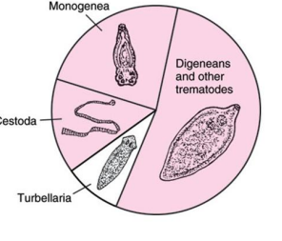
Classification of Platyhelminthes

Slide 5
1- Class Turbellaria (planarians)
1- Most are free–living, marine and benthic, but some are fresh water.
2- They are dorsoventrally compressed.
3- Marine species can be quite colorful, but the terrestrial turbellarians tend to be drab .
4- They move by coordinates waves of cilia on a secreted mucus trail, some species can swim by rhythmic muscle contractions.
5- Their ciliated epidermis, the presence of sub-epidermal rhabdites, and their free-living condition distinguish turbellarians from members of the other classes of Platyhelminthes.

Slide 6
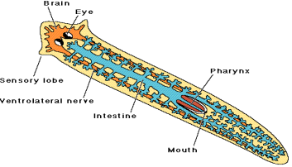
Digestive System of Turbellaria
In planarians, the pharynx can extend through the mouth that is mid-ventrally located.
The intestine has three branches, one anterior and two posterior. This gastrovascular cavity is lined with columnar epithelium.

Slide 7
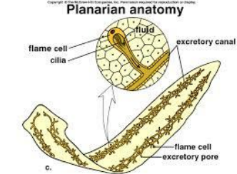
Excretion system
1- The excretory „system‟ is composed of flame cells, excretory tubules and excretory pores.
2- The cilia of flame cells (protonephridia)beat and remove excess H2O and nitrogenous wastes from tissue cells to the excretory tubules and out the excretory pores.
3- The development of the system is necessary because the more nitrogenous wastes and excess H2O need to be removed.

Slide 8
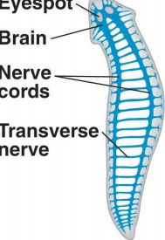
Nervous System of Turbellaria
Includes: brain, longitudinal nerve cords and transverse nerves. Most free living planarians and parasitic larval forms possess a variety of sensory organs, such as eyespots (light), statocysts (balance), rheoreceptors (sense direction of water current) They do not have image-forming eyes, but many species have pigment cells and photoreceptors concentrated into eyespots.

Slide 9
Reproduction
a) Asexual: binary fission and they regenerate any missing parts.
b) Sexual: hermaphrodites exchange gametes with each other.
• Fertilization is internal. The zygote is released into H2O.

Slide 10
2- Class Monogenea
Monogenetic flukes are small flukes without a well-developed sucker. At their posterior end, they have a bulbous structure covered with hooks called an opisthaptor. Most monogeneans are ectoparasites on fish or other aquatic animals, a few live in the urinary bladders of turtles and frogs. Their life cycle involves a single host. Eggs hatch into ciliated larvae, which may attach directly to a host or swim freely for a time before attaching. Adults lack cilia.

Slide 11
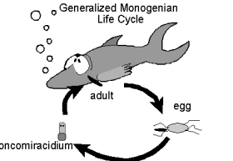

Slide 12
3- Class Trematoda (Flukes) A- subclass Digenea
1- The Digeneans are a large and successful group of parasites.
2- They all have complicated life cycles involving at least one intermediate host, which is normally an aquatic snail as well as the primary host which is normally a vertebrate.
3- The adults are flat worm shaped, they have two sucker. The first is the oral sucker, around the mouth, it has two functions, a) to hold the animal to its host and b) to assist in feeding.
The second sucker is found a little way further down the animals body and for attachment.

Slide 13
They have an “alternation of generations”. This means the egg hatches into a larval form which reproduces asexually to produce numerous copies of itself, these copies change into another larval form which in time grows into a sexually reproducing adult.
This possession of an asexual generation means that a single egg can produce not just one infections agent, but many, this is called Polyemberyony.
The species that infect humans can be divided into groups, the Schistosomiasis (meaning they live and feed inside the blood vessels).

Slide 14
The difference between the non-Schistosomiasomes and the Schistosomiasomes is that in the non-Schistosomiasomes the cercaria larvae never leave the intermediate host. Instead they form cysts on vegetation or in the snails body as G. Fasciola . Thus the primary host always becomes infected as a result of eating material contaminated with encysted cercaria or metacercaria.

Slide 15
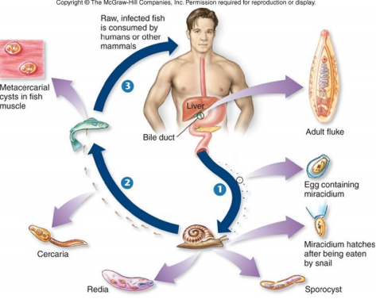
life cycle of G:Fasciola

Slide 16
3-Class Trematoda B- Subclass Aspidogastrea
1- Small group of absolutely no economic importance .
2- They are parasites of freshwater and marine mollusc and vertebrates.
3- have a nervous system of extraordinary complexity, greater than that of related free living forms, they have a very great number of sensory receptors of many different types.

Slide 17
4- Class Cestoda (tapeworms)
1-Their bodies are long and flat, made up of many segments called proglottids. Each
proglottid is a reproductive unit.
2- Adults lack cilia and their surface is a tegument (as in monogeneans and trematodes), but in cestodes the tegument is covered with microvilli, which increase its surface area and thereby its ability to absorb nutrients from a host.
3- Digestive tracts are absent completely. At the tapeworm's anterior end is a specialized segment called a scolex, which is usually covered with hooks or suckers and serves to anchor it to the host.
4- Most require at least two hosts, with the host of the adult tapeworm a vertebrate.
Intermediate hosts are often invertebrates. A number of tapeworm species inhabit
humans.

Slide 18
A- subclass Cestodaria
contains only a few species of unusual worms, their bodies are unsegmented and roughly oval in shape, they have only a single set of male and female reproductive organs and the larvae have 10 hooks in posterior end of the body for attachment .

Slide 19
B- subclass Eucestoda
1- The larvae have 6 attachment hooks.
2- The adult body consists of a head, called a 'Scolex' which is distinguished by the
presence of suckers and hooks, the hooks may be absent as in Taenia saginatus .
3- They live in darkness there are no eyes.
4- they do not feed in the usual manner there is no mouth .
5- Behind the scolex is a band of rapidly growing material that produces an endless series of reproductive segments called 'Proglottids'. The proglottids contain both male and female reproductive organs, making the tapeworms hermaphrodites. The male organs mature before the female ones. In some species such as the fish tapeworm
(Diphyllobothrium latum) can reach 20 meters in length, contain 3,000 proglottids and
produce millions of eggs every day.

Slide 20
Two orders, Pseudophyllidea and Cyclophyllidea
Cyclophyllidean
cestodes have terrestrial host life-cycles.
scolex with 4 suckers and sometimes hooks.
The larvae of Taenia spp. cause cysticercosis in cattle,
pigs and humans ,
while those of Echinococcus cause Echinococcosis or
hydatid disease in humans, domestic and wild animals.

Slide 21
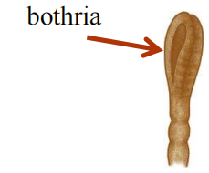
Pseudophyllidean
Cestodes have aquatic host life-cycles.
Scolex with 2 longitudinal bothria.
Cause Sparganosis in humans.

