Slide 1
Protozoa
Dr. Wasan Addai Al-Marsomy

Slide 2
  Protozoans are important organisms in the life on earth. The Protozoa are essentially single-celled eukaryotic organisms.
  Protozoa are one-celled animals found worldwide in most habitats. Most species are free living, but all higher animals are infected with one or more species of protozoa. Infections range from asymptomatic to life threatening, depending on the species and strain of the parasite and the resistance of the host.

Slide 3
The bases for classification of protozoa are:
(1) Morphological characteristics such as (a) organelles of locomotion (b) body size and shape (c) organelles of attachment to substrata (d) colonial organization (e) pellicle or superficial differentiation (f) sub pellicle bodies and febrile systems (g) feeding organelles (h) internal differentiation and cytoplasmic inclusions (i) nuclear characteristics.
(2) Non-morphological characteristics; such as (a) ecological consideration of free-living forms (b) host-parasite relationships of symbiotic forms (c) general physiological characters (d) biochemical and serological characters (e) pigments, coloration in general, characteristic food reserves (f) morphogenetic features: attention to full life cycles (g) genetic factors and phylogenetic considerations.

Slide 4
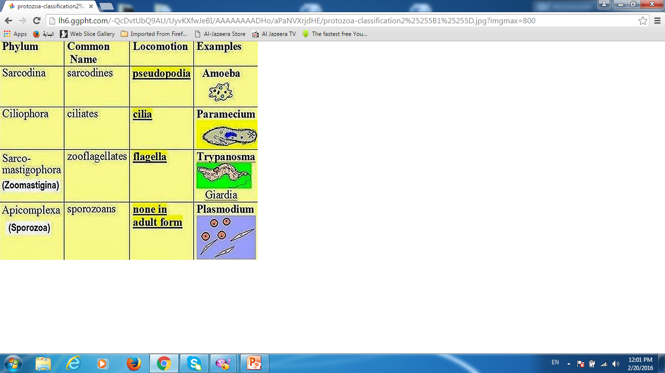

Slide 5
Kingdom: Protista
Subkingdom: Protozoa
Phylum: Mastigophora
Unicellular heterotrophic protozoans of the kingdom Protista.
Most of the approximately 1,500 species are range by one or more flagella, and members of the group are sometimes referred to as flagellates.
Some have pseudopodia
Asexual reproduction by equal longitudinal, binary or repeated fission, some species reproduce sexually by a process called syngamy, the fusion of two gametes produced by meiosis.
Some parasitic members of the Mastigophora are the causative organisms of disease in humans and other animals.
Divided into the two classes.

Slide 6
‒Class: Phytomastigophorea
Typically with chloroplasts; if chloroplasts lacking, relationship to pigmented forms clearly evident, mostly free living.
‒Class: Zoomastigophorea
Chloroplasts absent; have one to many flagella; amoeboid forms (in some groups); sexuality known in some groups.

Slide 7
Class: Phytomastigophorea
Plant-like flagellates; likewise all methods of nutrition are exhibited, commonly one or two flagella. Divided into orders of which:
1- Order: Cryptomonadida ex: Chryptomonas, Chilomonas.
2- Order: Dinoflagellida ex: Ceratium, Gymnodinium, Noctiluca.
3- Order: Euglenida ex: Euglena, Copromonas.
4- Order: Chrysomonadida ex: Chrysamoeba, Dinobryon.
5- Order: Volvocida ex: Volvox, Chlamydomonas

Slide 8
1- Order: Cryptomonadida
Flagella 2, usually arising from a gullet, Body dorsoventrally flattened; a single large contractile vacuole. Chromatophores typically 2; color green, brown or colorless. Food reserves starch and very rarely amyloid substances; cyst-wall cellulose. Freshwater and marine. Asexual reproduction, ex: Cryptomonas and Chilomonas which are colorless in stagnant water.

Slide 9
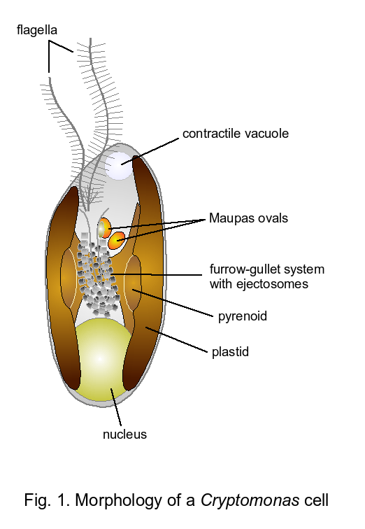
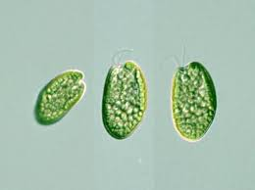
G: Cryptomonas

Slide 10
2-Order: Dinoflagellida
They contain either numerous yellow-brownish plastids or none. Two flagellate, one in a transverse groove (annulus) and the other trailing in a longitudinal groove (sulcus). The annulus divides the body into an anterior epicone and a posterior hypocone. The body may be naked as in Gymnodinium or covered with a theca made of cellulose plates that are usually sculptured and provided with pores, as in Ceratium.
All methods of nutrition are adopted. Some colored species live as mutualistic. Ceratium sp. is both photo-and phagotrophic in fresh and salt waters.

Slide 11
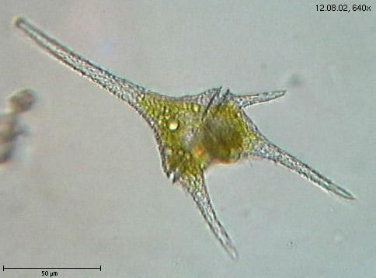
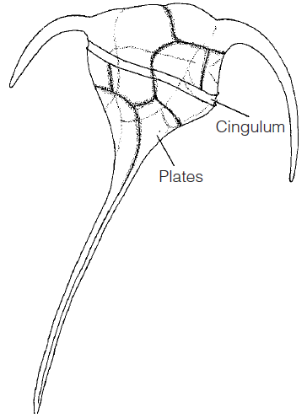
G: Ceratium

Slide 12
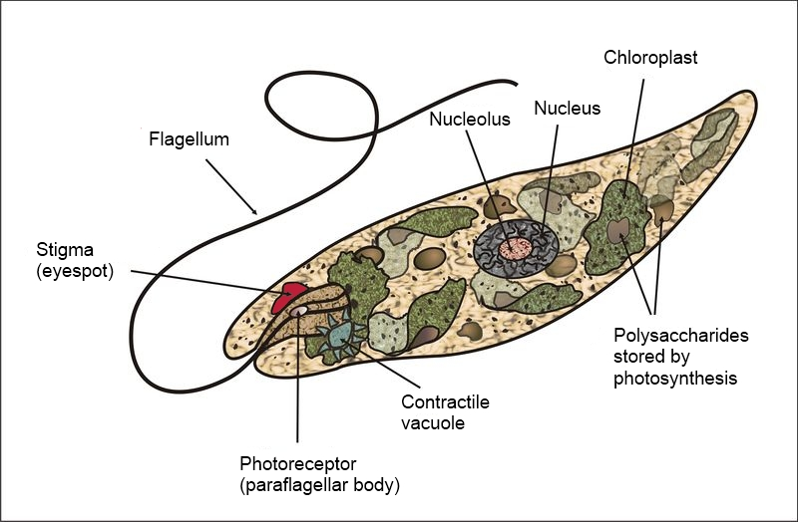
3-Order: Euglenida: Flagellum 1 or 2 emerging from an anterior. Pellicle may be flexible allowing for movement. Chromatophores are green of various shapes and numbers; food reserve paramylum. Asexual reproduction by longitudinal binary fission.
G: Euglena

Slide 13
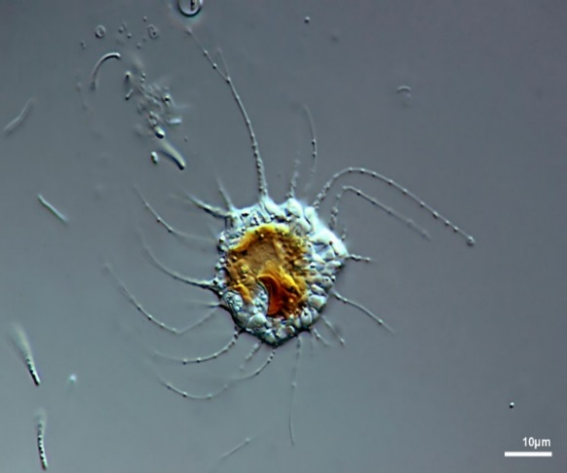
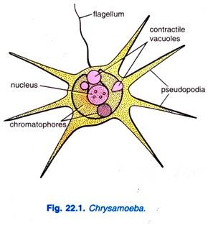
4- Order: Chrysomonadida
Flagellum 1 or 2. Yellow, brown or colorless without starch reserves, products of photosynthesis fatty oils and leucosin, e.g. Chrysamoeba.
G: Chrysamoeba

Slide 14
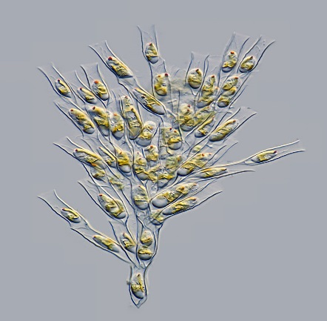
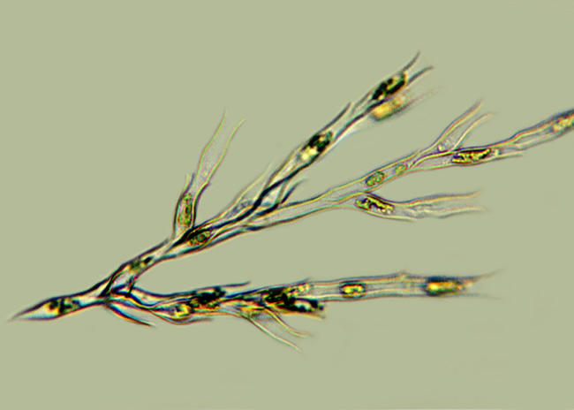
Chrysomonads of Drinking water:
Sometimes certain species of colonial chrysomonads become too numerous in water stored in reservoirs and makes it unsuitable for drinking. This is due to the odors of the aromatic oils produced by these organisms and liberated from their bodies when they die. The oils of Dinobryon have a fishy odor, while that of Synura has an odor that resembles ripe cucumbers and bitter and spicy taste.
G: Dinobryon sp.

Slide 15
5- Order: Volvocida (Phytomonadida)
Flagellum 1 or 2. Chromatophores are green and commonly cup shaped, colonial and often single. They closely resemble typical plants. Reserve material is starch. Many are solitary, ex. Chlamydomonas. Haematococcus which is red and produce the phenomenon of "red rain" by it sudden appearance in rain pools.
The family volvocidae is well known by its colonial forms ex. Gonium (discoid) Pandorina and Volvox (spheroid). Sexual reproduction (isogamous and anisogamous) is common.

Slide 16
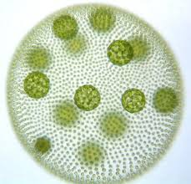
G: Volvox

Slide 17
II- Class: Zoomostigophorea
Flagellates and heterotrophic; never have a cellulose membrane; reserves are lipids and glycogen. A kinetoplast and other additional organelles are characteristic. Reproduction by binary fission (longitudinal), sexuality absent. Free living or parasitic in various animals.

Slide 18
1- Order: ChoanofIagellida ex: Monosiga, Codosiga.
2- Order: Retortomonadida ex: Chilomastix, Retortomonas.
3- Order: Trichomonadida ex: Trichomonas.
4- Order: Diplomonadida ex: Hexamita, Giardia.
5- Order: Rhizomastigida ex: Mastigamoeba, Histomonas.
6- Order: Hypermastigida ex: Trichonympha.

