Slide 1
Invertebrates Dr. Wasan Addai Al-Marsomy

Slide 2
The Kingdoms
1. Monera (the prokaryotes)
2. Protista (the single-celled eukaryotes)
3. Fungi
4. Plantae
5. Animalia

Slide 3
Animal Phylums There are around 30 to 40 different animal phylums
1. Phylum Porifera “The Sponges ”
2. Phylum Cnidaria “Jellyfish/Coral ”
3. Phylum Platyhelminthes “The Flatworms”
4. Phylum Nematoda “The Roundworms ”
5. Phylum Annelida “The Segmented Worms ”
6. Phylum Mollusca “Think Seafood - Clams, Oysters”
7. Phylum Arthropoda “Insects ”
8. Phylum Echinodermata “Starfish”

Slide 4
What is an Invertebrate?
1. Invertebrates are animals without a vertebral column.
2. The Invertebrates are not a homogenous group of phyla.
3. They show greater range of forms and adaptations than do the vertebrates.
4. Invertebrates consist about 97% of all known animal species, the remaining 3% are the rest.

Slide 5
The benefits of Invertebrates
1. Crayfish, Clam, Shrimp...ect. Considered to be a great recourse of food for human.
2. Used in scientific research, such as drosophila which used in genetics.
3. Some species act as indicator for water pollution, such as Daphinia.
4. Some insects produce wax, honey and silk, and play an important role in plant
fertilization.
5. Used in biological control as a biological agents to control pests, such as lady
beetles which used against aphids.
6. Invertebrates species play a significant role in food chain and serve as food for
other animals.

Slide 6
The harms of Invertebrate
1. Some invertebrates are regarded as pests on agriculture products, such as grasshopper, beetles, nematodes and mites.
2. Some species with medical importance that transmit and cause diseases, such as Nematodes, Ticks, Plasmodium, Schistosoma, flies, fleas and mosquitoes....
3. Several group of marine invertebrates, such as Cnidarians and Sponges are accumulated on ship and electric generates causing in reduction of their efficiency.

Slide 7
Basic of classification
✓ Animal Classification according to the number of cells
1. Protozoa: one cell animals.
2. Parazoa: multicellular animal with loosely aggregated cells .
3. Metazoa: multicellular animal, cells are arranged in a germ layer.

Slide 8
Metazoan are classified according to their germ layers into :
1. Diploblastea; with two germ layers, ectoderm & endoderm (Cnidaria & Ctenophora).
2. Triploblastea: with three germ layers, ectoderm, mesoderm & endoderm (other animals).

Slide 9
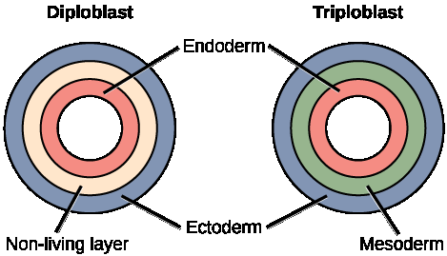
Animal Classification

Slide 10
Animal Classification Presence or absence of body cavity (Coelom)
(Coelom: The space between the body wall and the alimentary canal) .
1. Acoelomate: animals that do not have a cavity, where the region
between their internal organs and body wall. The body volume is
filled with mesenchyme and other tissues.

Slide 12
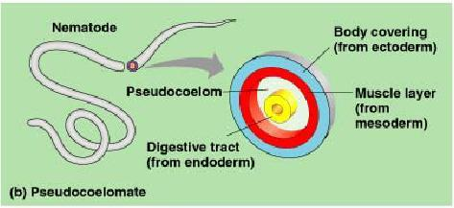
Pseudocoelomate: animal that do have a body cavity but this cavity do not surrounding by the cells of the mesoderm and not lined by a cellular peritoneum.

Slide 13
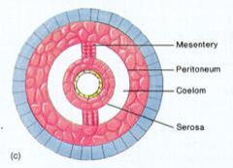
Eucoelomate: With a body space which surrounded by the mesodermic cells and lined with peritoneum .

Slide 14
Animal Classification according to the symmetry
(symmetry): The concept of symmetry allow for division of a whole body into two or
more equal portions by separation along lines or planes.
1. Asymmetrical: animal include those animal which no plane that can be used to
divide their body into equivalent parts (Porifera).
2. Spherical symmetry: occurs when any plane passing through the center divides the
body into symmetrical halves.
3. Radial symmetry: occurs when more than two planes passing through the
longitudinal axis can divide the organism into symmetrical halves.
4. Bilateral symmetry: occurs when one plane can pass through the organism dividing
it into right and left halves.

Slide 15
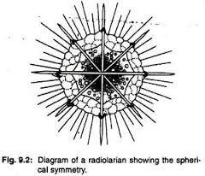
Animal Classification according to the symmetry

Slide 16
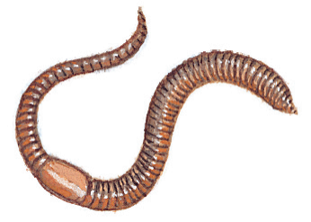
Animal Classification according to the Presence or absence of Segmentation
Metamerism is a segmentation of body and each segment
contains one pair of some or all organs, such as nephridia,
coelomoduct, gonads and ganglia. Metamerism appear in
Annelida, Arthropoda and Chordate.

Slide 17
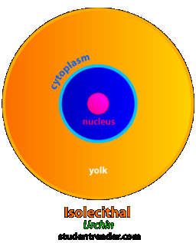
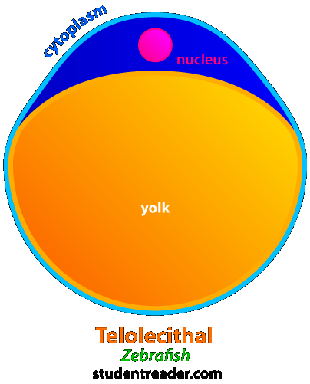
Animal Classification according to the amount of yolk
1. Isolecethal eggs, small amount of yolk, with total holoblastic cleavage (total or entire cleavage).
2. Telolecethal eggs, large amount of yolk, with meroblastic cleavage (partial cleavage).

Slide 18
Animal Classification Coelomate divided according to their mode of development

