Slide 1
Imaging of specific GIT diseases
Dr.shaymaa khalid
Al kindy college of medicine
2024-2025

Slide 2
Objectives:
To know the main radiological tools used to investigate common abdominal GIT diseases such as cholecystitis, pancreatitis, appendicitis and bowel obstruction.
To know the common radiological findings in these diseases.
To know the role of imaging in these diseases.

Slide 3
Peptic ulcer disease
Investigation
Endoscopy is the investigation of choice to confirm ulceration and biopsy.
Radiology is of limited use.
Hemorrhage is challenging to detect even with multi-phase CT scan.
Role of imaging:
There is limited use of imaging in dyspeptic patients.
In acute setting , an erect CXR is invaluable as is no only often allow the diagnosis of pneumoperitonium , but also gives important informations about the general health of the patient( cardiomegally , pneumonia, pulmonary metastasis)
in acute setting , patients may have a CT scan of the abdomen if they present with pain and perforation is not difficult to identify. in patients with GI hemorrhage ,even with multi phase contrast enhanced CT , hemorrhage is challenging to indentify.

Slide 4
Small bowel obstruction
Account for 80% of all mechanical intestinal obstruction.
It has mortality rate of 5.5 %
May be complete of incomplete.
Causes:
Adhesions: almost exclusively from prior surgery 60%.
Hernias :( often femoral or inguinal but incisional occur) 15%.
Neoplasm, lymphoma 2%
Congenital atresia in newborn.
Inflammatory bowel disease.
Gall stone ileus 2%
Investigations
Plain radiograph for the initial assessment , CT is most sensitive imaging modality.
Role of imaging :
Confirm obstruction.
Demonstrate the cause.
Find the transition point.
Indentify any complications e.g. ischemia or perforation

Slide 5
Radiological features
1- Abdominal radiograph
Abdominal radiographs are only 50-60% sensitive for small bowel obstruction . In most cases, the abdominal radiograph will have the following features:
dilated loops of small bowel proximal to the obstruction.
predominantly central dilated loops
Valvulae conniventes are visible
Multiple air-fluid levels if the study is erect.
gasless abdomen: if fluid filled.
String of beads appearance: small pockets of gas within a fluid-filled small bowel.
the cause may be demonstrated e.g. gas in femoral hernia.

Slide 6
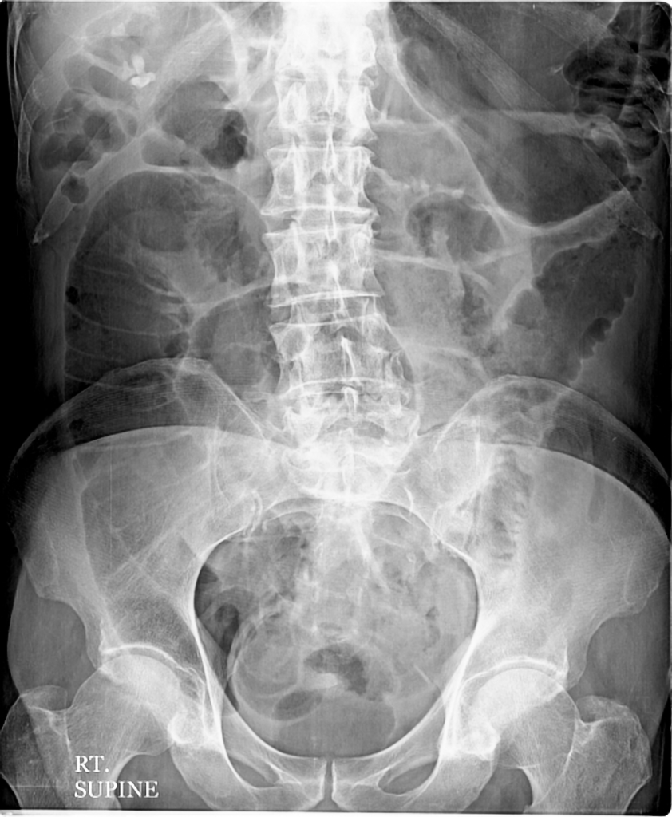
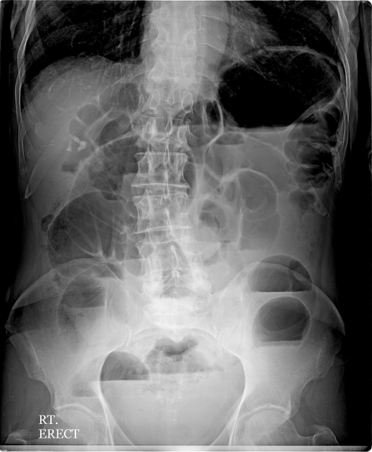
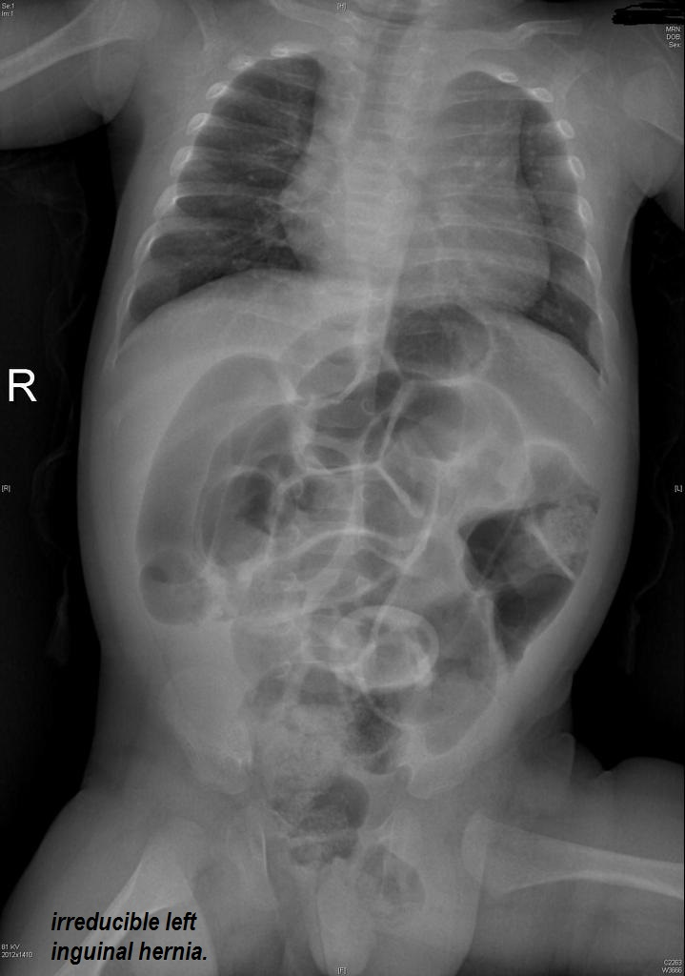

Slide 7
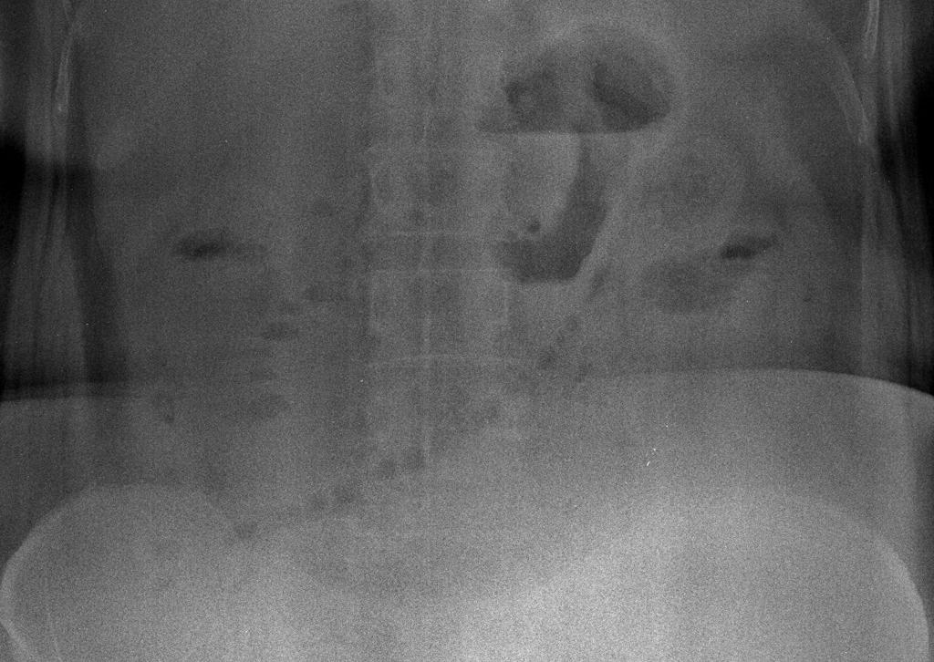
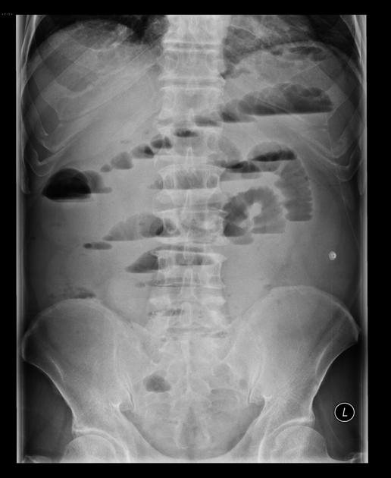
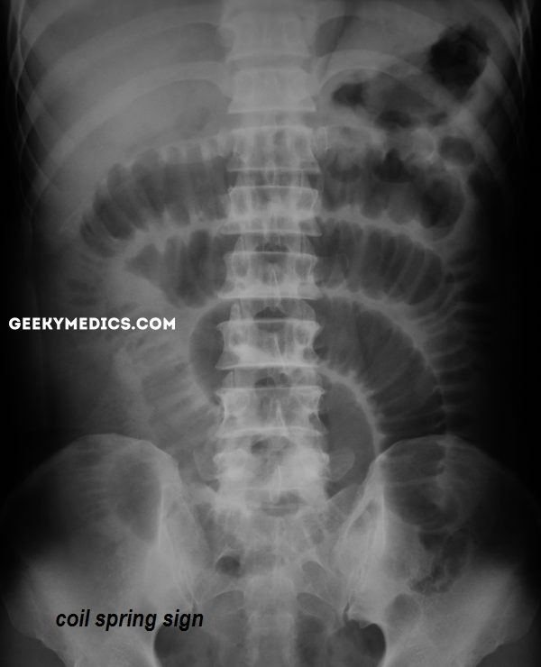
It consists of an obliquely or horizontally oriented row of small gas bubbles in the abdomen, which represent small pockets of gas along the superior wall of the small bowel that are trapped between the valvulae conniventes. The inferior margins of these bubbles have an ovoid appearance due to the meniscal effect of the intraluminal fluid.
The string of pearls sign, when present in the appropriate clinical setting, is virtually diagnostic of small bowel obstruction.
Stepladder sign represents the appearance of distended small bowel loops with gas-fluid levels that appear to be stacked on top of each other, typically observed on erect abdominal radiographs in the setting of small bowel obstruction.

Slide 8
2- CT SCAN
Dilated loops of small bowel.
The dilated bowel may be gas or fluid filled.
Transition point at the site of obstruction.
The cause will be at the transition point
If no cause is demonstrated, it is likely secondary to adhesion.

Slide 9
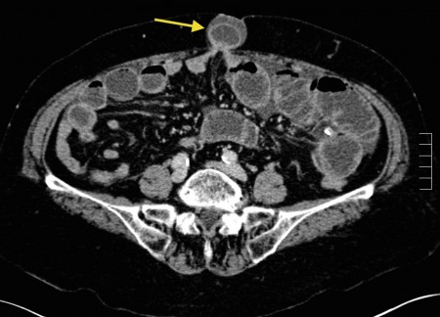
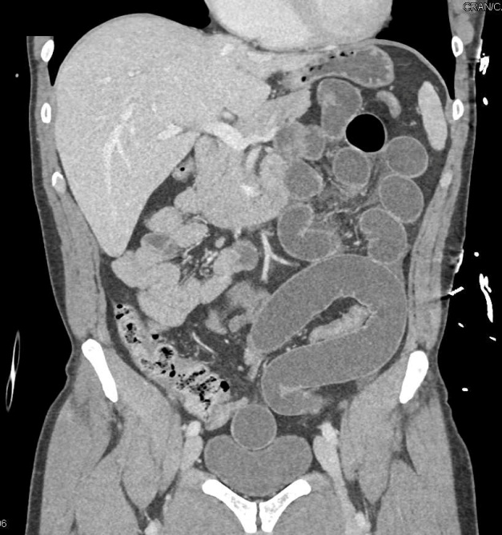
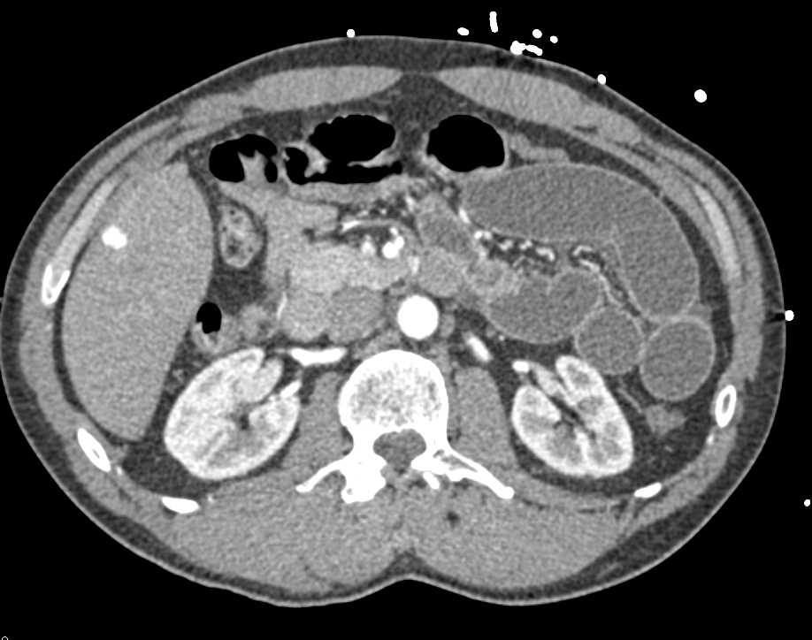
Small bowel obstruction due to hernia
Small Bowel Obstruction due to Adhesions

Slide 10
Large bowel obstruction
Dilatation of proximal large bowel and collapse distally.
If dilated over 6 cm , the bowel wall may perforate.
Etiology:
Colonic cancer 60%.
Acute diverticulitis 35%.
volvulus
Ischemic stricture.
Fecal impaction.
Hernias.

Slide 11
Role of imaging :
confirm diagnosis
Indentify level ( and possible the cause ) of obstruction.
Indentify any complications.
plan treatment.

Slide 12
Investigations
Plain radiograph
Colonic distension: the large bowel has the ability to distend up to 6 cm .gasses secondary to gas-producing organisms in feces.
Since the large bowel tend to be peripherally in the abdomen, it may be possible to determine the level of obstruction.
Collapsed distal colon: very few or no air-fluid levels are found in the large bowel because water is reabsorbed .
Small bowel dilatation, which depends on
  duration of obstruction
  incompetence of the ileocecal valve
rectum has little or no air.
An obstructing tumor may cause complete or incomplete obstruction and result in proximal dilatation of the large bowel from the site of the disease.
chest x ray to check for free gas under the diaphragm is also a useful screen for bowel perforation. .

Slide 13
CT is currently the most widely used modality for assessment of large bowel obstructions and whether it is partial or complete .
It is not only able to confirm the diagnosis and localize the location of obstruction but in most instances also is able to identify the cause.
It should be traced distally until a transition is found. The cause is often present at this point, although sometimes the obstructing lesion is distal to the apparent transition point.
Complications, such as those of ischemia or perforation, should be assessed for.
The CT scan almost always performed with IV contrast to delineate blood vessels and allow enhancement of organs to be assessed.
Contract enemas have also largely been replaced by CT scan.

Slide 14
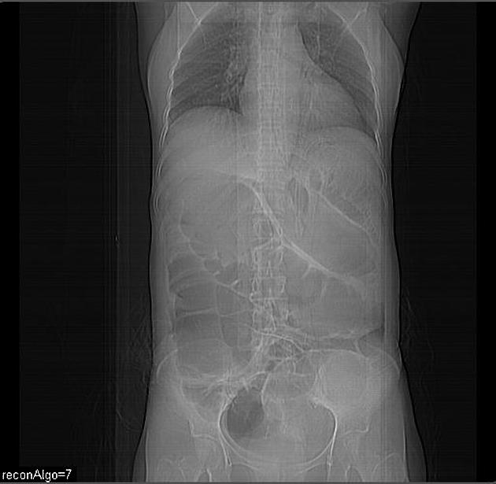
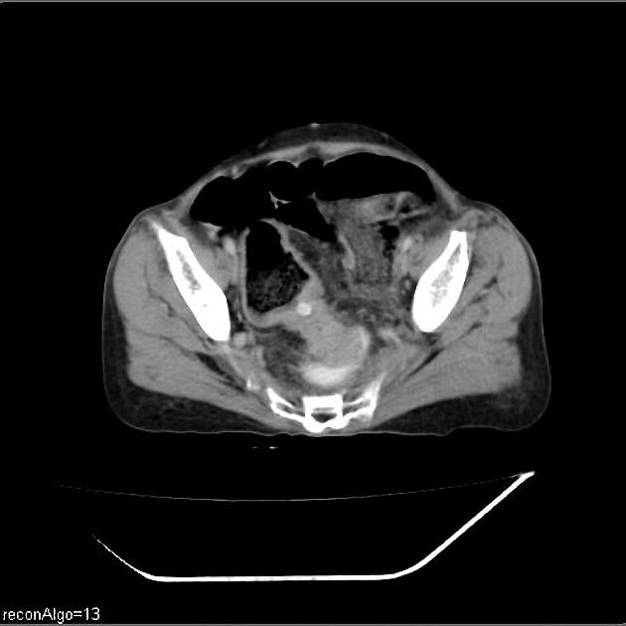
Large bowel obstruction due to Rectosigmoid adenocarcinoma

Slide 15
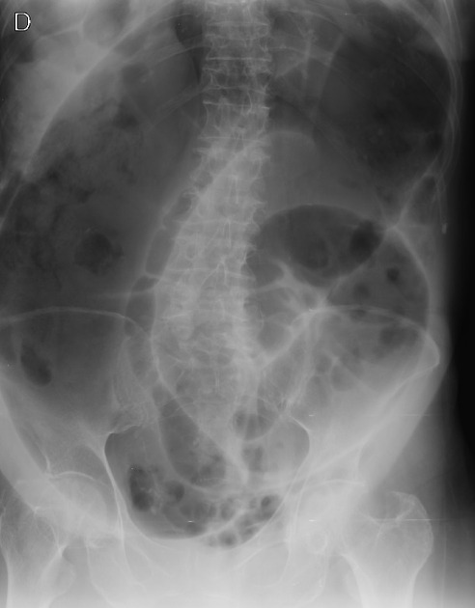
Sigmoid volvulus
Sigmoid volvulus is a cause of large bowel obstruction and occurs when the sigmoid colon twists on its mesentery, the sigmoid mesocolon.
Plain radiograph
Abdominal radiographs will show a large, a haustral dilated loop of the colon, often with a few air-fluid levels.
The coffee-bean sign is a sign on an abdominal plain radiograph of a sigmoid volvulus.

Slide 16
Appendicitis
CT scan is the most sensitive modality to detect appendicitis although its use should be limited because of radiation dose required and ultrasound should be employed as first line where possible.
Causes :
lymphoid hyperplasia (60%).
Appendicolith (33%).
Rare: foreign body ,Chrons disease, tumor.
Investigation
US is often that all required ( quick, dynamic and no radiation)
Cross sectional imaging is most sensitive ( CT and MRI)
Role of imaging:
Confirm the appendicitis.
Assess for peri-appendiceal collection.
Assess for perforation.
Determine if there is another cause of the symptoms.
Appendicolith may also be identified.

Slide 17
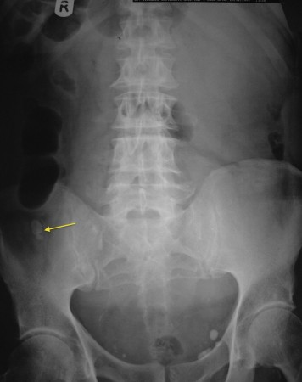
Radiographic features
Plain radiograph
Plain radiography is infrequently able to give the diagnosis, however, is useful for identifying free gas and may show an appendicolith in 7-15% of cases. In the right clinical setting, finding an appendicolith makes the probability of acute appendicitis up to 90%.

Slide 18
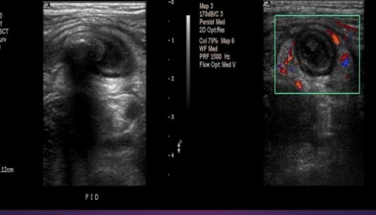
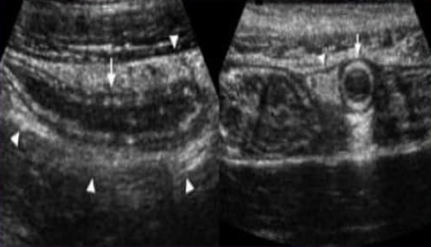
Ultrasound
Ultrasound with its lack of ionizing radiation should be the investigation of choice in young patients. ultrasonography is reliable at identifying abnormal appendices, especially in thin patients.
The technique used is known as graded compression, using the linear probe over the site of maximal tenderness, with gradual increasing pressure exerted to displace normal overlying bowel gas.
Real time ultrasound signs of acute appendicitis
Direct signs :
Non compressibility of the apendix ( perforation : appendix might be compressible)
Diamter of the appendix >6 mm.
Single wall thickness >_ 3 mm
Target sign :hypoechoic ( fluid filled lumen), hyperechoic ( mucosa and submucosa),hypoechoic( muscularis layer)
Appendicolith : hyperechoic with posterior shadowing.
Color doppler and contrast enhanced US : hypervascularity in early stages of AA, hypoavascularity in abcess and necrosis.
Indirect sign:
Free fluid surrounding appendix.
Local abscess formation.
Increased echogenisity of local mesentric fat.
Enlarged local mesentric lymph nodes.
Thickening of the peritoneum.
Signs of secondary small bowel obstruction.

Slide 19
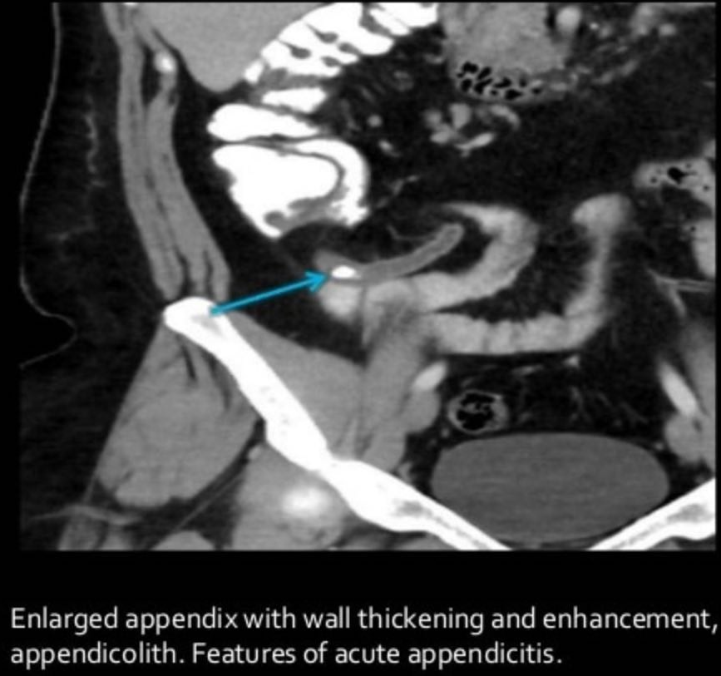
CT
CT is highly sensitive (94-98%) and specific (up to 97%) for the diagnosis of acute appendicitis and allows for alternative causes of abdominal pain also to be diagnosed.
Usually performed with IV contrast ( no oral contrast is required)
CT findings include :
Appendiceal dilatation (>6 mm diameter)
Wall thickening (>3 mm) and enhancement
Thickening of the cecal apex: cecal bar sign, arrowhead sign
Peri appendiceal inflammation: ( fat stranding, fluid , phlegmon and abcess)
Focal wall non-enhancement representing necrosis (gangrenous appendicitis) and a precursor to perforation
Appendicolith
Peri appendiceal reactive nodal enlargement.

Slide 20
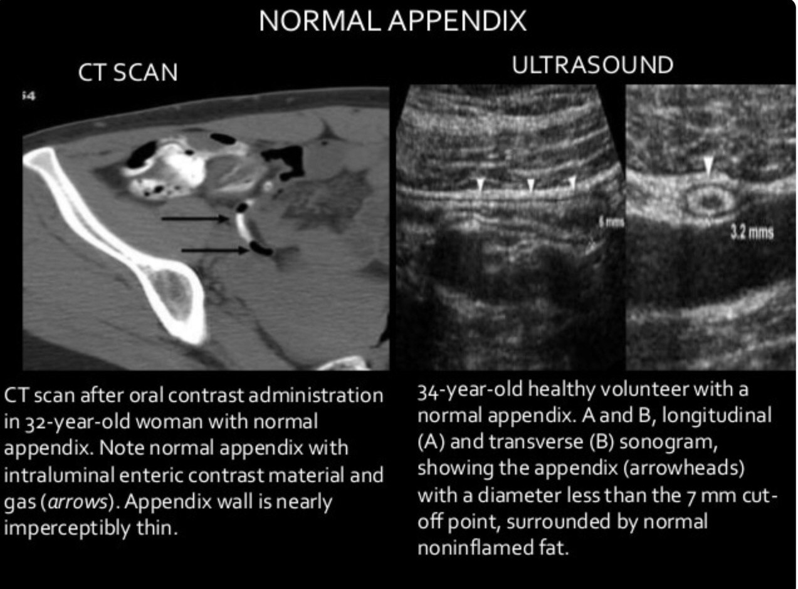
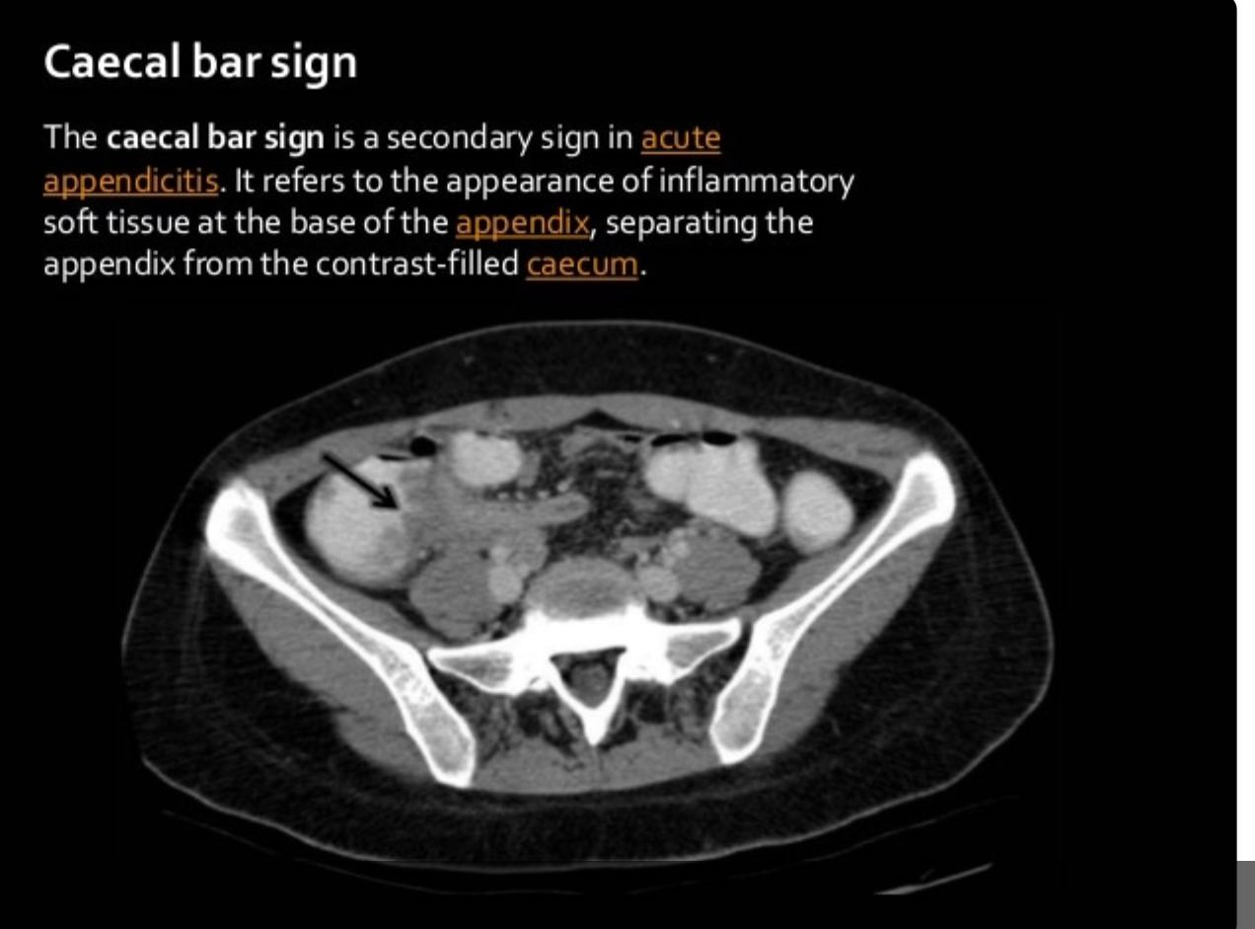
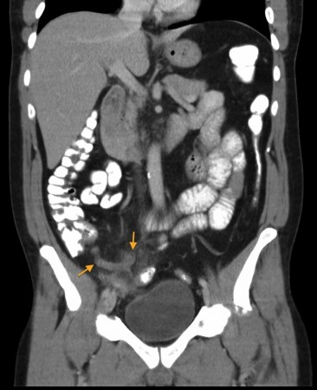
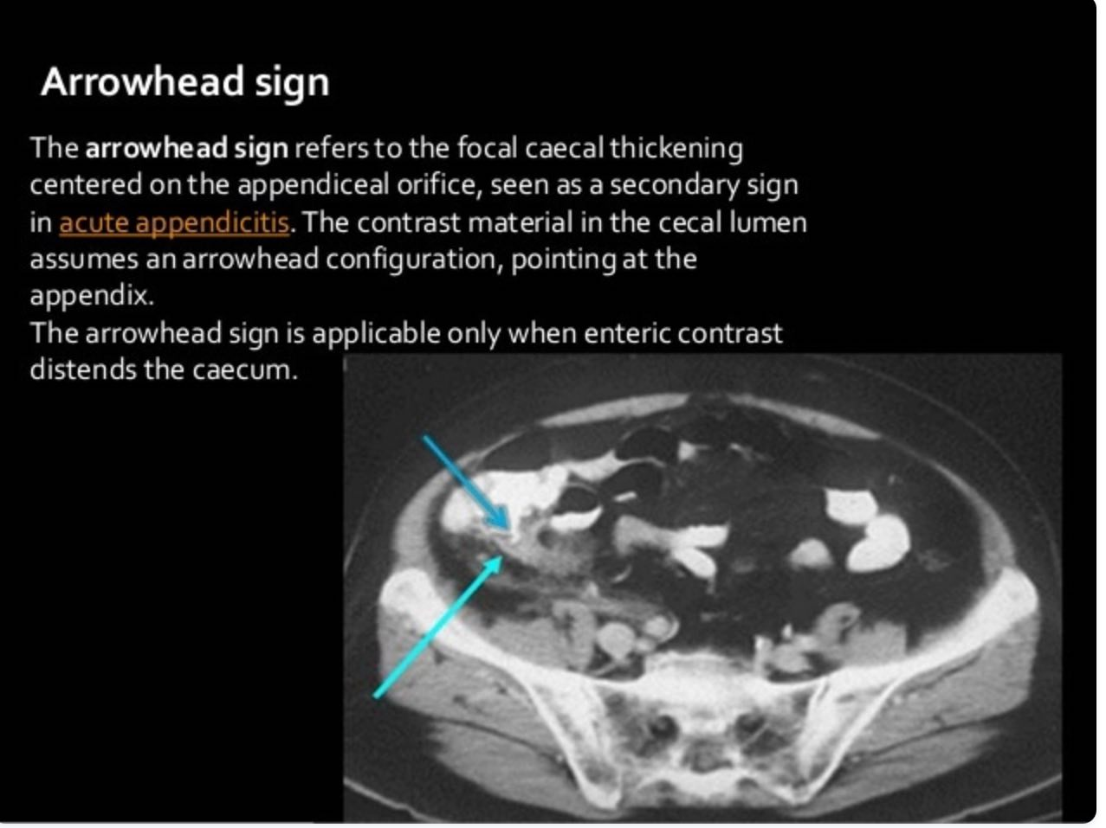
Acute appendicitis. This coronal CT image clearly shows the appendix (arrows) extending medially from the caecum. The tip of the appendix is dilated and there is haziness (‘stranding’) of the fat around it, indicating an inflammatory process. CT is also excellent at identifying the potential complications of appendicitis, such as perforation, abscess formation, portal vein thrombosis and liver abscess formation.

Slide 21
Inflammatory bowel disease
Is a generic term used to describe diseases of the GI tract that have an inflammatory cause. Chrons( CD) disease and ulcerative colitis(UC) are the commonest causes.
CD : any part of the bowel may be affected, skip lesions, fistulation.
UC :only the colon is affected.
Investigations:
Blood tests: raised inflammatory markers, CRP,ESR.
Coloscopy: visualize abnormal areas and allow biopsy.
Ultrasound: thickened bowel wall.
CT : used in acutely unwell patients to indentify complications.
MRI: assessment of small bowel or perianal fistula( chrons)
Role of imaging
Radiology can be useful for diagnosis and follow up.
Indentify abnormal bowel
Determine response to therapy
Indentify complications

Slide 22
Radiological features
Ultrasound
Bowel US allow assessment of the whole bowel.
Findings include: bowel wall thickening , loss of normal bowel wall architecture, increased vascularity, US may also detect complications: localized perforation, interloop abscess and fistula.
CT
CT with both IV and luminal contrast can be used to assess small and large bowel .
Findings include : bowel wall thickening ,ulceration, strictures ,fistulae (CD),abscess formation and perforation.
MRI
MRI particularly useful in Crohns disease : assessment of small bowel disease and assessment of perianal fistulae.

Slide 23
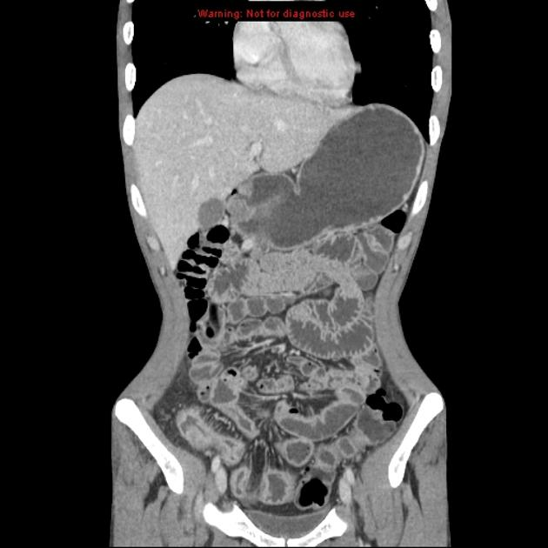
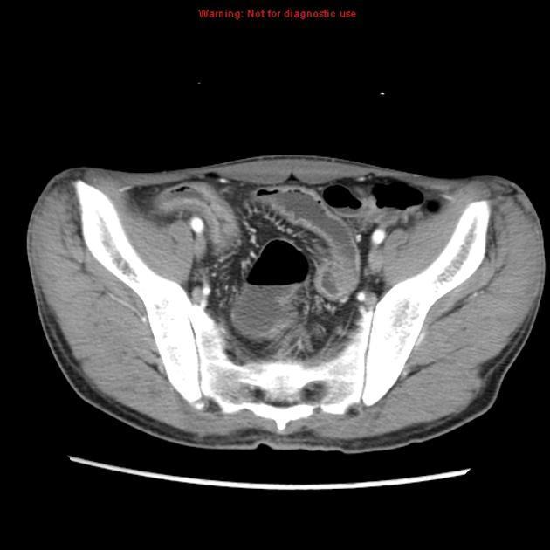
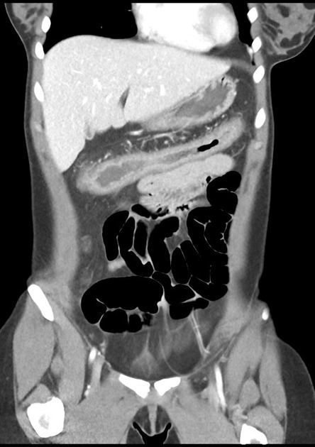
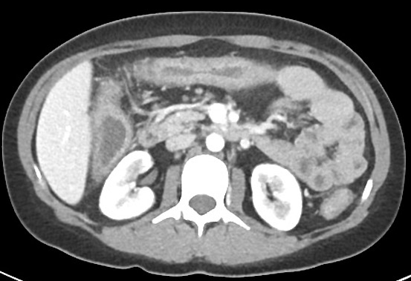
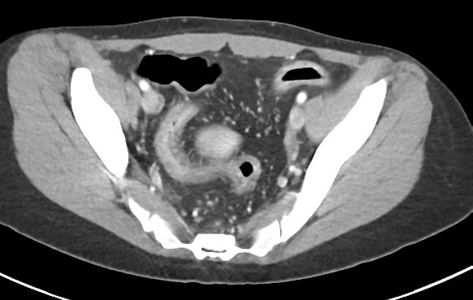
Crohn disease
Ulcerative colitis

Slide 24
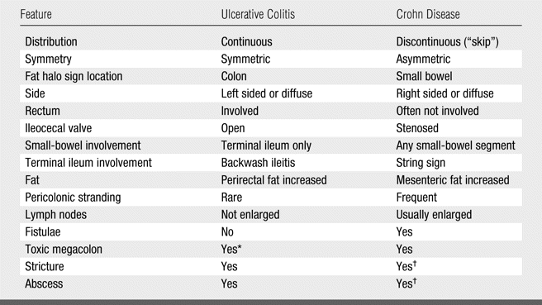

Slide 25
Toxic mega colon
Toxic megacolon is an acute complication seen in both types of inflammatory bowel disease and, less commonly, in infectious colitis and other types of colitis.
It is due to fulminant colitis, which causes loss of the neurogenic tone of the colon, leading to severe dilatation and increasing the risk of perforation.
Causes:
Ulcerative colitis is the most common cause.
Other less common causes of toxic megacolon and colitis include:
Crohn disease
infectious colitis (especially C. difficile colitis)
neutropenic colitis
ischemic colitis

Slide 26
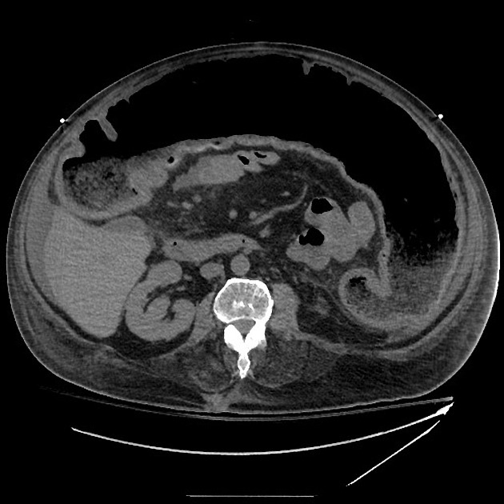
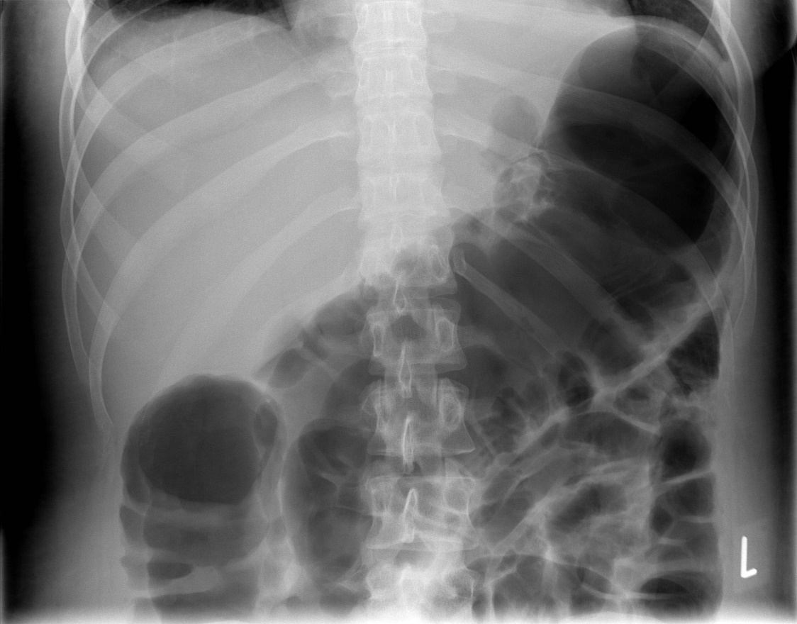
The colon (typically transverse colon) becomes dilated to at least 6 cm .Signs of pneumoperitoneum may be present if dilatation has progressed to perforation. Dilatation increases on serial imaging.

Slide 27
Colorectal cancer
Is the most common cancer of the GIT and the second most frequently diagnosed malignancy in adults .CT and MRI are the modalities most frequently used for staging.
Investigation:
CT for diagnosis and staging.
MRI for local staging in rectal carcinoma.
CT colonoscopy for screening .
Barium studies no longer used in most centers.
Role of imaging:
Initial diagnosis: virtual colonoscopy.
Abdominal CT scan in the acute patient.
Local staging in rectal carcinoma by MRI.
Staging by CT ( chest , abdomen and pelvis).

Slide 28
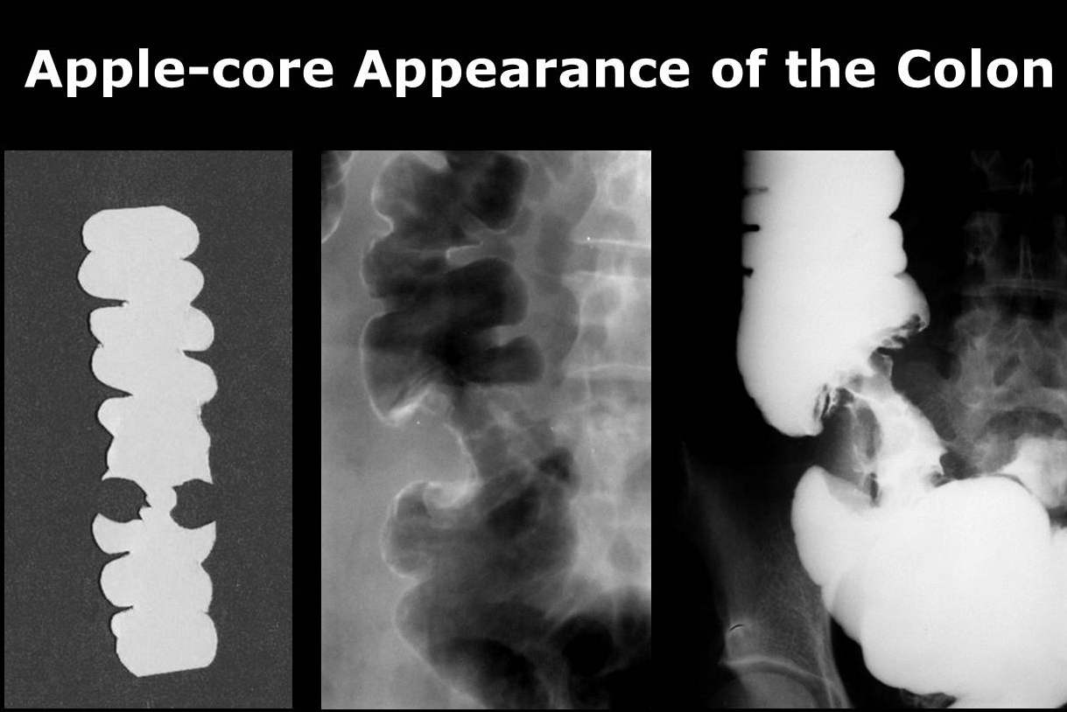
Radiological features
CT :
Soft tissue density masses arising from the bowel wall.
Challenging to see small tumors on CT.
Low sensitivity for bowel cancers(45-77%)
Bowel wall thickening with luminal narrowing.
Proximal luminal dilatation.
Ulceration in larger mass.
Complications ,e.g. fistula, obstruction ,intussusceptions, perforation.

Slide 29
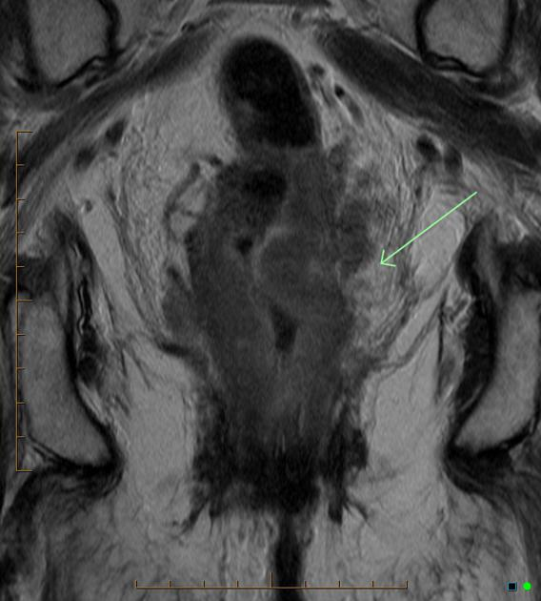
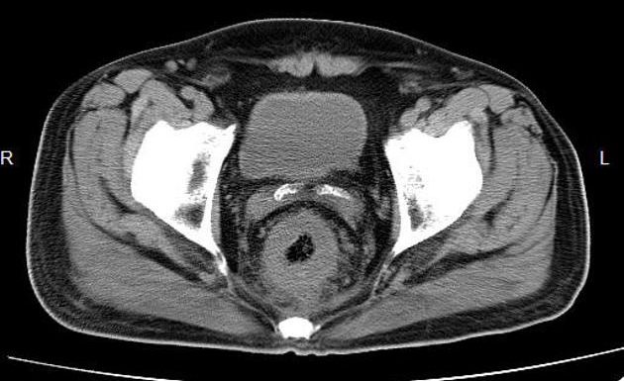
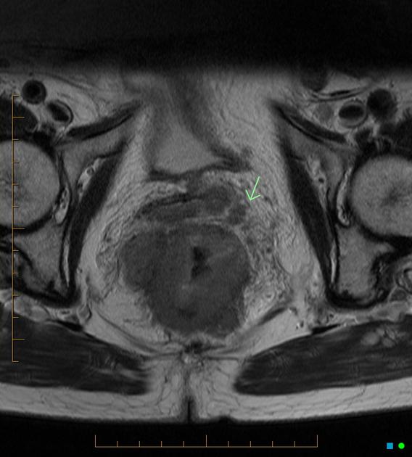
Circumferential wall thickening of the rectum with narrowing of the lumen.

Slide 30
Gastric cancer
Investigations
Endoscopy used to visualize and biopsy.
CT used for staging of metastatic disease.
Role of imaging:
Imaging is limited to the assessment of distant metastatic disease in gastric cancer.
Plain radiograph and ultrasound are of limited value.
CT is the modality that is used for assessment of distant spread.
PET/CT is used in some centers.
Radiographic features:
CT:
performed with negative contrast ( distended with water or gas)
Polyploid mass in the stomach.
Focal wall thickening.
Ulceration.

Slide 31
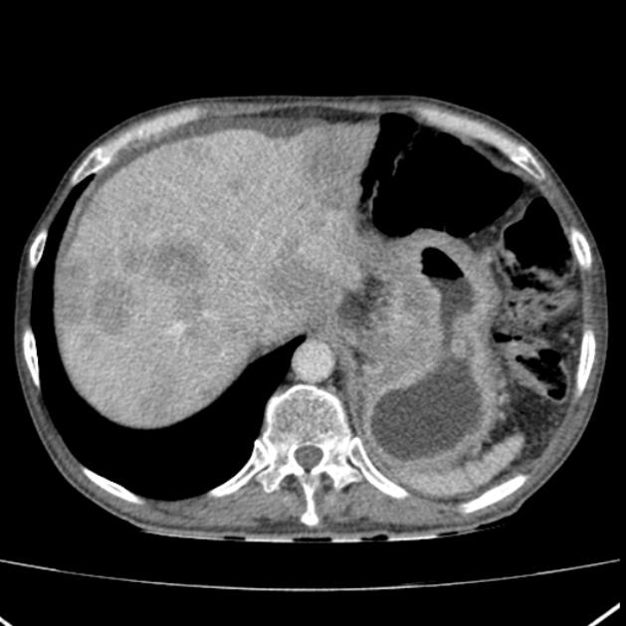
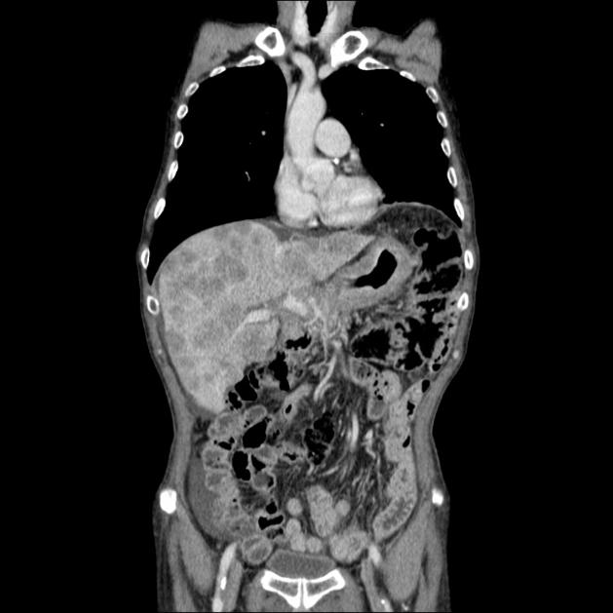
Marked circumferential thickening of the gastric wall (linitis plastica) associated with multiple lymphadenopathy and multiple round hypodense lesions corresponding to hepatic metastasis

Slide 32
Acute pancreatitis
Investigation
Not required for diagnosis but may help.
Very useful in the assessment of complications.
Role of imaging
Clarify the diagnosis when the clinical picture is confusing.
Assess severity and determine the prognosis.
Detect complications.
Determine possible causes.
Radiographic features
Imaging studies of acute pancreatitis may be normal in mild cases.
Dual phase (arterial and portal venous )contrast enhanced CT scan provides the most comprehensive initial assessment , typically with oral contrast.

Slide 33
CT scan
focal or diffuse parenchymal enlargement
changes in density because of edema
indistinct pancreatic margins owing to inflammation
surrounding retroperitoneal fat stranding
necrosis of pancreatic parenchyma
lack of parenchymal enhancement.
infected necrosis.
abscess formation.
circumscribed fluid collection
hemorrhage
  high-attenuation fluid in the retroperitoneum or peripancreatic tissues
calcification
  evidence of background chronic pancreatitis

Slide 34
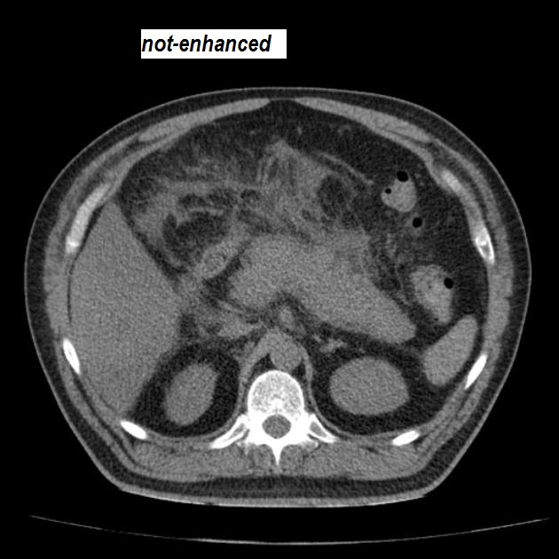
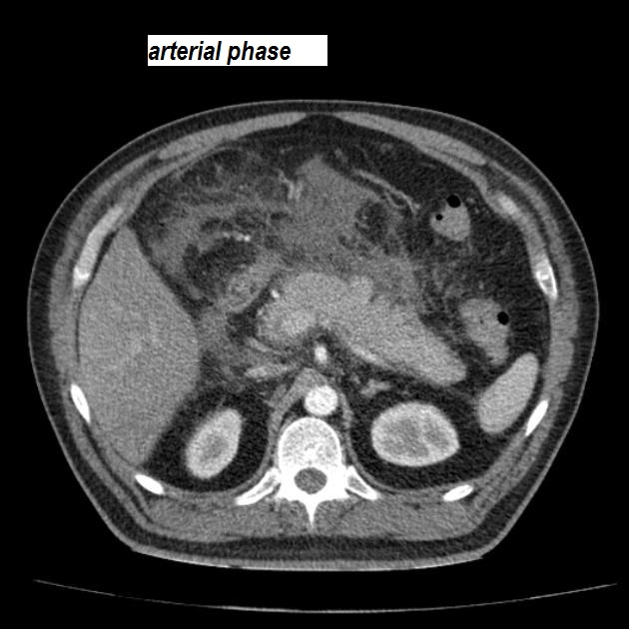

Slide 35
Gallstones disease
Represents a group of conditions that are linked to ,or caused by gallstones .these stones are formed from sludge in the gall bladder and may range from millimeters in diameter to several centimeters.90%of gallstones are asymptomatic , but they may become impacted, causing pain or jaundice.
Investigations
Assess whether gallstones are likely to be the cause of symptoms .
Look for any other cause of symptoms.
Role of imaging
Assess whether are gall stones.
Determine if they are likely to be causing symptoms.
Locate the gallstones e.g. gallbladder ,CBD.
Look for complications.
Look for associations e.g. liver disease.

Slide 36
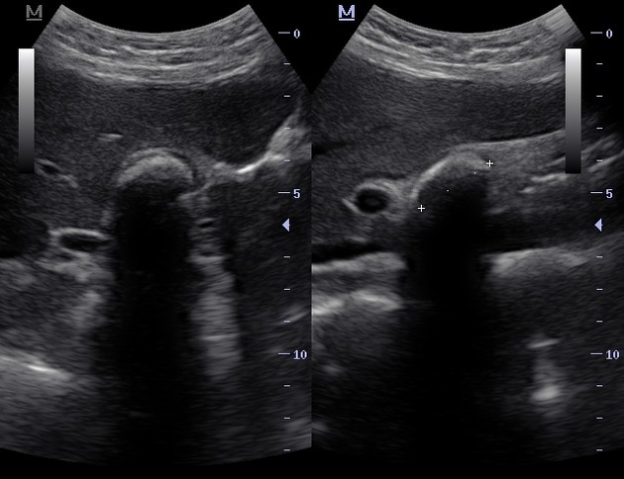
Radiographic features
US: is the first best test when assessing the gall bladder.
Patients need to be fast at least 6 hours before their US to ensure that the gall bladder is as filled with bile as possible, it is impossible to assess the gall bladder wall when it is non distended.
The gall stones are highly reflective echogenic focus within gallbladder lumen, normally with prominent posterior acoustic shadowing .
  gravity-dependant movement is often seen with a change of patient position (the rolling stone sign)
Dilatation of the biliary tree if there is CBD stone.

Slide 37
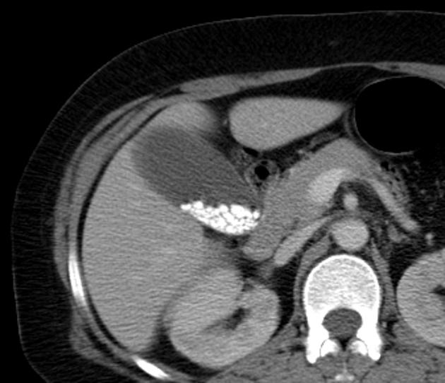
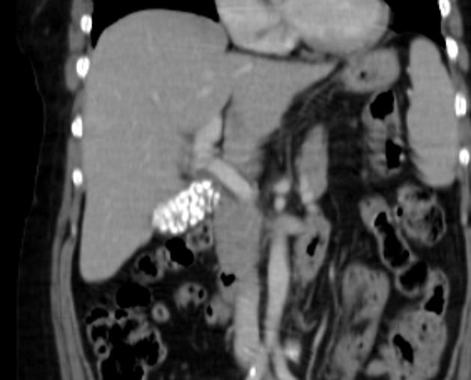
CT scan
is not the best test for detection of stones, some stones are not visible on CT scan ,however it is helpful when looking for complications, including perforations.

Slide 38
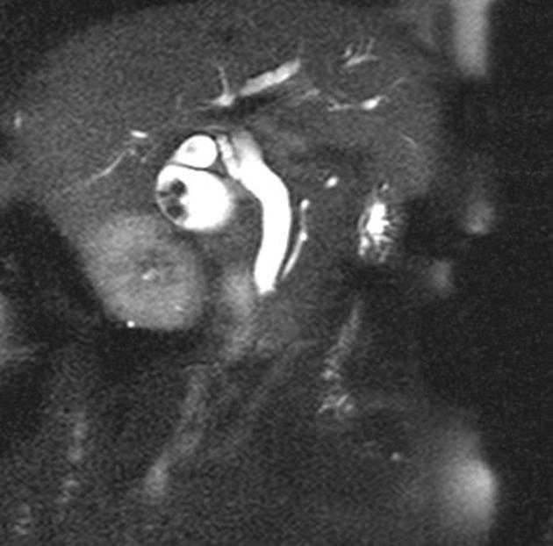
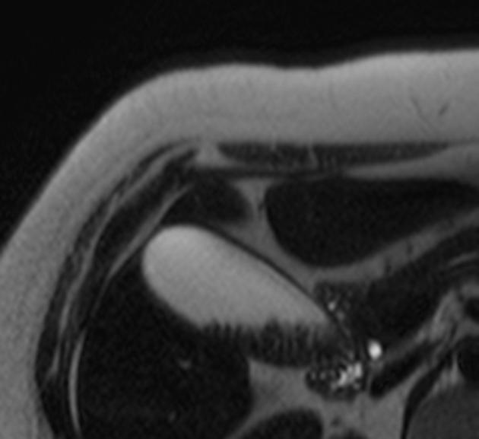
MRI
MRI can be used to assess the biliary tree and indentify the level of obstruction using MR cholagiopancreatography(MRCP)
Gallstones are filling defects ( signal voids) in the gall bladder and duct system .
Dilated biliary tree proximal to the level of obstruction.

Slide 39
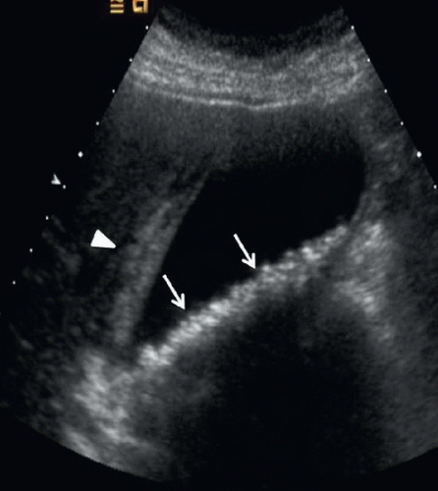
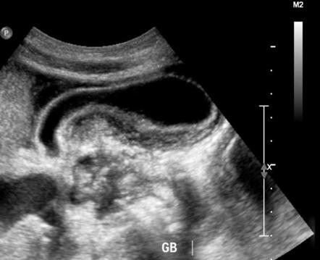
Acute cholecystitis
Investigations
US best test to conform acute cholecystitis.
CT to assess complications.
Role of imaging
Confirm the presence of gall stones
Determine if any evidence of acute gall bladder inflammation.
Look for evidence of complications.
Radiographic features
US:
Most sensitive finding : echogenic gall stones, sonographic Murphy sign .
Secondary findings: gall bladder wall thickening , peri cholecystic fluid (>3 mm).
Less specific findings: gall bladder distension with sludge.

Slide 40
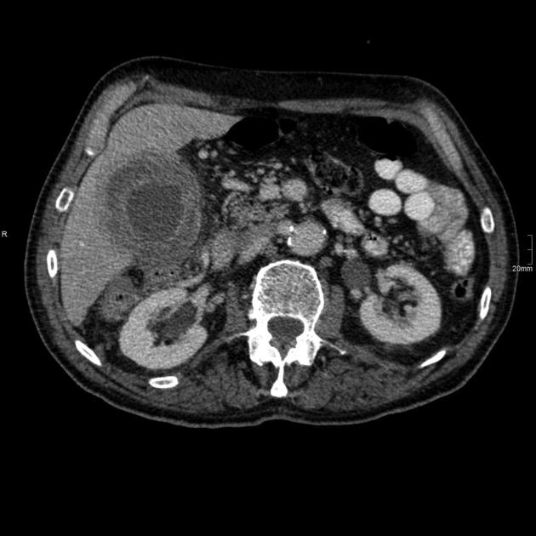
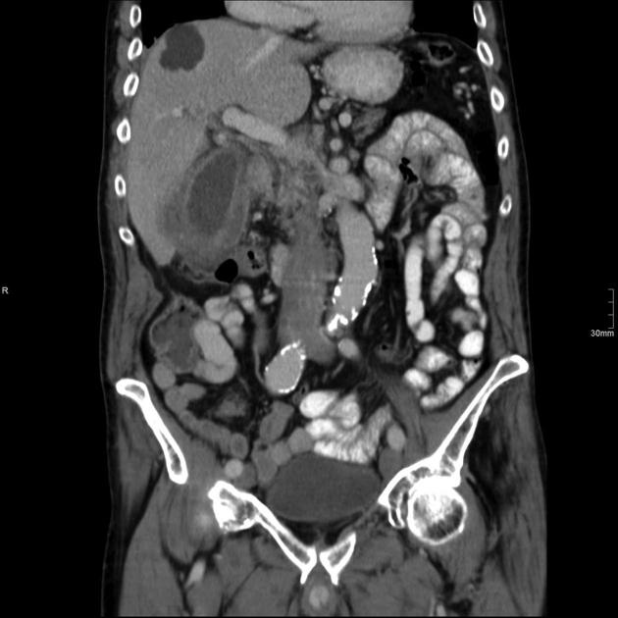
CT
CT is much less sensitive than US in the assessment of cholecystitis.
Gall stones may be very difficult to see at CT.
findings include :
Gall bladder distension.
Gall bladder wall thickening.
Pericholecystic fluid and inflammatory fat stranding.

Slide 41


