Slide 1
Histology Lec3

Slide 2
The skin
1- epidermis 2- Dermis or (corium)

Slide 3
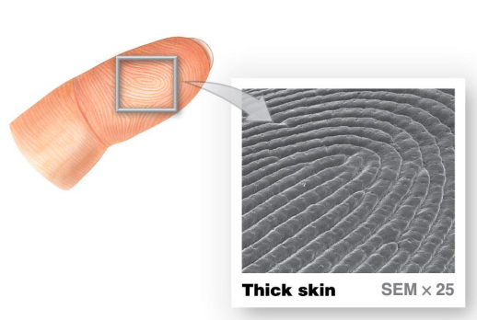
Thick skin epidermis
Stratum germinativum
Stratum spinosum
Stratum granulosum
Stratum lucidum
Stratum corneum
Fingerprints

Slide 4
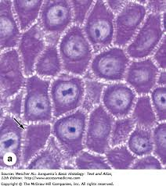
Stratum spinosum (intracellular bridges)

Slide 5
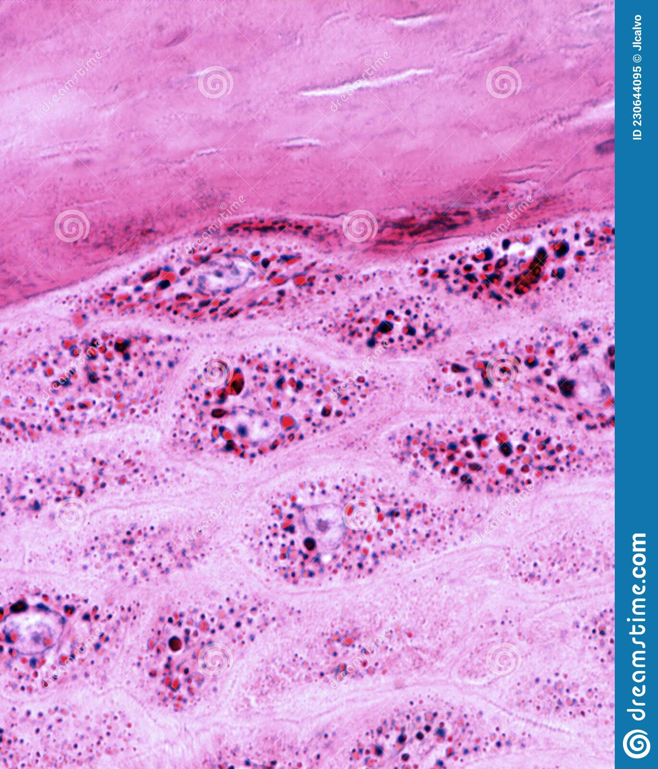
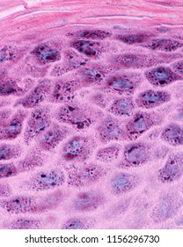
Stratum granulosum (keratohyalin granules)

Slide 7
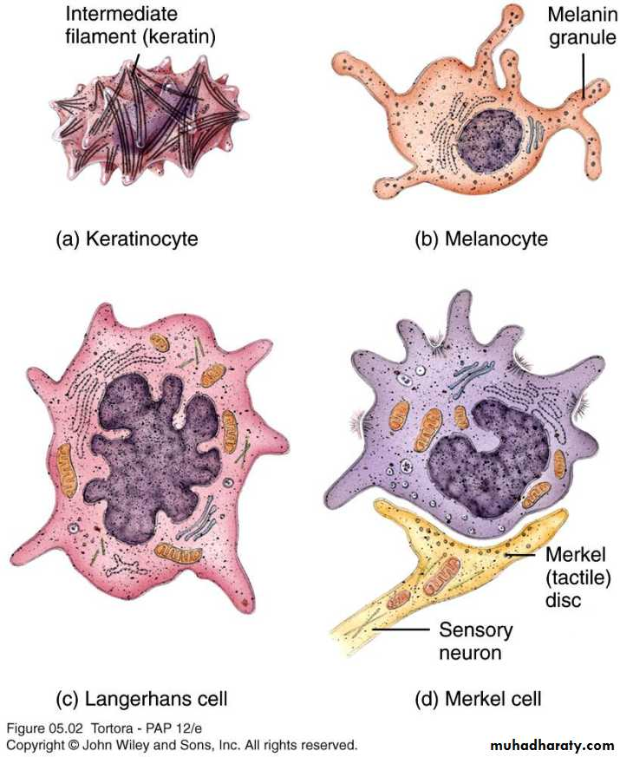
Epidermis cells
Keratinocyte
Melanocyte
Langerhans cell
Merkel cell

Slide 8
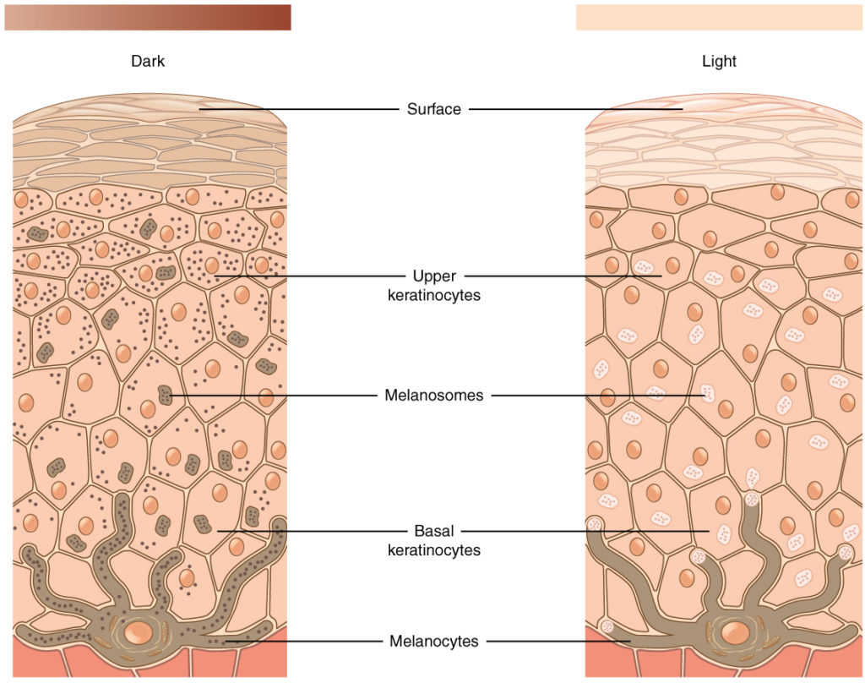
Melanin formation

Slide 9
Dermis
Papillary layer
Reticular layer

Slide 10
The nail
Nail body
Free edge
Nail root

Slide 11
The hair
Shaft
Root
Hair bulb
Hair papillae
Arrector pili muscle

Slide 12
Dermal root sheath
External root sheath
Inner root sheath
Henles layer
Huxleys layer
Cuticle of the
inner root sheath

Slide 13
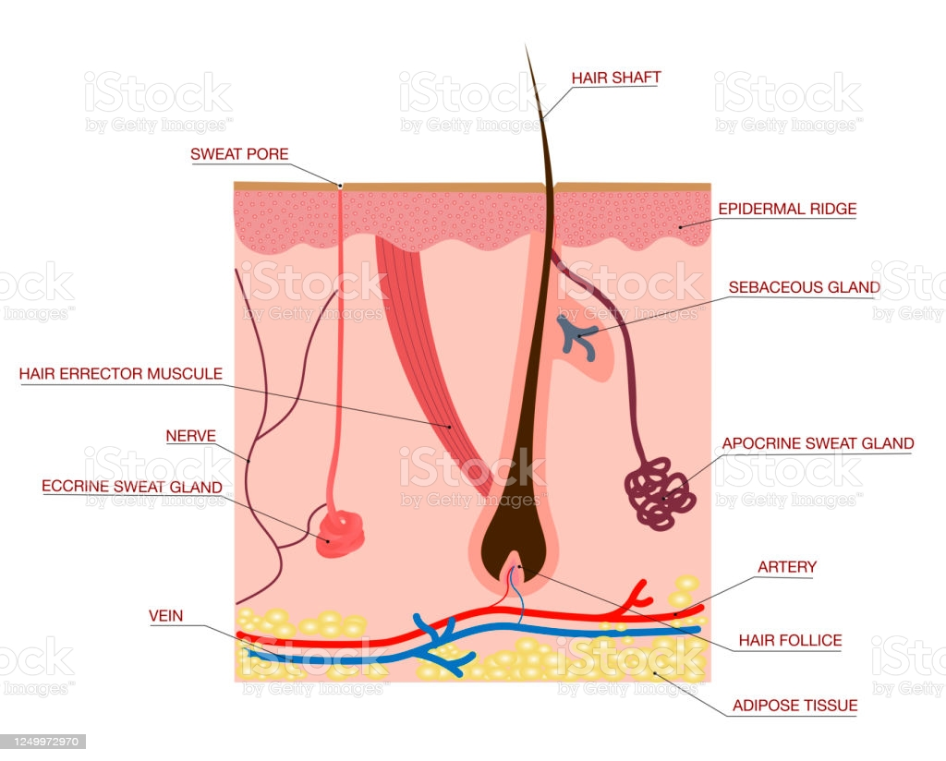
The skin glands
Sebaceous gland
Sweat gland
Merocrine gland
(eccrine gland)
Apocrine gland

Slide 14
