Slide 1
Histology lecture4
The digestive system

Slide 2
Digestive system :
Mouth
Pharynx
Digestive tube (digestive tract)
Digestive glands

Slide 3
Mouth
Lips
Cheeks
Tongue
Teeth
Salivary glands

Slide 4
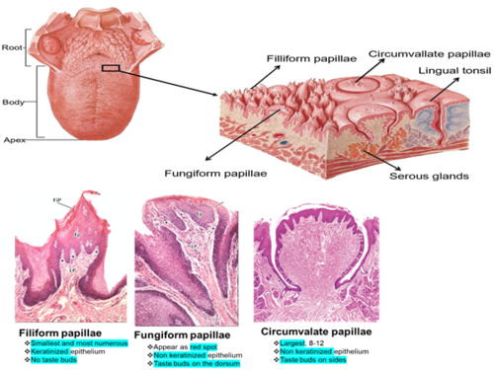
mouth
Lips
Cheeks
Tongue(filiform papillae, fungiform papillae, circumvallae papillae, foliate papillae)
Teeth
Salivary glands

Slide 5
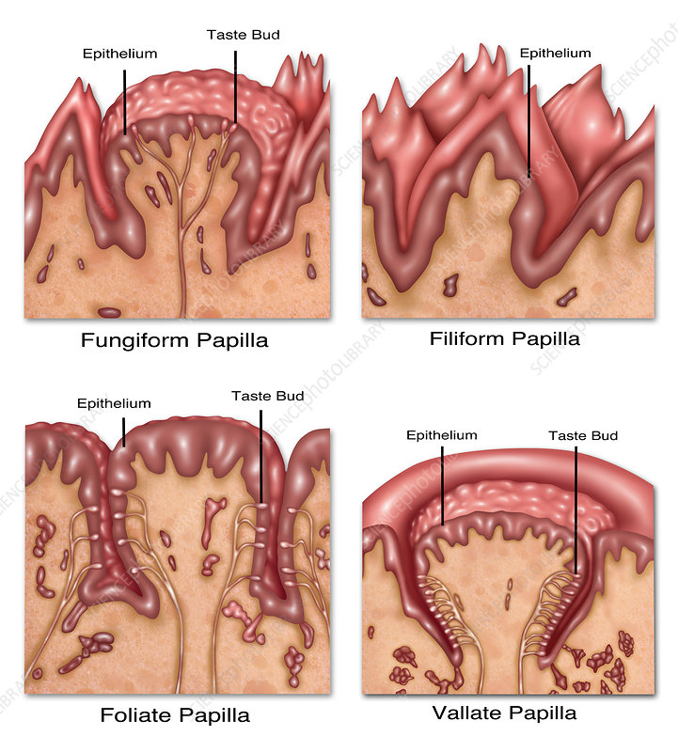
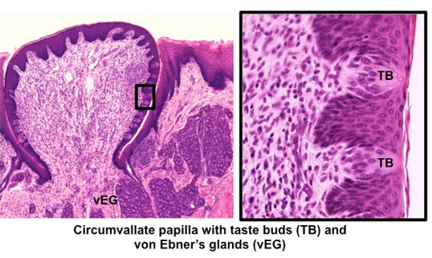
Tongue
filiform papillae
fungiform papillae
circumvallae papillae
foliate papillae)

Slide 6
Glands of the tongue :
Anterior lingual glands (sero-mucous)
Glands of Von ebner (serous)
Mucous glands of the root

Slide 7
Taste buds
Sustentacular or supporting cells
Gustatory or neuroepithelial taste cells

Slide 8
Mouth
Lips
Cheeks
Tongue
Teeth
Salivary glands
Tooth :
Crown
Root
Neck
Heard tissues: Dentine/enamel/cementum
Soft tissues : Pulp/periodontal membrane/gum or gingiva

Slide 9
Dentin

Slide 10
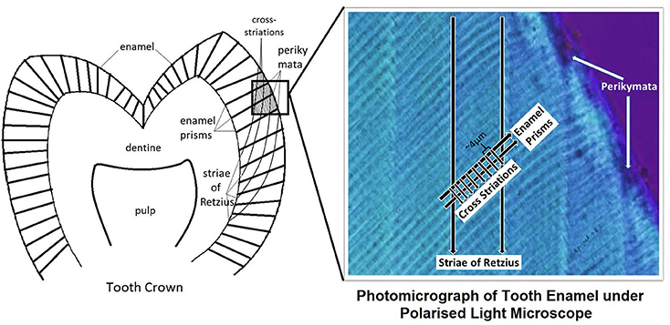
Enamel

Slide 11
Cementum

Slide 12
Pulp

Slide 13
Palate
Soft palate
Heard palate

Slide 14
Salivary glands
According to secreted materials :
Serous gland
Mucous gland
Sero-mucous gland
Three pairs :
Parotid glands
Sub-maxillary or sub-mandibular glands
Sublingual glands

