Slide 1
Histology lecture 1
Circulatory system

Slide 2
The circulatory system consist of:
Blood vascular system
Lymph vascular system

Slide 3
Blood vascular system
Blood capillaries
Continuous capillaries
Fenestrated capillaries
Sinusoidal capillaries

Slide 4
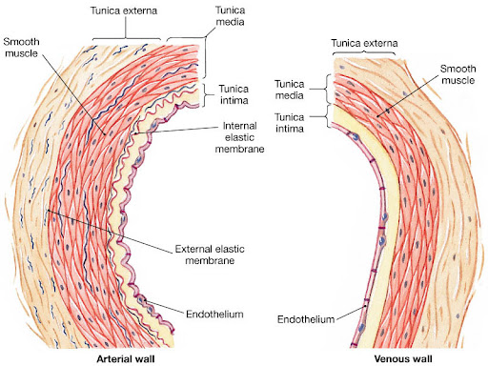
The arteries
Vessels has Three tunics :
Tunica interna ( tunica intima )
Tunica media
Tunica adventitia
(tunica externa)

Slide 5
Three types of arteries :
Arterioles
Small and medium sized arteries
Large arteries

Slide 6
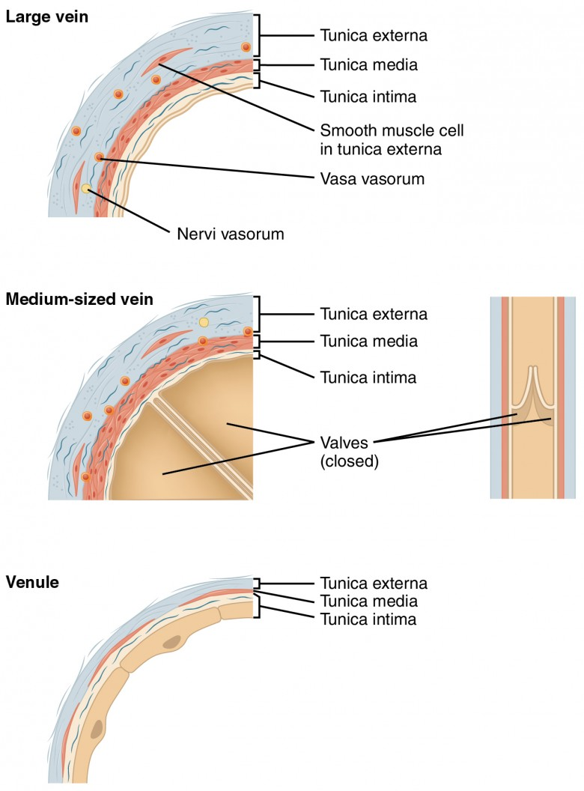
The veins
Three types of veins :
Venules
Small and medium sized veins
Large veins

Slide 7
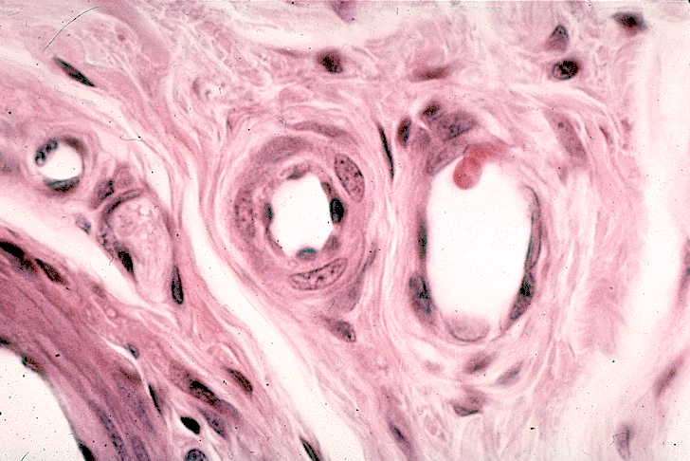

Slide 8
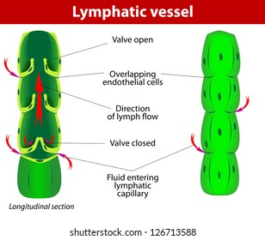
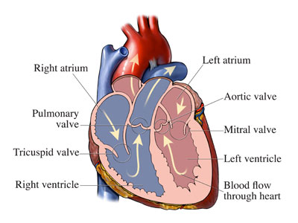
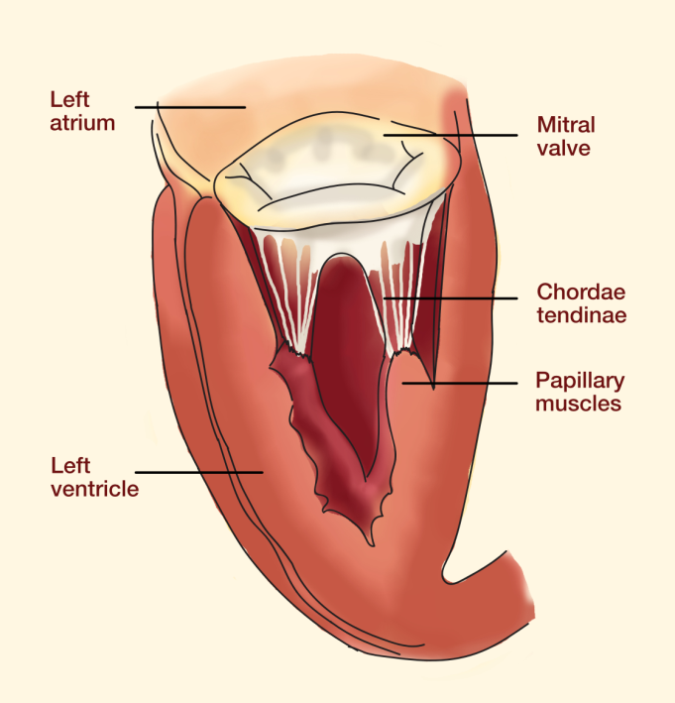
The valves
Venous valves
Cardiac valves
Lymphatic valves

Slide 9
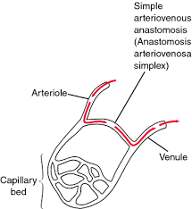
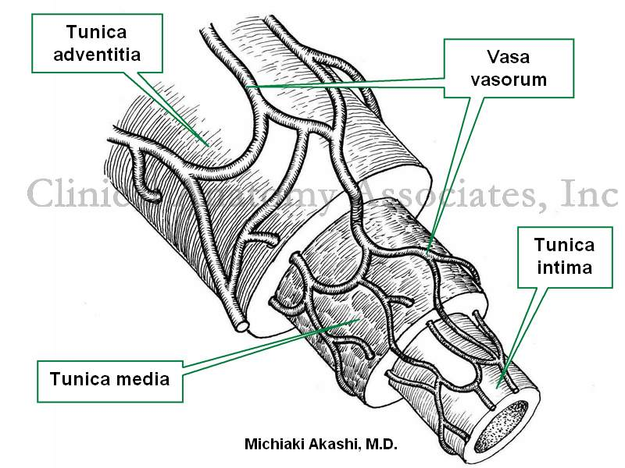
Arteriovenous anastomosus
Vasa vasorum

Slide 10
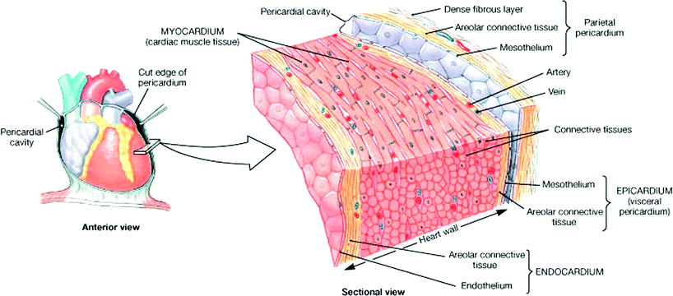
The heart
The heart wall consist of three layers :
Endocardium
Myocardium
Epicardium

Slide 11
Lymphatic vesicular system
lymphatic capillaries
Lymphatic collecting vessels
Main lymphatic vessels

