Slide 1
Nature Conservation

Slide 2
Rhinoceros
Eastern black Rhinoceros
Western black Rhinoceros

Slide 3
Hybrids
Tigon
Liger

Slide 4
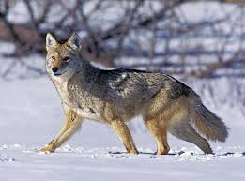
Hybrids
Grey Wolf
Red Wolf

Slide 5
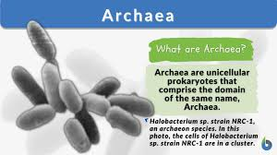
Archaea - Extemophiles

Slide 6
New Species
Black faced - Lion
Satere marmoset

Slide 7
New Species
Pseudoryx
Miniature deer

Slide 8
New Species
Megamouth Shark
Cryptic warbler-New species and Genus

Slide 9
New Species
Notothenoids
Coelocanth

Slide 10
New Phylum
Cycliophora - Lobesters
Laotian rock rat

Slide 11
New Ecosystems
Hydro- thermal marine vent
Lava tubes

Slide 12
New Ecosystems
Ancialine caves
Ancialine caves

