Slide 1
Lap 2
Cyanophyta (Blue green algae)
Division: cyanophyta Class:cyanophyceae
1-order:Chroococales
Genus: Merismopedia
2- order: Oscillatoriales
Genus: Oscillatoria, spirulina
3- order: Nostocales
Genus: Nostoc
4- order: Scytonematales
Genus :Scytonema

Slide 2
General characteristics of cyanophyta (blue-green algae):
The individual cells are prokaryotic, The simplest morphology in the cyanobacteria is that of unicells( freeliving ), or enclosed within a mucilaginous envelope as colonial forms or occurring as filamentous form.
Contain chlorophyll type A
Contain accessory pigment )phycocyanean( this pigment give unique blue- green color for this algal division)
3. Chloroplast is absent

Slide 3
4. Cyanophyta store their food as unique starch compound named as (cyanophycean starch)
5. Both vegetative and reproductive cells are non-flagellate
6. Sexual reproduction is absent.
This group is characterized by the presence of three types of cells:
1- Vegetative cells
2- Heterocysstes cells which are larger than vegetative cells and can be found at the base, apical, or intercalari between vegetative cells, and are important for nitrogen fixation in the soil.
3-Akinete cell, which are more elongated than vegetative cells and have thicker walls; their role is significant in reproduction.

Slide 4
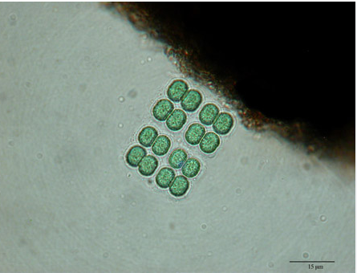
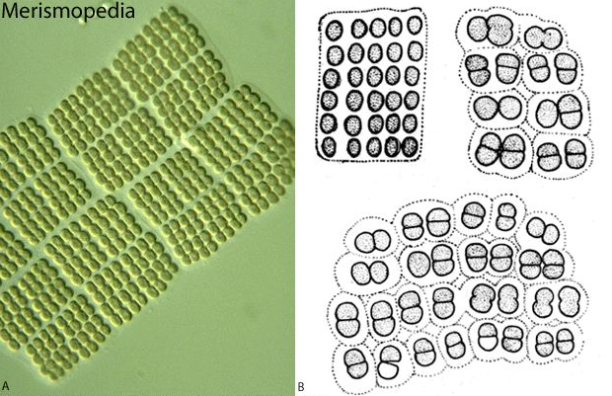
Merismopedia
Spherical to ovoid cells arranged in flat sheets colony
comprised of squareish clusters of four cells embedded in colorless, transparent gelatinous coating.

Slide 5
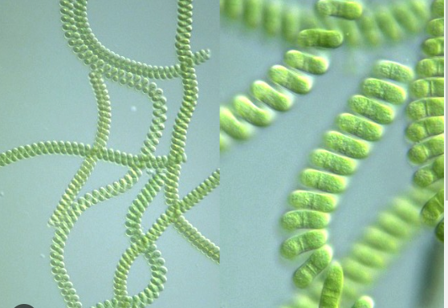
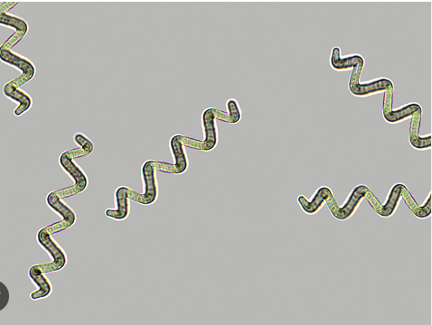
spirulina
Filamentous algae are unbranched
twisted or spiraled,They are multicellular, and the cell walls separating the cells cannot be distinguished under a microscope due to the twisting of the filament.
Different types of spirulina can be differentiated based on the number of spirals, the length of the spiral, and its thickness.

Slide 6
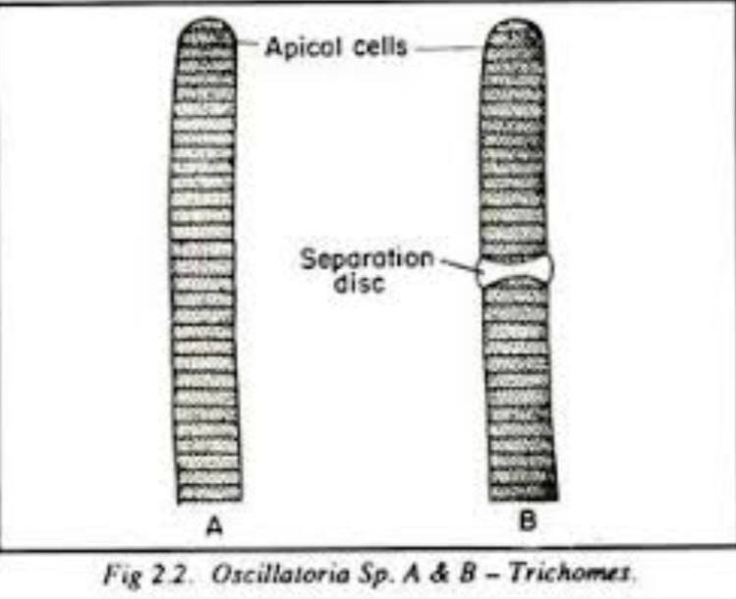
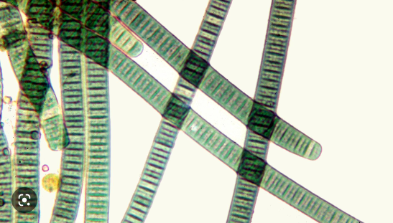
Oscillatoria
1-single filamentous form (un-branched)
2- The filament consists of vegetative cells characterized by a
length that is less than its width (a distinctive feature of this
alga).
3- containing compressed concave sides within the dead cells. This alga is an organism that reproduce by fragmentation. which can breaks into fragments called hormogonia. The hormogonia can glide away from the parent filament and grow into a new, longer filament. Breaks in the filament usually occur where dead cells are present

Slide 7
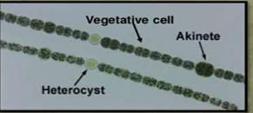
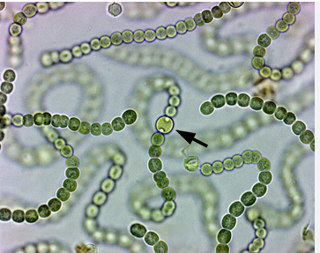
Nostoc
1-filamentous algae covered with mucilaginous sheath ,cells are barrel and more rounded .
2-un-branched
3-possesing specialized vegetative cell with homogenous transparent structure and thick wall and pores at either side where they meet other cells named (Heterocyst) responsible for nitrogen fixation(intercalary heterocyst)
4- possesing gaint thick-walled cell full of reserve material named (akinates ) responsible for vegetative reproduction during un-suitable environmental conditions.

Slide 8
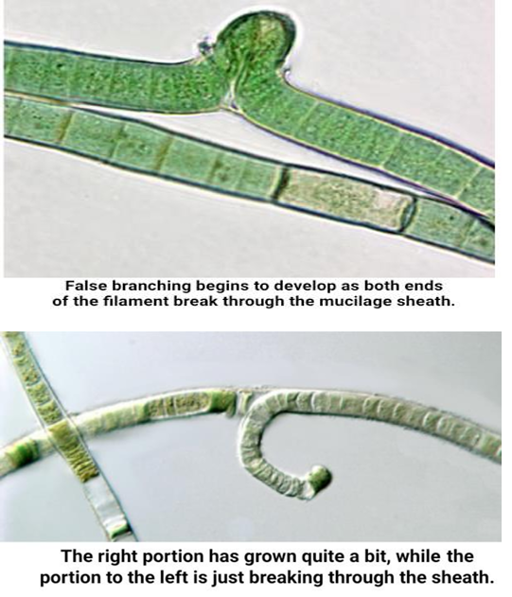
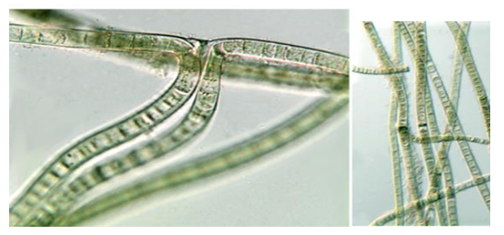
Scytonema
1-filamentous algae
2-characterized with false branching ,false branching may occur when a filament breaks apart at the site of added cells, both ends of filament then break through the mucilage sheath and continue to grow as ranches.

