Slide 1
طحالب عملي (5)
المرحلة الثانية

Slide 2
Division : Euglenophyta
Class: Euglenophyceae
1-Order:Euglenales
Genus: Euglena , Phacus

Slide 3
General Characteristics of Euglenophyta
unicellular eukaryotic organisms, possessing single or double flagella .
The plastids exhibit various shapes, such as disc-shaped, lamellar, ribbon-like, star-shaped, and reticular.
Stored food appears in granules known as paramylum.
photosynthetic species possesses green pigments including chlorophyll a and c, and golden brown pigment includes peridinin.

Slide 4
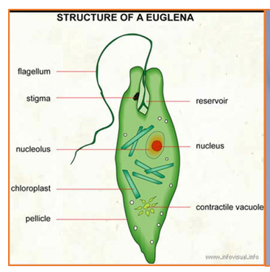
Euglena
1- oval or fusiform shape alga have a single flagellae
2-linear shape chloroplast 3-there is a red color eye spot near the front of the cell to direct algal movement toward the light source.
3-posses a flexible sheath surrounding cell called pellicle that gives the cell the ability to contract and move freely.

Slide 5
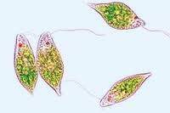
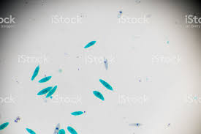
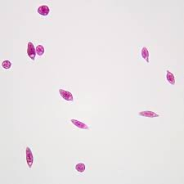
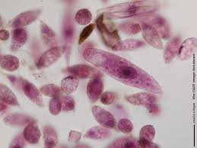
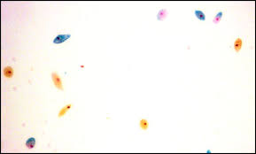
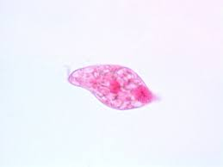
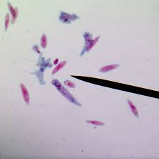
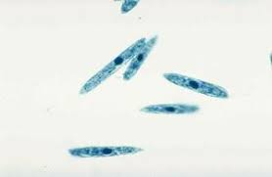
Euglena

Slide 6
Phacus
unicellular algae, oval-shaped or spherical cells tha are often flattened and leaf-like.
The cells instead move by gliding and swimming with their single flagellum. that extends from the lateral side of the algae, and it features a protrusion at the tapered end known as a spine.
The chloroplasts may be small and spherical .
stored food is in the form of paramylum.

Slide 7
