Slide 1
Micropropagation
أ.م.د. هديل مكي المؤمن
محاضرة 4

Slide 2
Micropropagat
Micropropagation is the practice of rapidly multiplying stock plant material to produce a large number of progeny plants, using modern plant tissue culture methods

Slide 3
Introduction
In nature plants propagate either
Sexually (seeds generation) results heterogeneity
Or
Asexually (vegetative multiplication) produce genetically identical plants.
Multiplication of genetically identical copies of a cultivar by asexual reproduction is called clonal propagation.
Via tissue culture called micropropagation,

Slide 4
Micropropagation

Slide 5
Advantages
Micropropagation has a number of advantages over traditional plant propagation techniques:
The main advantage of micropropagation is the production of many plants that are clones of each other.
used to produce disease-free plants.
It can have an extraordinarily high fecundity rate, producing thousands of propagules while conventional techniques might only produce a fraction of this number.
regenerating genetically modified cells or cells after protoplast fusion.
It is useful in multiplying plants which produce seeds in uneconomical amounts, or when plants are sterile and do not produce viable seeds or when seed cannot be stored (see recalcitrant seeds).
Some plants with very small seeds, including most orchids, are most reliably grown from seed in sterile culture.
A greater number of plants can be produced per square meter and the propagules can be stored longer and in a smaller area

Slide 6
Disadvantages
Micropropagation is not always the perfect means of multiplying plants. Conditions that limits its use include:
It is very expensive, and can have a labour cost of more than 70%.
An infected plant sample can produce infected progeny.
Not all plants can be successfully tissue cultured, often because the proper medium for growth is not known or the plants produce secondary metabolic chemicals that kill the explant.
Some plants are very difficult to disinfect of fungal organism

Slide 7
Benefits of Micropropagation
Many genetically identical plants can be created from one parent plant
Because plants are clones, the uniformity assures quality
Allows many plants to growing in a small place in a short time
In some species this method will produce healthier plants

Slide 8
Micropropagation (contin)
Positives and negatives of micropropagation
positives
rapid multiplication rates
low space requirement
negatives
labor costs
expensive (equipment, facilities, supplies)
loss by contamination
danger of variation

Slide 9
Methods of micropropagation
Axillary branching
Adventitious shoot formation
Somatic embryogenesis
>95% of all micropropagation
Genetically stable
Simple and straightforward
Efficient but prone to genetic instability
Little used, but potentially phenomenally efficient

Slide 10
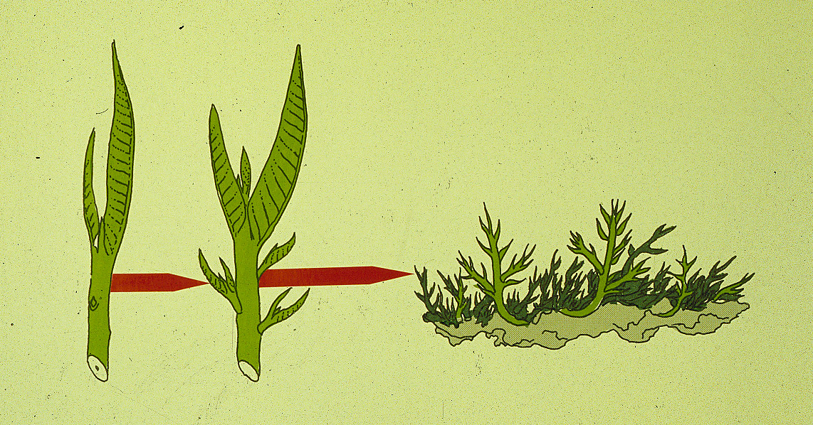
Axillary shoot proliferation
Growth of axillary buds stimulated by cytokinin treatment; shoots arise mostly from pre-existing meristems
Clonal in vitro propagation by repeated enhanced formation of axillary shoots from shoot-tips or lateral meristems cultured on media supplemented with plant growth regulators, usually cytokinins.
Shoots produced are either rooted first in vitro or rooted and acclimatized ex vitro

Slide 11
Disinfestation
Stock plant preparation
Washing in water
Disinfecting solution
Internal contaminants
Screening

Slide 12
Stage I - Sterilization
Pre-treatments
Transfer plants to a greenhouse to reduce endemic contaminants
Force outgrowth of axillary buds
Washing removes endemic surface contaminants
Antibiotics, fungicides, Admire, others
Bacteria and fungi will overgrow the explant on the medium unless they are removed
Pre-treatments to clean up the explant
Detergents
Sterilants and Antibiotics

Slide 13
STAGE II: Shoot Production
•
Stage II selection of cytokinin type and
concentration determined by:
Shoot multiplication rate
Length of shoot produced
Frequency of genetic variability
Cytokinin effects on rooting and survival

Slide 14
STAGE II: Shoot Production
Subculture shoot clusters at 4 -5 week intervals
3 -8 fold increase in shoot numbers
Number of subcultures possible is
species/cultivar dependent

Slide 15
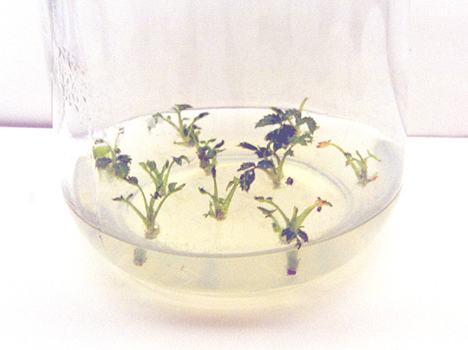
STAGE II: Shoot Production

Slide 16
STAGE III: Pretransplant (rooting)
Goals:
Preparation of Stage II shoots/shoot clusters
for transfer to soil (prehardening)
Elongation of shoots prior to ex vitro rooting
Fulfilling dormancy requirements

Slide 17
Root initiation ...
Auxins
Co-factors
C : N ratio
Light / darkness
Initiation vs growth
Juvenility / rejuvenation
Genotype

Slide 18
Shoot elongation ...
Basal ‘hormone free’ medium
Gibberellins
Carry-over of hormones

Slide 19
Root initiation
Auxins
Charcoal
C : N ratio
Light / darkness
Initiation vs growth
Juvenility / rejuvenation
Genotype

Slide 20
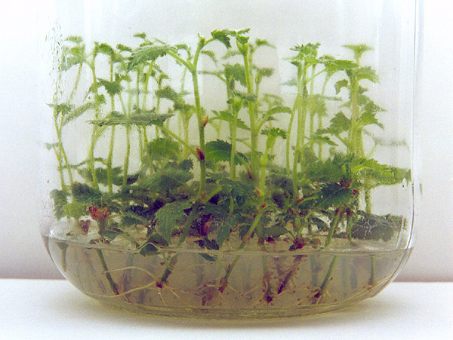
STAGE III: Pretransplant (rooting)

Slide 21
Acclimatization (hardening)
- survival of the new plant when removed from the in vitro environment

Slide 22
Micropropagation of almost all the fruit crops and vegetables is possible
Some examples: dwarfing sweet cherry, Shade trees, Ornamental shrubs, Roses, Clematis, Lilacs, Saskatoon berries, Nutraceutical Plants, Rhododendron, Azalea, mustard, corn, soybeans, wheat, rice, cotton, tomato, potato, citrus, turf, legumes

